Slide 1
Lecture 11: Requirement Engineering
Mia Mohammad Imran

Slide 2
So far we covered
Next …
What is software engineering
What are SDLC Models
  User Stories
Agile software development
Requirement Engineering
Software Design
  Architecture and Design Patterns
Testing
Deployment

Slide 3
Today’s agenda
Requirement Engineering
JIRA Demo

Slide 4
Mars Climate Orbiter (1999) Mission Failure!
One team of engineers used imperial units (like pounds and inches) while another used metric units (like kilograms and meters) for crucial spacecraft calculations
Result: NASA Lost a Spacecraft
Cost: $125 million
https://www.simscale.com/blog/nasa-mars-climate-orbiter-metric/

Slide 5
Healthcare.gov (2013) - Launch Failure
The U.S. federal health insurance marketplace website launched with severe performance problems, long delays, and system crashes
Scalability was underestimated: the system wasn’t designed to handle millions of users at launch
Different government databases needed to communicate, but the interoperability wasn’t well-defined
Result: Cost of $1.7 billion
https://www.henricodolfing.com/2022/12/case-study-launch-failure-healthcare-gov.html

Slide 6
Denver Airport Baggage System (1990s) - Failure
Overly Complex Automation
A fully automated baggage handling system at Denver International Airport caused a 16-month delay and a $560M budget overrun
Stakeholders had conflicting expectations: airlines, airport management, and developers had different assumptions about automation
The system was designed without considering real-world maintenance needs, making repairs and operations impractical

Slide 7
Therac-25 Radiation Therapy Machine (1980s)
Safety Requirements Missing
A medical radiation machine delivered fatal overdoses due to software errors
Safety requirements did not include fail-safes for detecting double radiation exposure
Human error handling was ignored: users could inadvertently trigger a fatal condition

Slide 8
Losing $460m in 45 minutes!
In 2012, Knight Capital’s loss of $460 M in 45 min due to a configuration bug!
It was a software deployment and process control failure
However, requirements mismanagement played a role there:
  An old, dormant, obsolete feature was reactivated
  There was not explicit documentation and tracking of obsolete feature
https://www.bugsnag.com/blog/bug-day-460m-loss/

Slide 9
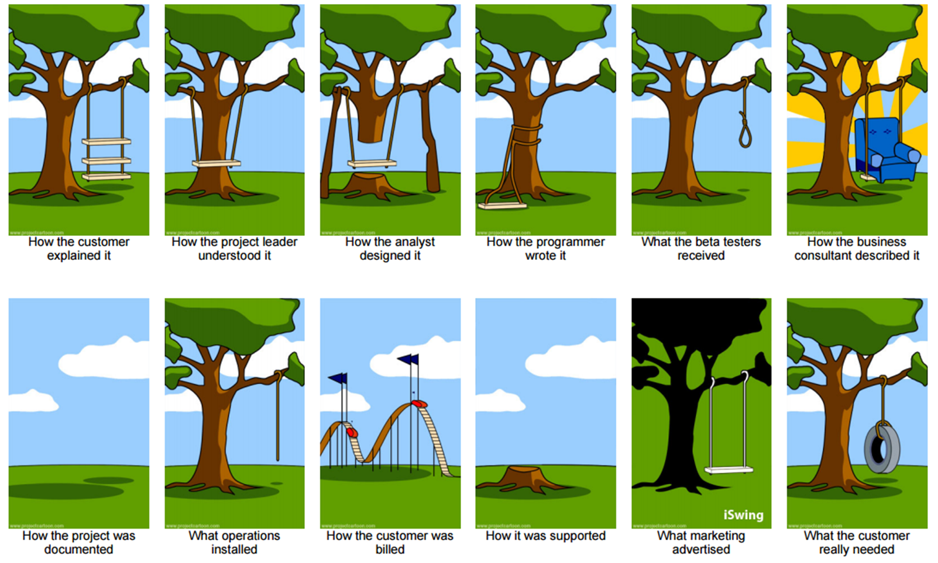
What is Requirements Engineering?

Slide 10
Three Types of Requirements
Functional requirements
Non-functional requirements
Domain requirements

Slide 11
Functional Requirements: The "What"
Think of these as your shopping list for software features:
"I want to log in with my fingerprint"
"The app should send me notifications when my friends post"
"Users can upload cat pictures (because the internet needs more of those)"

Slide 12
Functional Requirements: The "What"
Describe specific behaviors and functions the system must perform
Define inputs, outputs, and processing rules
Example: "The system shall allow users to reset their password via email verification"

Slide 13
Non-Functional Requirements: The "How Good"
These are like the quality standards for a 5-star hotel:
Speed: "Faster than you can say 'requirements engineering'"
Security: "Fort Knox level (we don't want your cat pictures leaked)"
Reliability: "As dependable as your coffee machine on Monday morning"

Slide 14
Non-Functional Requirements: The "How Good"
Performance requirements (response time, throughput)
Security requirements (authentication, authorization)
Reliability requirements (uptime, fault tolerance)
Usability requirements (user interface, accessibility)
Scalability requirements (user load, data volume)

Slide 15
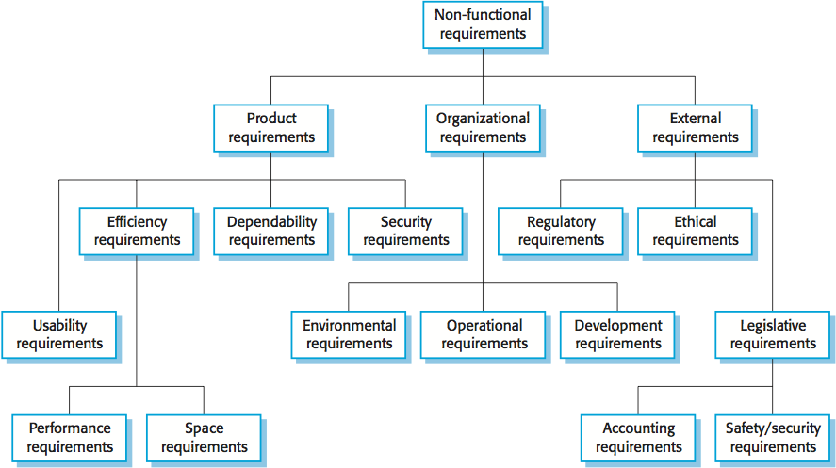
Non-Functional Requirements: The "How Good"

Slide 16
Question
Is "The system must encrypt passwords" functional or non-functional? (Think about it!)

Slide 17
Domain Requirements
Requirements specific to the application domain
Business rules and regulations
Industry standards and compliance needs

Slide 18
Requirements Engineering Process: 4 Steps
Elicitation
Analysis
Validation
Management

Slide 19
Elicitation: Detective Work
We're like software detectives here! We:
Interview users (without the good cop/bad cop routine)
Observe how people work (not in a creepy way)
Run workshops (with actual snacks, not just virtual ones)
Read existing documentation (yes, even the boring parts)

Slide 20
Analysis: Solving the Puzzle
Sort through requirements like organizing your Netflix watchlist
Find conflicts ("The system should be lightning-fast BUT run on a calculator from 1995")
Prioritize what matters (MoSCoW method - not related to the city!)
Must have: The non-negotiables
Should have: The "would be really nice" features
Could have: The "if we have time" wishes
Won't have: The "maybe in version 2.0" dreams

Slide 21
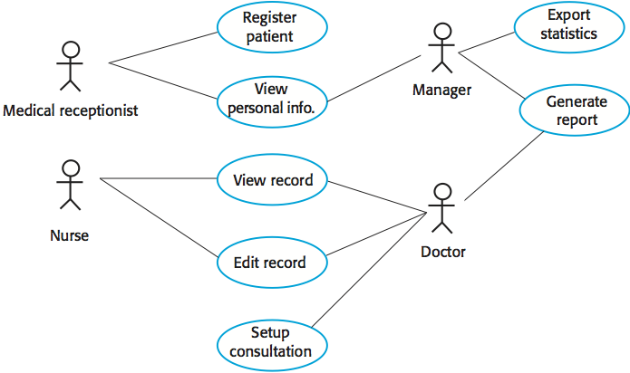
Elicitation and Analysis

Slide 22
Problems to look for…
Problems to look for during requirements elicitation and analysis:
Stakeholders don't know what they really want
Stakeholders express requirements in their own terms
Different stakeholders may have conflicting requirements
Organizational and political factors may influence the system requirements
The requirements change during the analysis process
New stakeholders may emerge and the business environment may change

Slide 23
Specification: Telling the Story
Document everything clearly (no room for "the system should be cool")
Use real examples: Instead of "system shall be fast," say "system shall load within 2 seconds"
User stories: "As a tired student, I want auto-save so that I don't lose my work when I fall asleep on my keyboard"
Use Cases: Like writing movie scripts of how users interact with your system
Specifications: The technical bestseller nobody wants to read but everyone needs!

Slide 24
Examples: Is it Good or Bad?
Requirement: "Users can reset their password through email verification within 5 minutes"

Slide 25
Examples: Is it Good or Bad?
Requirement: "The system should be user-friendly"

Slide 26
Examples: Is it Good or Bad?
Requirement: "The system should be user-friendly"
Why it's bad: What does "friendly" mean? Is it buying users coffee?

Slide 27
Questions
How would you gather requirements for a social media app for pets?

Slide 28
Requirements Validation
Requirements Reviews
Verifiability: is the requirement realistically testable?
Comprehensibility: is the requirement properly understood?
Traceability: is the origin of the requirement clearly stated?
Adaptability: can the requirement be changed without a large impact on other requirements?

Slide 29
Requirements Validation
What problems to look for:
Validity: does the system provide the functions which best support the customer's needs?
Consistency: are there any requirements conflicts?
Completeness: are all functions required by the customer included?
Realism: can the requirements be implemented given available budget and technology?
Verifiability: can the requirements be checked?

Slide 30
Requirements Validation: Reality Check
Review with stakeholders (and actually listen to their feedback)
Check if requirements make sense (Can we actually build a mind-reading app?)
Make sure we haven't forgotten anything important

Slide 31
Requirements Validation
Prototyping
  Using an executable model of the system to check requirements
Test-case generation
  Developing tests for requirements to check testability

Slide 32
Requirements Traceability
Capability to trace a requirement is needed to ensure that the product has fully implemented the requirements. (While not part of requirements process activities, it needs to be started early)
We need to trace requirements:
  Requirements from source (people and documents)
  Requirements to later steps (design, implementation, test, and release)
We also need to link requirements to other “pre-requisite” requirements.

Slide 33
Requirements Definition using Use Case Description
Use Case Diagrams are mostly for functionalities and are not detailed enough, so we need to use “English” text for further descriptions of the requirements:
  Functional details
  Pre-conditions
  Post-conditions
  Non-functional characteristics about the functionalities
  “alternative paths” (e.g., error processing)
  UI sample (e.g., “looks”)
  Etc.

Slide 34
Partially Filled Traceability Table
Requirement | Design | Code | Test | Other related requirements
1 | compon. X | Module 3 | Test Case 32 | 2, 3
2 | compon. w | Module 5 | Test Case 16 | 1
3 | compon. X | Module 2 | Test Case 27 | 1
4
5

Slide 35
Requirements Prototyping
Requirements prototyping mostly address the User Interface (UI) part of the requirement in terms of:
  Visual looks (size, shape, position, color)
  Flow (control and logical flow; depth of flow)
The prototyping may be performed in one of the two modes:
  Low fidelity: using paper/cardboard to represent screens and human to move the boards
  High fidelity: using automated tools such as Visual Basic to code the screens and direct the logical flow of these screens

Slide 36
Requirements Specification
Once the requirements are defined, prototyped, and reviewed, it must be placed into a Requirements Specification document
IEEE /EIA Standard 12207.1-1997 -> NOT FREE
Introduction
High-level description
Detailed descriptions
  Details of each functionality (input-out-process)
  Interfaces, including user interfaces and network interfaces
  Performance requirements (response time, throughput, etc.)
  Design constraints, standards, etc.
  Additional attributes such as security, reliability, etc.
  Any additional unique requirements

Slide 37
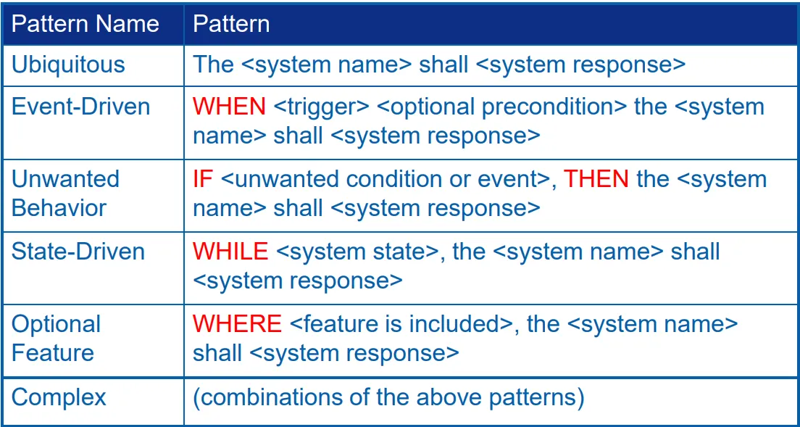
Another Specification: EARS
Easy Approach to Requirements Syntax
https://ieeexplore.ieee.org/abstract/document/5328509

Slide 38
Finally: Requirements “Sign Off”
Having a requirements specification agreed to and signed off is important:
  Serves as a milestone marker and formally exits a phase of software of engineering
  Serves as baseline from which any future changes can be monitored and controlled
Remember “Agile,” which wants less “legalese” like sign-off—obviously, it comes to play large/expensive projects and ignoring them might have severe consequences !

Slide 39
Common Challenges
Requirement Changes
Communication Gaps
Requirements Quality Issues

Slide 40
Best Practices
Stakeholder Involvement
Documentation Standards
Validation Techniques
Change Management

Slide 41
Tools and Techniques
Requirement Management Tools
JIRA
IBM Rational DOORS
RequisitePro
GitHub Project Board
Modeling Tools
UML diagrams
Use case diagrams
Process flow diagrams
Data flow diagrams

Slide 42
Wrapping Up
Requirements failures cost millions or lives
Requirements come in three forms: functional, non-functional, domain
The process includes elicitation, analysis, validation, and management
Best practices: involve stakeholders, document clearly, validate continuously, manage changes carefully

Slide 43
Case Studies:
https://www.henricodolfing.com/search/label/Case%20Studies

