Slide 1
Lecture 12: Requirement Analysis Diagrams
Mia Mohammad Imran

Slide 2
Today’s Agenda
Requirement Analysis Diagrams
  Main focus on Use Case Diagrams

Slide 3
Recap: User Stories
Definition
  Short, simple description of a system feature from the perspective of an end-user.
Follows the format:
  “As a [role], I want [goal], so that [benefit].”
  “As a bank customer, I want to withdraw cash from the ATM, so that I can access my money conveniently.”
Key Characteristics
  User-centered (focus on needs, not system functions)
  Concise and understandable by both technical and non-technical stakeholders

Slide 4
Scenario
Scenarios are concrete, specific stories that describe how users interact with the system. They tell a story about:
A specific instance of system usage
The actors involved
The sequence of events that occur
The expected outcomes
Include who, what, when, where, why
A functional requirement is often represented as a scenario
"Sarah approaches her bank's ATM and inserts her card. She enters her PIN correctly and selects 'Withdraw Cash' from the main menu. She requests $100 from her checking account. The ATM verifies she has sufficient funds, dispenses the money, and asks if she wants a receipt. Sarah takes her money, selects 'yes' for the receipt, and completes her transaction."

Slide 5
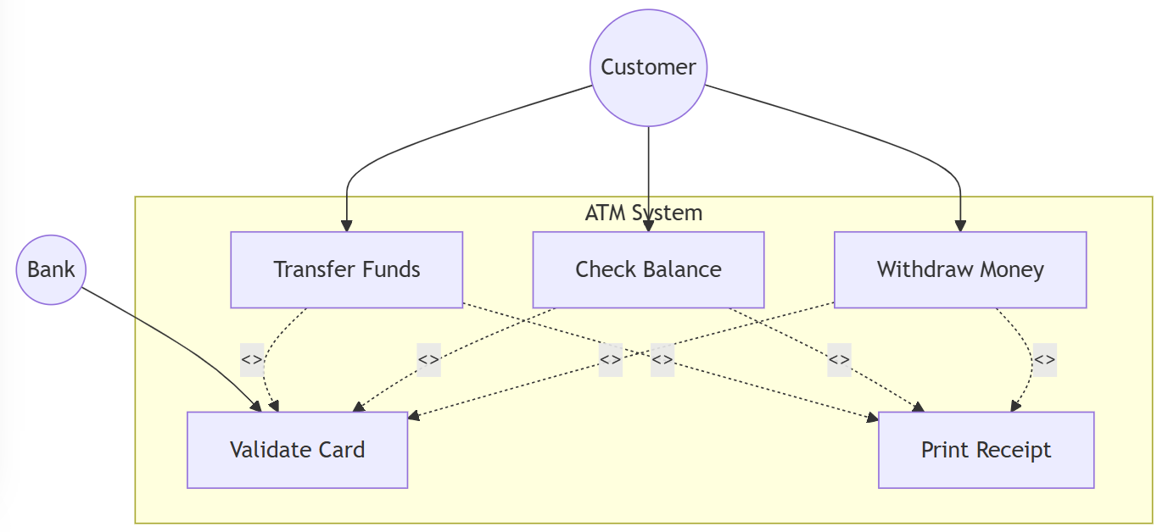
Use Cases
Use cases are more structured than scenarios. They capture:
Actor(s): Who interacts with the system
Preconditions: What must be true before the use case begins
Main flow: The normal sequence of interactions
Alternative flows: What happens when things go differently
Postconditions: What must be true after the use case completes

Slide 6
Use Cases
Actor: Bank Customer (Sarah)
Goal: Withdraw money from account via ATM
Preconditions:
Customer has an active account and ATM card
Sufficient funds are available in the account
Main Flow:
Customer inserts ATM card
System prompts for PIN
Customer enters valid PIN
System displays main menu
Customer selects “Withdraw Cash”
Customer enters withdrawal amount
System verifies account balance
ATM dispenses cash
ATM prompts for receipt option
Customer selects “Yes”
ATM prints receipt and ends session
Alternate Flows:
  Invalid PIN entered → System displays error → Retry option
  Insufficient funds → Transaction canceled, error displayed
  Customer selects “No” for receipt → Transaction ends without printing
Postconditions:
  Account balance reduced by withdrawal amount
  Transaction logged

Slide 7
Connecting User Stories, Scenarios, and Use Cases
User Story → What & Why
Scenario → Context & How in real life
Use Case → Detailed structured steps
Flow: User Story → Scenario → Use Case
Question: If the connection between User Stories, Scenarios, and Use Cases is not clearly established in a project, what potential problems could arise in requirements understanding and system development?
Notes:
If the connection between User Stories, Scenarios, and Use Cases is not clearly established in a project, what potential problems could arise in requirements understanding and system development?
Ambiguity in Requirements
User stories alone may be too vague, leading to multiple interpretations.
Without linking them to scenarios and use cases, the how and step-by-step flow remain unclear.
Gaps in System Behavior
Missing connections mean that exception handling, alternate flows, and system responsibilities may never be documented.
Critical paths (e.g., error cases, edge cases) could be overlooked.
Miscommunication with Stakeholders
Business stakeholders may only see high-level user stories, while developers need detailed use cases.
Without the scenario bridge, both sides may misunderstand requirements.
Inadequate Testing & Validation
Test cases rely on structured use cases for coverage.
If connections aren’t established, testing may miss real-life situations described in scenarios.
Traceability Issues
Lack of linkage makes it difficult to trace a requirement from high-level intent (user story) to design and testing artifacts (use case).
This weakens project control and increases risk of scope creep.

Slide 8
Why Diagrams?
Requirement analysis bridges business needs and system design
Diagrams reduce ambiguity, improve communication, and guide development
Clarify system requirements
Facilitate stakeholder communication
Provide validation baseline for design/testing

Slide 9
Modelling notation
UML (Unified Modeling Language): Widely used for software design (use cases, class, sequence, state diagrams).
DFDs (Data Flow Diagrams): Clear for process/data movement representation.
ERDs (Entity Relationship Diagrams): Best for database structure.
BPMN (Business Process Model and Notation): Standardized for business workflows.
Natural Language / User Stories: Accessible to non-technical stakeholders.
Factors in Choosing Notation
Audience: Technical team vs business stakeholders
Purpose: High-level communication vs detailed design
Complexity: Balance detail with readability
Tool Support: Availability of CASE tools & standards compliance
Consistency: Use uniform notation across project

Slide 10
Types of Diagrams
Use Case Diagrams
Data Flow Diagrams (DFDs)
Entity-Relationship Diagrams (ERDs)
Sequence Diagrams

Slide 11
Types of Diagrams
Use Case Diagram → “Here’s what users expect.”
DFD → “Here’s how data flows through processes.”
ERD → “Here’s how data is structured in the database.”
Sequence Diagram → “Here’s how one requirement plays out dynamically.”

Slide 12
Mermaid
www.mermaidchart.com
https://mermaid.js.org/syntax/flowchart.html

Slide 13
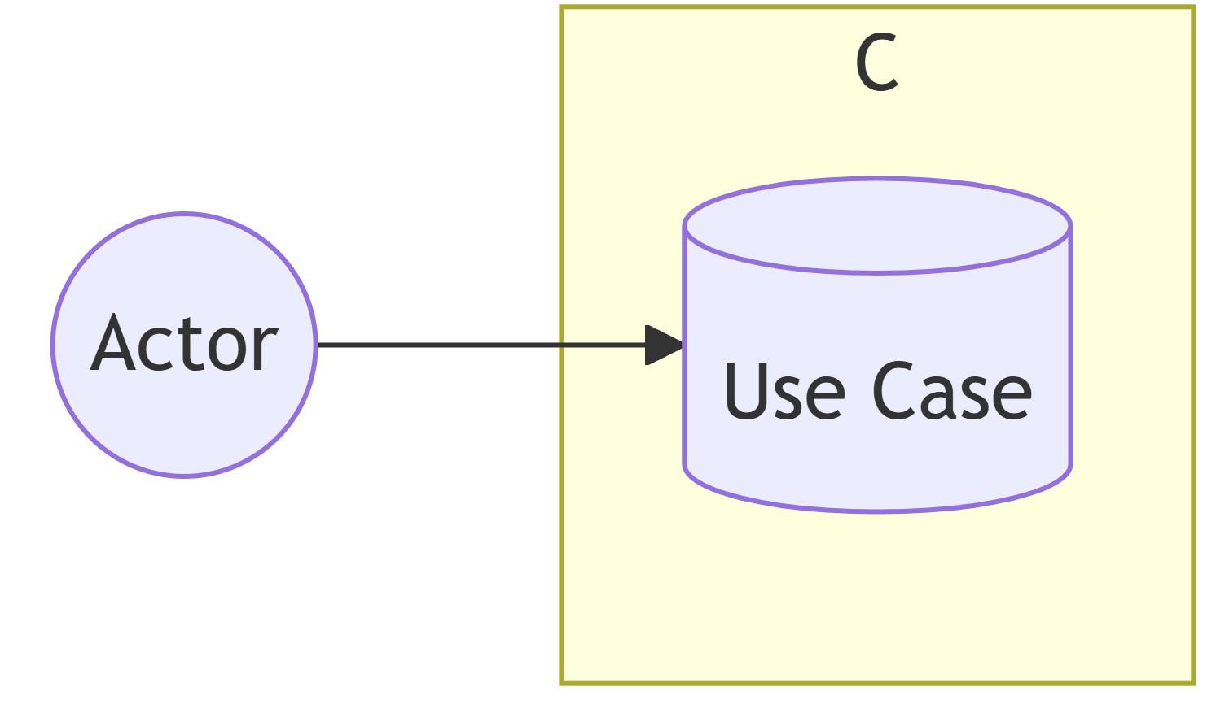
Use Case Diagram
A type of UML diagram focused on the functional requirements of a system
Actors: Represent roles that interact with system Can be:
Human users (customers, administrators)
External systems (payment gateway, server)
Time-based triggers (scheduler, timer)

Slide 14
Use Case Diagram
System Boundary
Rectangular box containing use cases
Defines scope of the system
Separates internal functionality from external actors
Helps identify system interfaces

Slide 15
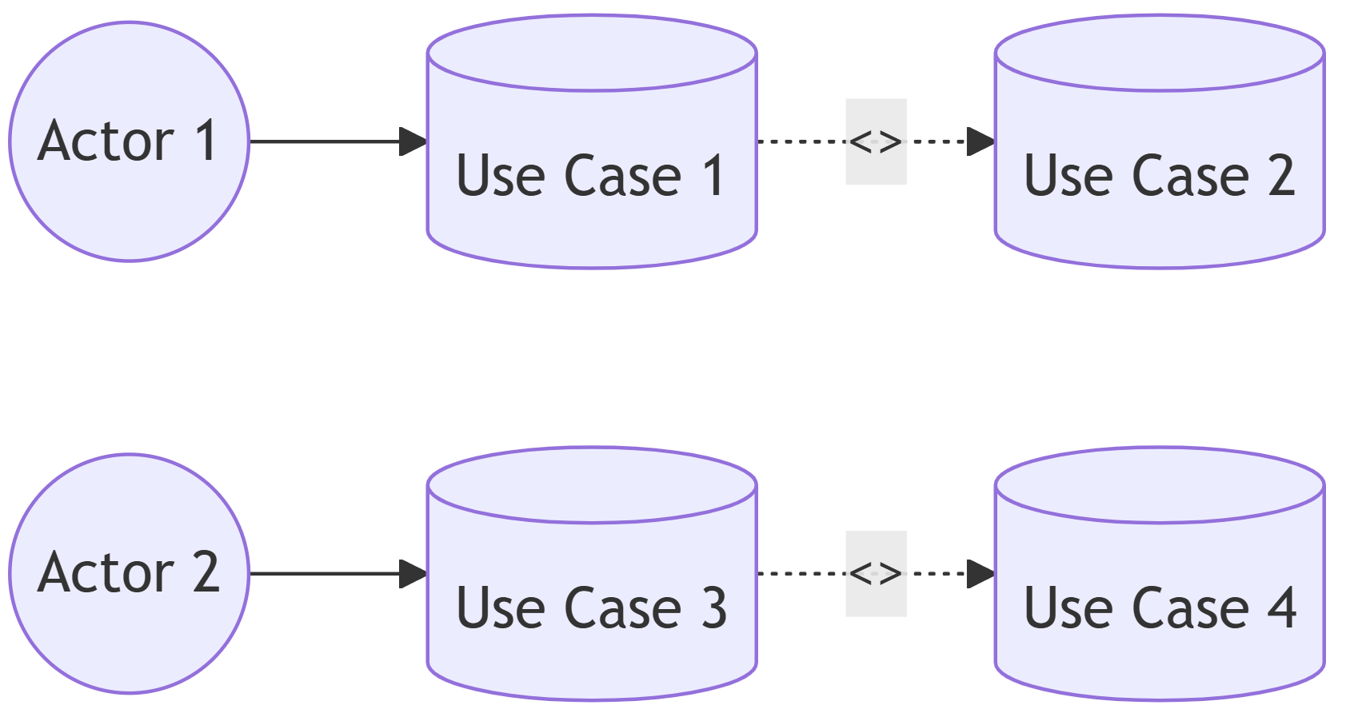
Use Case Diagram
Relationships
Association: solid line
Include: dotted arrow with <<include>>
Extend: dotted arrow with <<extend>>
Generalization: solid arrow w/ hollow head

Slide 16
Example - ATM System

Slide 17
Best Practices
Keep diagrams simple and focused
Use meaningful names
Include only relevant actors
Show important relationships only
Maintain consistent level of detail

Slide 18
Let’s Build a Coffee Shop System
Assume, you are a local business owner and want to add a coffee shop and requires a Coffee Shop System to support operations.
Question: Who are our actors?

Slide 19
Let’s Build a Coffee Making System
Question: Who are our actors?
Customer
Staff
Payment System

Slide 20
Let’s Build a Coffee Making System
Question: What are our use cases?

Slide 21
Let’s Build a Coffee Making System
Question: What are our use cases?
Place Order — starts the process
Pay for Order — payment step
Make Coffee — barista prepares drink
Serve Coffee — customer receives drink
Add Extras — optional (e.g., whipped cream, flavor shot)
Offer Discount — optional (e.g., loyalty reward)

Slide 22
Let’s Build a Coffee Making System
Question: What are the Relationships?

Slide 23
Let’s Build a Coffee Making System
Question: What are the Relationships?
Associations:
Place Order — starts the process.
Pay for Order — included in “Place Order”; payment step
Make Coffee — happens after payment; barista prepares the drink
Serve Coffee — happens after making coffee; customer receives the drink
Add Extras — extends “Place Order”; optional (e.g., whipped cream, flavor shot)
Offer Discount — extends “Pay for Order”; optional (e.g., loyalty reward or coupon)

Slide 24
Let’s Build a Coffee Making System
Question: What are the Relationships?
Associations:
Customer → Place Order
Customer → Pay for Order
Payment System → Process the Payment for Order
Barista → Make Coffee
Barista → Serve Coffee
Includes
Place Order → Pay for Order
Pay for Order → Issue Receipt
Extend
Place Order → Add Extras
Pay for Order → Offer Discount

Slide 25
Data Flow Diagrams
To show how information moves through the Coffee Shop System
Focuses on processes, data stores, and data flows
Helps understand who sends what data, and where it goes
External Entities (rectangles) - Sources/destinations of data
Processes (circles) - Data transformations
Data Stores (open rectangles) - Where data is stored
Data Flows (arrows) - Movement of data

Slide 26
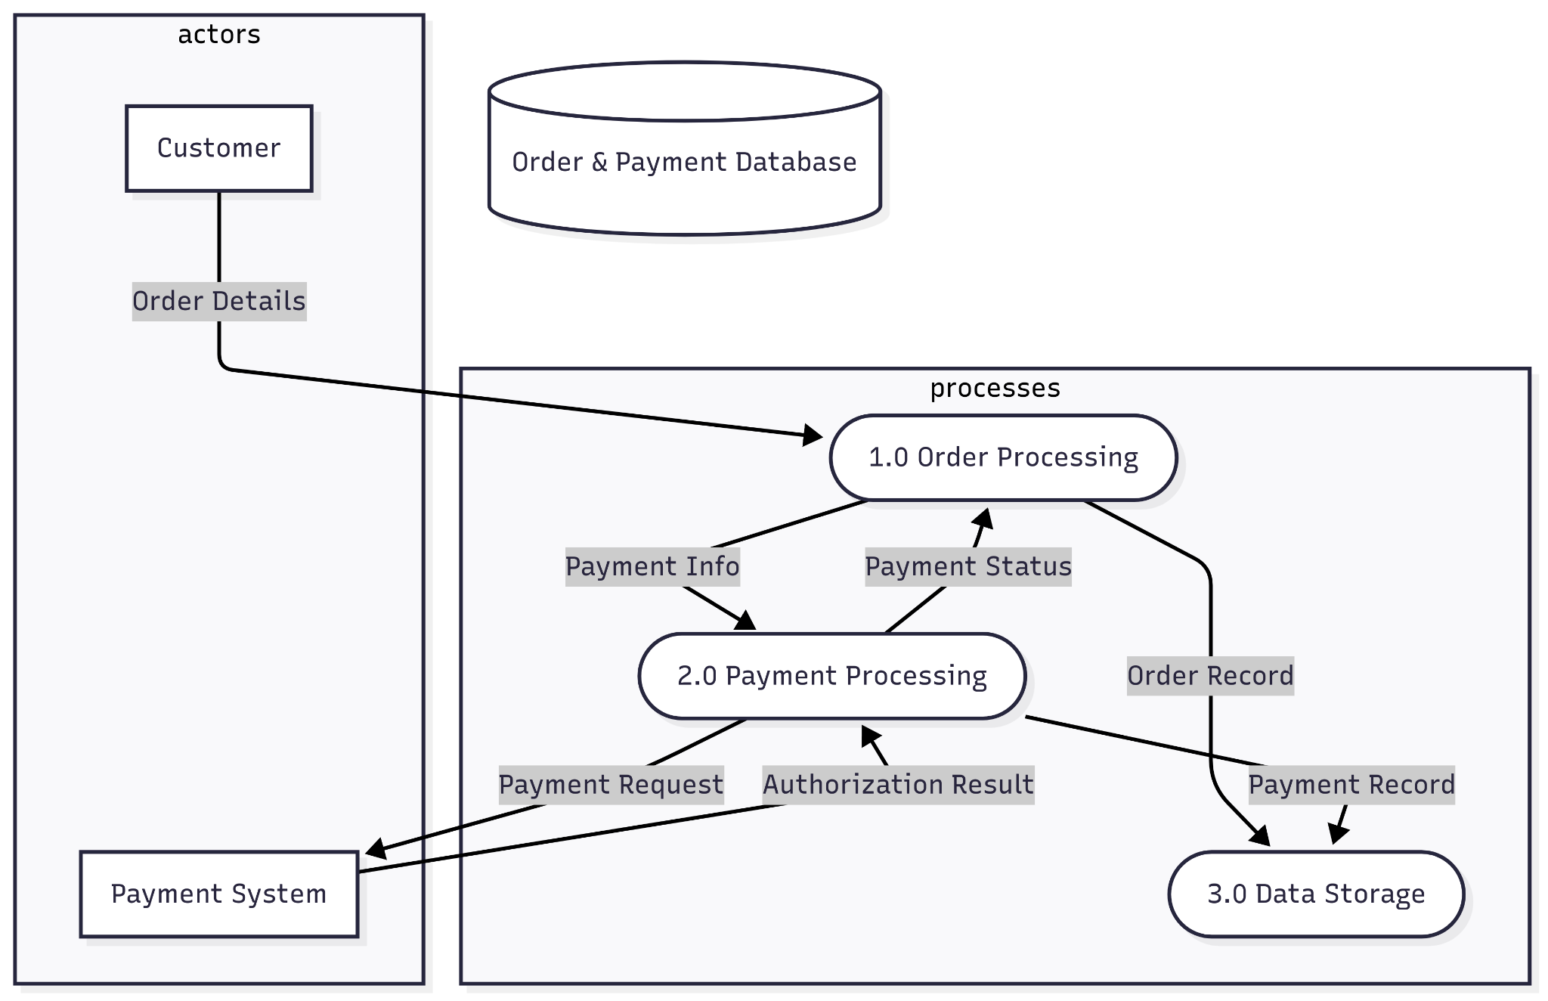
Coffee Shop Example
Data flows from Customer → Order Processing → Database
Payment processing and status updates

Slide 27
Entity-Relationship Diagrams: Database Structure and Relationships
Shows structure of database
Illustrates relationships between different data entities
Essential for database design
Entities (rectangles) - Objects or concepts
Attributes - Properties of entities
Relationships - How entities connect
Cardinality - One-to-one, one-to-many, many-to-many
Customer -> Order (one-to-many)
Order -> OrderItem (one-to-many)
Product -> OrderItem (one-to-many)

Slide 28
Sequence Diagram: Time-Ordered Interactions
Shows order of interactions between system components
Illustrates how processes operate with each other
Demonstrates timing of operations

Slide 29
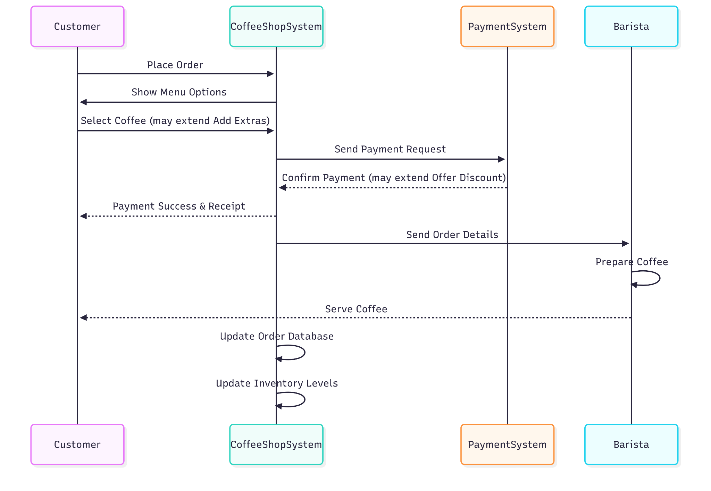
Key Components
Actors/Objects (boxes at top)
Lifelines (vertical dashed lines)
Messages (horizontal arrows)
Activation boxes (vertical rectangles)

Slide 30
In Summary…
Use Case: User interaction perspective
  Requirements gathering, planning user interactions
DFD: Data movement perspective
  System design, understanding data flow
ERD: Data structure perspective
  Database design, data modeling
Sequence Diagram: Time-ordered operation perspective
  Detailed process design, understanding timing
Question: How do these diagrams complement each other?

Slide 31
Mapping with User Stories: Use Case
As a customer, I want to order coffee through the mobile app So that I can save time by avoiding the queue
Place Mobile Order
As a barista, I want to see incoming orders in real-time So that I can prepare drinks efficiently
View Order Queue
As a manager, I want to view daily sales reports So that I can track business performance
Generate Reports
Use Case Diagram Mapping:
Each user story typically maps to one or more use cases
The "As a [role]" part identifies the actor
The "I want to" part becomes the use case

Slide 32
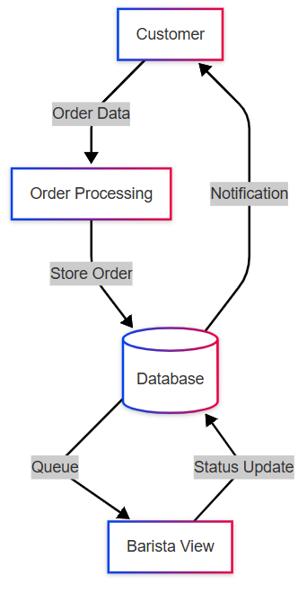
Mapping with User Stories: DFD
As a customer, I want to order coffee through the mobile app So that I can save time by avoiding the queue
DFD Mapping:
User stories help identify data flows and processes
The "So that" part often reveals required data transformations

Slide 33
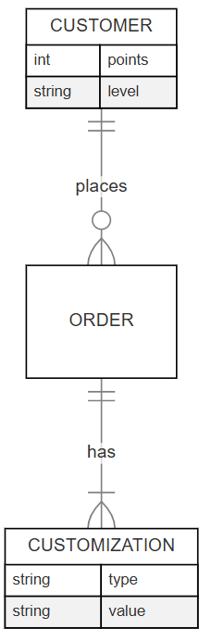
Mapping with User Stories: ERD
As a customer, I want to customize my drink so that I can get it exactly how I like it and enjoy a more personalized experience.
ERD Mapping:
User stories help identify entities and their attributes
The "I want to" part often reveals required data relationships

Slide 34
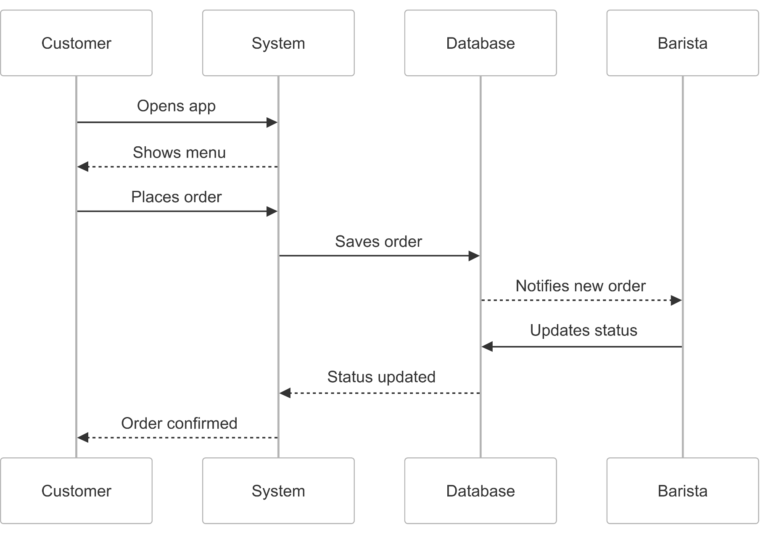
Mapping with User Stories: Sequence Diagram
Story: As a customer, I want to order coffee through the mobile app So that I can save time by avoiding the queue
Sequence Diagram Mapping:
User stories help identify the sequence of interactions
The "So that" part often reveals the expected outcome

