Slide 1
Lecture 13 - Code Quality
Mia Mohammad Imran

Slide 2
So far..
We have covered
Software Engineering introduction
Git, Code Review
SDLC basics
SDLC methodologies like Waterfall, Agile
Requirement Engineering
Remaining Areas…
Software Design
Testing
Deployment/Maintenance
Possible 1-2 advanced topics

Slide 3
Today’s Agenda
We move to Software Design.
Introducing to Code Quality related concepts

Slide 4
Why Code Quality
How a software is built to last?
This begins with design and code quality
Working code is not always good code
Poorly structured code leads to bugs, slow progress, and developer frustration
Example: “It runs today, but can we change it tomorrow?”
“Good code is written for humans to understand, computers already understand bad code. They deal in binaries which we humans unlikely to understand!”

Slide 5
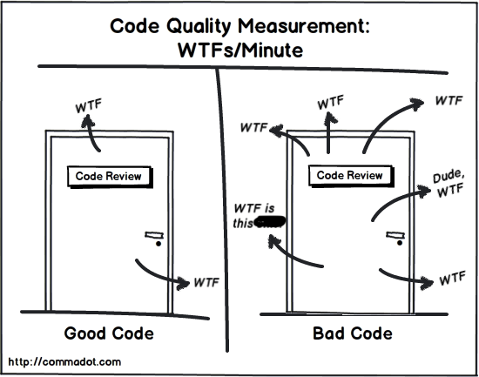
What is Code Quality
“Code Quality is the degree to which source code is readable, maintainable, reliable, testable, and efficient, ensuring that it fulfills both functional requirements (it works) and non-functional expectations (it’s easy to change, reuse, and extend).”
High-quality code is:
Correct and consistent
Understandable by others
Modular and well-structured
Supported by tests and documentation
Free of unnecessary complexity

Slide 6
Good or Bad?
def f(x, y):
z = x * y / 100
if z > 50:
print("ok")
else:
print("no")

Slide 7
Good or Bad?
def is_discount_acceptable(price, discount_rate):
discount_value = price * discount_rate / 100
return discount_value > 50

Slide 8
Good or Bad?
if order.type == "express":
shipping_cost = order.weight * 10
else:
shipping_cost = order.weight * 5

Slide 9
Good or Bad?
def calculate_shipping_cost(order):
rates = {"express": 10, "standard": 5}
return order.weight * rates.get(order.type, 5)

Slide 10
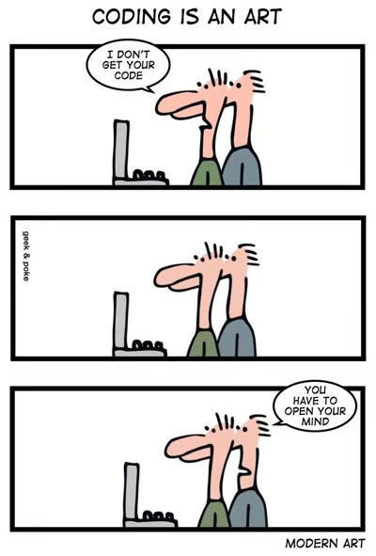
Let’s Talk about Some Terms
Code Refactoring
Code Smell
Technical Debt
Atoms of Confusion

Slide 11
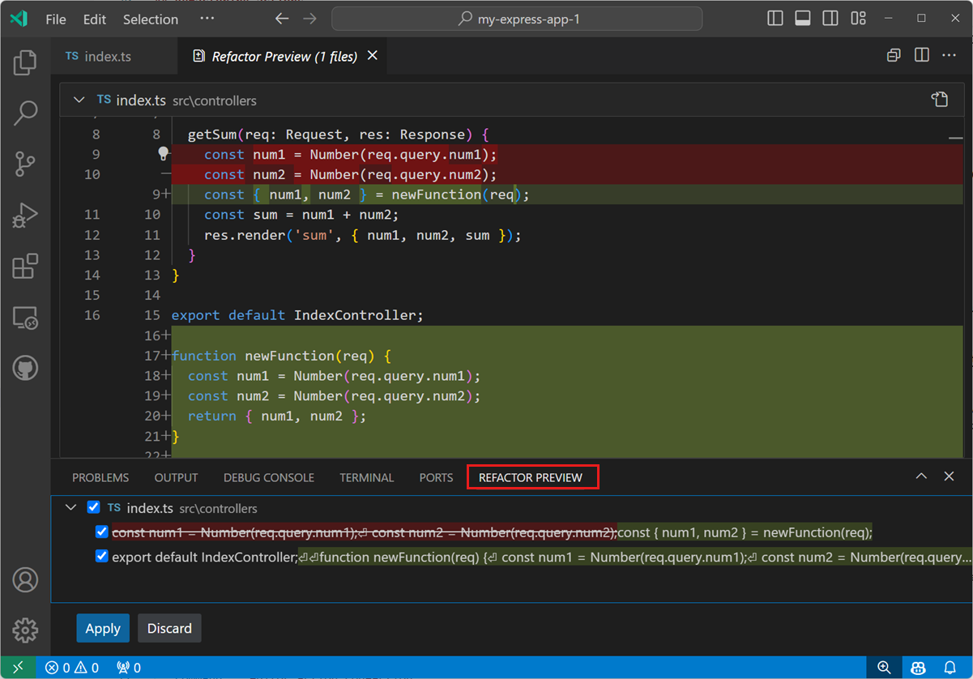
Code Refactoring
“Code refactoring is a software development practice that alters the internal structure of software code without modifying its external behavior or impacting its functions. These minor changes aim to make code more readable and maintainable.”
https://www.ibm.com/think/topics/code-refactoring

Slide 12
Code Refactoring
A series of small behavior-preserving transformations
Each transformation (called a 'refactoring') does little
The system is also kept fully working after each refactoring
Reduces the chances that a system gets seriously broken during the restructuring
We can prove that after refactoring, behavior has not changed by rerunning our tests
If not done regularly
Over time, as more and more code is written, the system becomes harder to maintain and extend.

Slide 13
Code Refactoring
Refactoring does not fix bugs or add new functionality
Improves the understandability of the code
Changes code structure and design
e.g. eliminates duplication or optimize
Removes dead code
Make it easier for human maintenance in the future
Adding new behavior to a program might be difficult with the program's current structure
Refactor it first to make it easy, and then add the new behavior

Slide 14
Code Refactoring
Continuous Refactoring: iterative improvement during development cycles
Clean Code: philosophy emphasizing readable and maintainable code
Code Modernization: updating old code to modern standards
Code Transformation: structural code change using automated tools
Legacy Code Management: handling untested or outdated codebases
Boy Scout Rule: “Leave the code cleaner than you found it”
Automated Refactoring Tools: IDE features that assist refactoring

Slide 15
Example
Behavior is identical, but now:
Easier to add or modify discount types
Code is shorter, clearer, and more adaptable
if customer_type == "premium":
discount = total * 0.2
elif customer_type == "regular":
discount = total * 0.1
else:
discount = 0
final_price = total - discount
print("Final price:", final_price)
discount_rates = {
"premium": 0.2,
"regular": 0.1,
"new": 0.05
}
discount = total * discount_rates.get(customer_type, 0)
final_price = total - discount
print("Final price:", final_price)
Logic is explicit but rigid — adding new customer types requires editing the same block
The code is correct, but not flexible or easy to extend

Slide 16
Code Refactoring: Question from your boss
"Refactoring is an overhead activity - I'm paid to write new, revenue generating features."
Tools/technologies are now available to allow refactoring to be done quickly and relatively painlessly.
Experiences reported by some object-oriented programmers suggest that the overhead of refactoring is more than compensated by reduced efforts and intervals in other phases of program development.
While refactoring may seem a bit awkward and an overhead at first, as it becomes part of a software development regimen, it stops feeling like overhead and starts feeling like an essential.

Slide 17
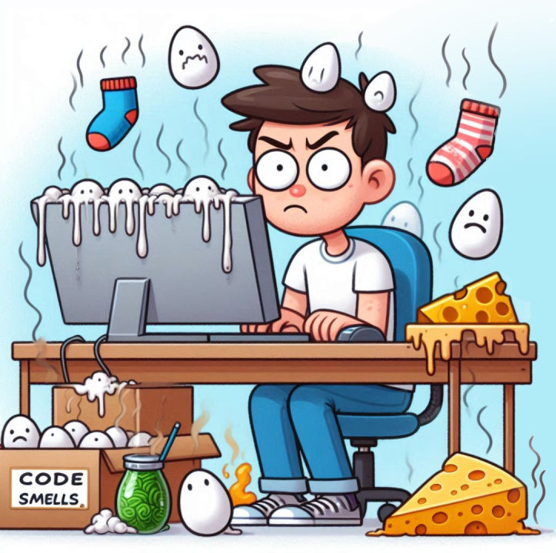
Code Smell
What comes to your mind when I say “code smell”?

Slide 18
Code Smell
What comes to your mind when I say “code smell”?
class Invoice {
void printInvoice(Customer c, double discount, double tax, double shippingFee) {
double total = c.getCartValue() - discount + tax + shippingFee;
System.out.println("Invoice for: " + c.getName());
System.out.println("Total Payable: " + total);
if (c.getCountry().equals("USA")) System.out.println("Ship via UPS");
else if (c.getCountry().equals("India")) System.out.println("Ship via BlueDart");
else System.out.println("Ship via Standard Mail");
}
}
“Your program runs perfectly. No errors, no crashes but developers hate working on it. What’s wrong?” It smells!

Slide 19
Code Smell
Code Smell: https://refactoring.guru/refactoring/smells
Code smell refers to any symptom in the source code that possibly indicates a deeper problem. It does not necessarily mean the code is incorrect, but that its design or structure may be suboptimal, making it harder to maintain, understand, or extend.
Usually not bugs, but indicators of poor design.
Increase technical debt and maintenance cost.
Often result from poor refactoring or rapid development.
Are subjective, depending on project standards and context.
Think of it like a warning light in your car. The car still runs, but you should probably check under the hood.

Slide 20
Which of the following is a code smell?
A recursive function that causes a stack overflow
A class exceeding 500 lines and handling multiple unrelated responsibilities
A missing semicolon causing a compilation failure
An unhandled exception leading to a runtime crash

Slide 21
A better version of earlier example
interface ShippingStrategy { void ship(); }
class USAShipping implements ShippingStrategy {
public void ship() { System.out.println("Ship via UPS"); }
}
class IndiaShipping implements ShippingStrategy {
public void ship() { System.out.println("Ship via BlueDart"); }
}
class DefaultShipping implements ShippingStrategy {
public void ship() { System.out.println("Ship via Standard Mail"); }
}
class Invoice {
void printInvoice(Customer c, ShippingStrategy strategy) {
double total = c.calculateTotal();
System.out.println("Invoice for: " + c.getName());
System.out.println("Total Payable: " + total);
strategy.ship();
}
}

Slide 22
Categories of Code Smells
Category | Core Idea
Bloaters | Code that’s grown too large
OO Abusers | Poor use of OOP principles
Change Preventers | Changes cause ripple effects
Dispensables | Code that adds no value
Couplers | Too many dependencies

Slide 23
Code Smell: Long Method
def allocate_supplies(camp):
if not camp["approved"]:
print("Request pending")
return
if camp["requested_items"] > warehouse["available_items"]:
print("Insufficient stock")
return
distance = get_distance("HQ", camp["location"])
cost = distance * 5
print("Allocating supplies with cost:", cost)

Slide 24
Code Smell: Long Method
def allocate_supplies(camp):
if not camp["approved"]:
print("Request pending")
return
if camp["requested_items"] > warehouse["available_items"]:
print("Insufficient stock")
return
distance = get_distance("HQ", camp["location"])
cost = distance * 5
print("Allocating supplies with cost:", cost)
A Long Method smell occurs when a function performs multiple tasks, making it hard to read, test, or modify
What happens if we need to change how transport cost is calculated?

Slide 25
Possible Refactored Version
def allocate_supplies(camp):
if not validate_request(camp): return
if not check_stock(camp): return
calculate_transport_cost(camp)
Each operation has its own function for easier modification

Slide 26
Code Smell: The “God Class”
class ReliefCoordinator:
def assign_volunteers(self): ...
def manage_donations(self): ...
def schedule_deliveries(self): ...
def compile_reports(self): ...
def notify_partners(self): ...
A God Class has too many responsibilities or handles too many operations. It becomes difficult to maintain, test, or extend
What happens if several developers edit this class at the same time?

Slide 27
Code Smell: Shotgun Surgery
class DonationService:
def record(self): log("Donation recorded")
class VolunteerService:
def register(self): log("Volunteer joined")
class DispatchService:
def send(self): log("Supplies dispatched")
Shotgun Surgery occurs when a single change forces you to modify code in many different classes.
What happens if we need to change the log format to include timestamps?

Slide 28
Code Smell: Duplicate Code
def send_email_to_donor(name, email, message):
print(f"Dear {name}, {message}")
def send_email_to_volunteer(name, email, message):
print(f"Dear {name}, {message}")
Duplicate Code occurs when identical or similar logic exists in multiple places
What happens if we change the email template?

Slide 29
Code Smell: Long Parameter List
def create_volunteer(name, age, region, phone, email, skill, language):
...
A Long Parameter List occurs when a method takes too many parameters, often due to missing abstraction
What happens when new volunteer attributes are added?

Slide 30
Code Smell: Dead Code
def record_donation():
print("Recording new donation")
def old_donation_system(): # unused
print("Legacy donation logic")
Dead Code refers to unused variables, methods, or classes that no longer affect program behavior
What happens if we keep unused methods in the codebase?
Remember one of the cases we talked about that caused millions of dollars?

Slide 31
Code Smell: Middle Man
class ReliefCoordinator:
def __init__(self):
self.manager = VolunteerManager()
def assign_volunteer(self, name):
self.manager.assign(name)
class VolunteerManager:
def assign(self, name):
print(f"Volunteer assigned: {name}")
A Middle Man occurs when a class does little more than delegate work to another class, adding unnecessary layers
What happens if most methods in ReliefCoordinator just call VolunteerManager?

Slide 32
Let’s summarize some of the Code Smells
Long Method – 200-line function, does everything.
God Class – one class knows the whole system.
Duplicate Code – copy-paste four times, fix bugs four times.
Long Parameter List – `updateUser(id, name, age, email, addr, phone, …)`.
Dead Code – commented-out block nobody dares to delete.
Magic Numbers – `if (score > 42)` … why 42?
Poor Names – `int d; // days` (but could be dollars).
Shotgun Surgery – one small change forces edits in ten files.

Slide 33
Smell ↔ symptom, not disease
Smell is **what you see**; the **disease** can be
bad design
wrong responsibility split
rushing / low skill
misunderstanding of requirements

Slide 34
Code Smell
Question: How you detect code smell? (And how do you prevent?)

Slide 35
Detecting smells – no tools yet
Read aloud: if you can’t explain the method in one sentence, it’s too long
Count variables: >5–7 locals is suspicious
Scroll bar test: one screen height ≈ 40 lines; need to scroll? smell.
Highlight duplicates: Ctrl+C / Ctrl+V in the same project? smell

Slide 36
Quick fix catalogue (refactor “aroma” away)
Code Smell | Refactoring Solution
Long Method | Extract Method (split into helpers)
God Class | Extract Class / Subtype
Duplication | Pull Up Method / Template Method
Long Parameters | Introduce Parameter Object
Magic Number | Replace with Named Constant
Dead Code | Delete (version control remembers)
Poor Names | Rename Variable / Method

Slide 37
Technical Debt (TD)
“You’ve smelled the code... but what happens when we ignore the stink?”
Code smells are symptoms, Technical debt is the disease they signal (or at least the cost of the disease)!
Technical Debt: is a metaphor coined by Ward Cunningham that describes the implied cost of additional rework caused by choosing an easy (limited) solution now instead of using a better approach that would take longer.
"Shipping first time code is like going into debt. A little debt speeds development so long as it is paid back promptly with a rewrite... The danger occurs when the debt is not repaid."

Slide 38
INTENTIONAL and UNINTENTIONAL DEBT
# INTENTIONAL DEBT - We know this is temporary
def calculate_revenue(orders):
# TODO: Replace with proper database query once schema is finalized
# Currently using hardcoded values for MVP demo
return sum([order['amount'] for order in orders]) * 0.85 # Hardcoded tax rate
# UNINTENTIONAL DEBT - We didn't realize this was problematic
def process_user_data(user_input):
# This grew organically and became a maintenance nightmare
result = user_input.strip().lower()
if len(result) > 100:
result = result[:100]
# ... 50 more lines of string manipulation
return result

Slide 39
An example of how Technical Debt grows
class PaymentProcessor:
def process_payment(self, amount, card_number, expiry, cvv):
"""
Quick and dirty payment processing
KNOWN DEBT: No validation, no error handling, hardcoded logic
BUSINESS REASON: Investor demo in 2 weeks
"""
# Debt Item 1: Hardcoded test credentials
if card_number == "4111111111111111": # Test card
return {"status": "success", "transaction_id": "test_123"}
# Debt Item 2: Simple length validation only
if len(card_number) != 16:
return {"status": "error", "message": "Invalid card"}
# Debt Item 3: No actual payment gateway integration
# Using a mock for demo purposes
transaction_id = f"tx_{int(time.time())}"
# Debt Item 4: Writing to a simple file instead of database
with open("transactions.txt", "a") as f:
f.write(f"{transaction_id},{amount},{card_number}\n")
return {"status": "success", "transaction_id": transaction_id}
https://github.com/imranraad07/cs4090-git-demo

Slide 40
How Technical Debt grows: 3 Months Later
# payment_handler.py - Version 2.0 (Interest Payments Start)
# INTEREST: Patching problems from the quick implementation
class PaymentProcessor:
def __init__(self):
# INTEREST: Now we need to track more state
self.failed_attempts = {} # Track failed attempts per card
self.refund_queue = [] # Manual refund tracking
def process_payment(self, amount, card_number, expiry, cvv, user_email, billing_address):
"""
INTEREST: Added parameters and complexity because original was too simple
"""
# INTEREST 1: Fraud detection added as afterthought
if self.is_suspicious_transaction(amount, card_number, user_email):
return {"status": "fraud_rejected", "message": "Transaction flagged"}
# INTEREST 2: Rate limiting because we had no security initially
if self.failed_attempts.get(card_number, 0) > 3:
return {"status": "error", "message": "Too many failed attempts"}
# INTEREST 3: CVV validation added after security audit
if not self.validate_cvv(card_number, cvv):
self.failed_attempts[card_number] = self.failed_attempts.get(card_number, 0) + 1
return {"status": "error", "message": "Invalid CVV"}
# INTEREST 4: Expiry validation added after customer complaints
if not self.validate_expiry(expiry):
return {"status": "error", "message": "Card expired"}
# INTEREST 5: Address verification added for fraud prevention
if not self.verify_address(billing_address):
return {"status": "error", "message": "Address verification failed"}
# The original simple logic, now buried under patches
if card_number == "4111111111111111":
return {"status": "success", "transaction_id": "test_123"}
transaction_id = f"tx_{int(time.time())}"
# INTEREST 6: More complex logging for compliance
with open("transactions.txt", "a") as f:
f.write(f"{transaction_id},{amount},{card_number},{user_email},{billing_address}\n")
# INTEREST 7: Email confirmation added after customer requests
self.send_confirmation_email(user_email, amount, transaction_id)
return {"status": "success", "transaction_id": transaction_id}
# INTEREST: All these methods were added as patches
def is_suspicious_transaction(self, amount, card_number, email):
# Quick fraud detection added after actual fraud occurred
return amount > 1000 or "@temp-mail.org" in email
def validate_cvv(self, card_number, cvv):
return len(cvv) == 3 and cvv.isdigit()
def validate_expiry(self, expiry):
return len(expiry) == 5 and "/" in expiry
def verify_address(self, address):
return len(address) > 10 # Very basic check
def send_confirmation_email(self, email, amount, transaction_id):
# Quick email integration added after customer complaints
print(f"Email sent to {email}: Payment of ${amount} confirmed - {transaction_id}")
# payment_handler.py - Version 2.0 (Interest Payments Start)
# INTEREST: Patching problems from the quick implementation

Slide 41
How Technical Debt grows: The Breaking Point
class PaymentProcessor:
def __init__(self):
self.failed_attempts = {}
self.refund_queue = []
# COMPOUND INTEREST: More state to manage
self.currency_rates = self.load_currency_rates() # Added for international
self.tax_calculations = TaxCalculator() # Added for compliance
self.analytics = AnalyticsTracker() # Added for business intelligence
def process_payment(self, amount, card_number, expiry, cvv, user_email,
billing_address, currency="USD", product_type="digital",
customer_vat_number=None, shipping_country=None):
"""
COMPOUND INTEREST: Method now has 10 parameters and does 15 different things
Every new feature makes the code more fragile
"""
# COMPOUND INTEREST 1: International support hacked in
if currency != "USD":
amount = self.convert_currency(amount, currency, "USD")
if not amount:
return {"status": "error", "message": "Currency conversion failed"}
# COMPOUND INTEREST 2: Tax calculation patched in
tax_amount = self.tax_calculations.calculate_tax(
amount, product_type, shipping_country, customer_vat_number
)
total_amount = amount + tax_amount
# COMPOUND INTEREST 3: Business analytics added
self.analytics.track_payment_attempt(
user_email, total_amount, product_type
)
# All the previous validations (now even more complex)
if self.is_suspicious_transaction(total_amount, card_number, user_email, shipping_country):
self.analytics.track_fraud_attempt(user_email, total_amount)
return {"status": "fraud_rejected", "message": "Transaction flagged"}
# ... 50 more lines of validation and business logic ...
# The actual payment processing is now a small part of this method
transaction_id = f"tx_{int(time.time())}"
# COMPOUND INTEREST 4: Database migration started but not completed
try:
# New database code mixed with old file-based approach
self.save_to_database(transaction_id, total_amount, card_number,
user_email, billing_address, currency, tax_amount)
except Exception as e:
# Fallback to old file system - debt creates more debt!
with open("transactions.txt", "a") as f:
f.write(f"{transaction_id},{total_amount},{card_number},ERROR:{str(e)}\n")
# COMPOUND INTEREST 5: Multiple notification systems
self.send_confirmation_email(user_email, total_amount, transaction_id)
self.send_slack_notification(f"New payment: ${total_amount}")
self.update_customer_dashboard(user_email, transaction_id)
return {"status": "success", "transaction_id": transaction_id, "tax_amount": tax_amount}
# COMPOUND INTEREST: Supporting classes that grew organically
class TaxCalculator:
"""Added when we expanded to EU - complex rules hacked into simple system"""
def calculate_tax(self, amount, product_type, country, vat_number):
# Complex tax logic that should be in a separate service
if country == "DE" and product_type == "physical":
return amount * 0.19 # German VAT
elif country == "FR" and product_type == "digital":
return amount * 0.20 # French VAT
# ... 10 more country rules ...
return 0
class AnalyticsTracker:
"""Added when marketing wanted more data"""
def track_payment_attempt(self, email, amount, product_type):
# Mixed concerns: payment processing shouldn't handle analytics
print(f"Analytics: {email} attempted ${amount} for {product_type}")

Slide 42
What actually happened
# Technical Debt Impact Analysis - Real Numbers from This Project
class DebtImpactCalculator:
def calculate_real_costs(self):
return {
"development_timeline": {
"initial_savings": "2 weeks (launched in 2 weeks instead of 8)",
"month_3": "3 weeks spent adding basic security and validation",
"month_6": "6 weeks spent on fraud prevention and international support",
"month_9": "8 weeks spent refactoring for scalability",
"total_extra_work": "17 weeks (4+ months!) of emergency fixes"
},
"business_impact": {
"lost_customers": "~15% due to payment errors in first 3 months",
"fraud_losses": "$8,200 from insufficient validation early on",
"compliance_fines": "$5,000 for inadequate data protection",
"opportunity_cost": "Delayed mobile app launch by 3 months"
},
"team_impact": {
"developer_burnout": "2 senior developers left due to constant firefighting",
"hire_replacement_cost": "$45,000 in recruitment and training",
"morale_impact": "Team velocity dropped 40% due to code complexity"
}
}
def calculate_roi_of_proper_implementation(self):
"""What if we had built it right the first time?"""
proper_timeline = {
"proper_development": "8 weeks",
"additional_features": "4 weeks (built-in from start)",
"total": "12 weeks"
}
quick_timeline = {
"quick_development": "2 weeks",
"emergency_fixes": "17 weeks",
"refactoring": "8 weeks",
"total": "27 weeks"
}
return {
"time_saved_if_done_right": "15 weeks (almost 4 months!)",
"cost_savings": "Approximately $120,000 in developer time",
"business_benefits": "Earlier revenue, better customer retention, no fraud losses"
}
# The sobering reality
impact = DebtImpactCalculator()
print("ACTUAL COSTS OF TECHNICAL DEBT:")
print(impact.calculate_real_costs())
print("\nWHAT COULD HAVE BEEN:")
print(impact.calculate_roi_of_proper_implementation())

Slide 43
How it could have been prevented
# payment_service.py - Refactored Version (Debt Repayment)
# After 9 months of pain, we finally refactor properly
from abc import ABC, abstractmethod
import datetime
# Proper abstraction and separation of concerns
class PaymentGateway(ABC):
@abstractmethod
def process_payment(self, payment_request): pass
class ValidationService:
def validate_payment(self, payment_request):
# Single responsibility: validation only
pass
class FraudDetectionService:
def check_for_fraud(self, payment_request):
# Single responsibility: fraud detection
pass
class TaxCalculationService:
def calculate_tax(self, payment_request):
# Single responsibility: tax calculations
pass
class AnalyticsService:
def track_payment(self, payment_request, result):
# Single responsibility: analytics
pass
# Clean, focused payment processor
class CleanPaymentProcessor:
def __init__(self):
self.validation = ValidationService()
self.fraud_detection = FraudDetectionService()
self.tax_calculator = TaxCalculationService()
self.analytics = AnalyticsService()
self.gateway = StripeGateway() # Proper dependency injection
def process_payment(self, payment_request: PaymentRequest) -> PaymentResult:
"""
Clean, readable, maintainable code
Each concern is separated into its own service
"""
# Validate input
validation_result = self.validation.validate_payment(payment_request)
if not validation_result.is_valid:
return PaymentResult.error(validation_result.errors)
# Check for fraud
fraud_result = self.fraud_detection.check_for_fraud(payment_request)
if fraud_result.is_fraud:
return PaymentResult.fraud_detected(fraud_result.reason)
# Calculate tax
tax_info = self.tax_calculator.calculate_tax(payment_request)
# Process payment
gateway_result = self.gateway.process_payment(payment_request, tax_info)
# Track analytics
self.analytics.track_payment(payment_request, gateway_result)
return gateway_result
# Data transfer objects for clear contracts
@dataclass
class PaymentRequest:
amount: Decimal
currency: str
card_token: str # Never store raw card numbers!
customer_email: str
billing_address: Address
product_type: str
vat_number: Optional[str]
@dataclass
class PaymentResult:
status: str
transaction_id: str
error_message: Optional[str]
tax_amount: Decimal

Slide 44
Key Takeaways from the Example
The "2-week savings" cost 17 weeks of emergency fixes
Technical debt caused real business losses ($13,200 + lost customers)
Team morale and retention were significantly impacted
The proper implementation would have been faster overall
Separation of concerns from the start prevents debt accumulation

Slide 45
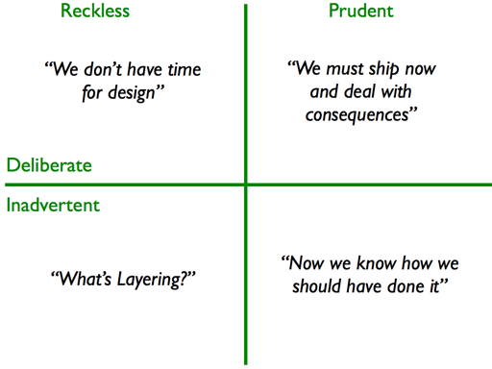
The Technical Debt Quadrant
Reckless vs Prudent: Did we know better?
Deliberate vs Inadvertent: Was it intentional?

Slide 46
The Reality is …
Technical debt is inevitable: but manageable
Recognize the signs: code smells, maintenance difficulties
Be intentional: choose when to take on debt
Track and plan repayment: don't let interest accumulate
Prevent new debt: follow good practices from the start
Remember: Technical debt isn't bad if managed properly. The problem is unacknowledged, unmanaged debt that grows over time!

Slide 47
Potential issues to find
SQL injection vulnerability
Hardcoded credentials
Magic numbers
Multiple responsibilities
Poor error handling
File I/O in function

Slide 48
Tooling to detect Technical Debt
SonarQube
ESLint → You should use this in your IDE
CheckStyle
Static analysis
Complexity metrics

Slide 49
Complexity metrics: Code Quality Metrics
Cyclomatic complexity
Cognitive complexity
Halstead complexity measures
Maintainability index

Slide 50
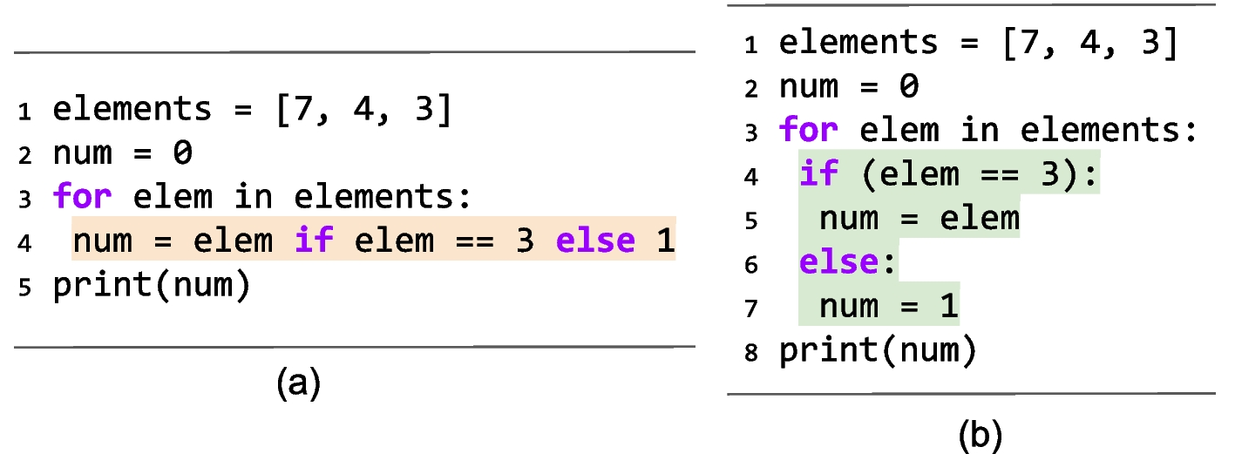
Atom of Confusion
How many developers does it take to fix an atom of confusion?
Just one, but 10 more to argue over what it was supposed to do.
https://atomsofconfusion.com/

