Slide 1
Lecture 14 - Technical Debt
Mia Mohammad Imran

Slide 2
Assignment-2 and Project
Assignment 2 has been posted:
  Deadline: Oct 27
  Lecture 11-12 should be helpful
Project Checkpoint-1:
  Start implementation
  Checkpoint-1: Nov 4
  Consider this as “Sprint 1”
  This is more of a deadline regarding incremental project

Slide 3
We were talking about Code Quality
We have covered
Code Refactoring
Code Smell
We will talk about …
Technical Debt
Atoms of Confusion
Design principles
Design patterns

Slide 4
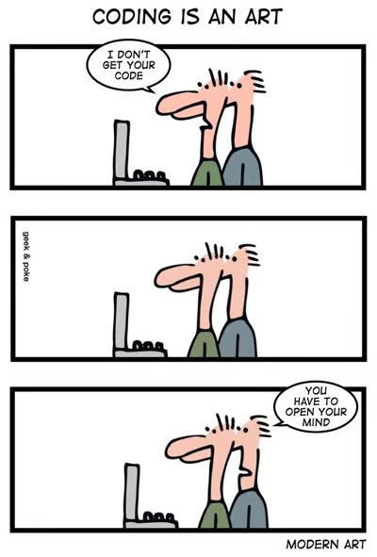
Recap …
Code Quality
Code Refactoring
Code Smell

Slide 5
Quick fix catalogue (refactor “aroma” away)
Code Smell | Refactoring Solution
Long Method | Extract Method (split into helpers)
Large Class | Extract Class / Subtype
Duplication | Pull Up Method / Template Method
Long Parameters | Introduce Parameter Object
Magic Number | Replace with Named Constant
Dead Code | Delete (version control remembers)
Poor Names | Rename Variable / Method

Slide 6
Refactoring Risks
Developer time is valuable: is this the best use of time today?
Despite best intentions, may not be safe
Potential for version control conflicts
It brings us to Technical Debt!

Slide 7
Technical Debt (TD)
“You’ve smelled the code... but what happens when we ignore the stink?”
Code smells are symptoms, Technical debt is the disease they signal (or at least the cost of the disease)!
Technical Debt is the Accumulation of Internal Problems in Project Codebase.
Not only Code Smells
Missing tests
Missing documentation
Dependency on old versions of third-party systems
Inefficient and/or non- scalable algorithms
Not just code!

Slide 8
INTENTIONAL and UNINTENTIONAL DEBT
# INTENTIONAL DEBT - We know this is temporary
def calculate_revenue(orders):
# TODO: Replace with proper database query once schema is finalized
# Currently using hardcoded values for MVP demo
return sum([order['amount'] for order in orders]) * 0.85 # Hardcoded tax rate
# UNINTENTIONAL DEBT - We didn't realize this was problematic
def process_user_data(user_input):
# This grew organically and became a maintenance nightmare
result = user_input.strip().lower()
if len(result) > 100:
result = result[:100]
# ... 50 more lines of string manipulation
return result

Slide 9
Types of Technical Debt
Type | Focus | Typical Symptoms
Code Debt | Violations of coding standards, missing tests, duplicated logic. | “Code smells” that have been ignored.
Design/Architecture Debt | Sub-optimal module boundaries, tight coupling, missing abstractions. | Hard-to-extend services; ripple effects when changing a single class.
Documentation Debt | Out-of-date README, missing API contracts, stale architecture diagrams. | New hires rely on guesswork; frequent “what does this do?” questions.
Test Debt | Insufficient coverage, flaky tests, missing integration or performance tests. | Bugs surface only in production; long debugging cycles.
Infrastructure Debt | Legacy CI pipelines, outdated container images, monolithic build scripts. | Long build times; frequent environment “works on my machine” issues.

Slide 10
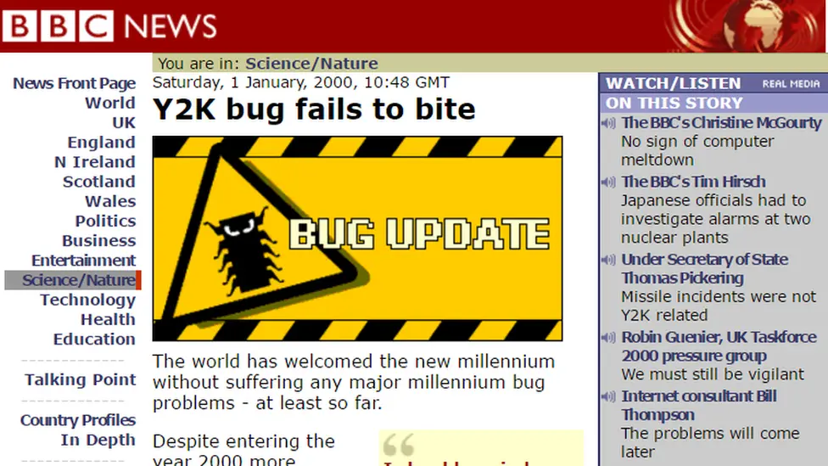
The Y2K bug is an example of architectural technical debt
IF YEAR > 00 THEN
...
“I just never imagined anyone would be using these systems 10 years later, let alone 20.”
The total cost of the work done in preparation for Y2K likely surpassed US$300 billion ($548 billion as of May 2025, once inflation is taken into account)

Slide 11
Python 2 to Python 3 Migration
Python 2 released in 2000
Python 3 released in 2008
But... the world was already running on millions of lines of Python 2!
Only as recent as 2020 python officially retire “end-of-life” python 2
Some companies still run it
Why was that needed?
Python 3 introduced major breaking changes to fix long-standing issues.
Clean Unicode support (vs byte/str mess)
Integer division behaving correctly
Cleaner iterator behavior (map, zip, range)
Standard library modernization
But... it broke backward compatibility!
Third-Party Ecosystem Fragmented
Packages had to support both versions simultaneously (via six, future, 2to3)
For years:
  Some libs were Py2-only
  Others were Py3-only
  Compatibility was fragile
# Python 2
print "Hello"
# Python 3
print("Hello")

Slide 12
Python 2 to Python 3 Migration
# Python 2
print "你好" # Might work, might crash, depends on terminal/env
# Python 3
print("你好") # Explicitly Unicode, well-defined
Python 2 let devs avoid thinking about encodings — until it failed silently.
Python 3 forced explicit encoding/decoding to eliminate confusion.
# Python 2
print 5 / 2 # 2 (floor division)
# Python 3
print(5 / 2) # 2.5 (true division)
Integer Division Changed
Developers had embedded assumptions in logic (e.g., loops, game physics, etc.)

Slide 13
An example of how Technical Debt grows
https://github.com/imranraad07/cs4090-git-demo

Slide 14
What actually happened: Actual Costs OF TB
Development Timeline:
- Initial Savings: 2 weeks (launched in 2 weeks instead of 8)
- Month 3: 3 weeks spent adding basic security and validation
- Month 6: 6 weeks spent on fraud prevention and international support
- Month 9: 8 weeks spent refactoring for scalability
- Total Extra Work: 17 weeks (4+ months!) of emergency fixes
Business Impact:
- Lost Customers: ~15% due to payment errors in first 3 months
- Fraud Losses: $8,200 from insufficient validation early on
- Compliance Fines: $5,000 for inadequate data protection
- Opportunity Cost: Delayed mobile app launch by 3 months
Team Impact:
- Developer Burnout: 2 senior developers left due to constant firefighting
- Hire Replacement Cost: $45,000 in recruitment and training
- Morale Impact: Team velocity dropped 40% due to code complexity

Slide 15
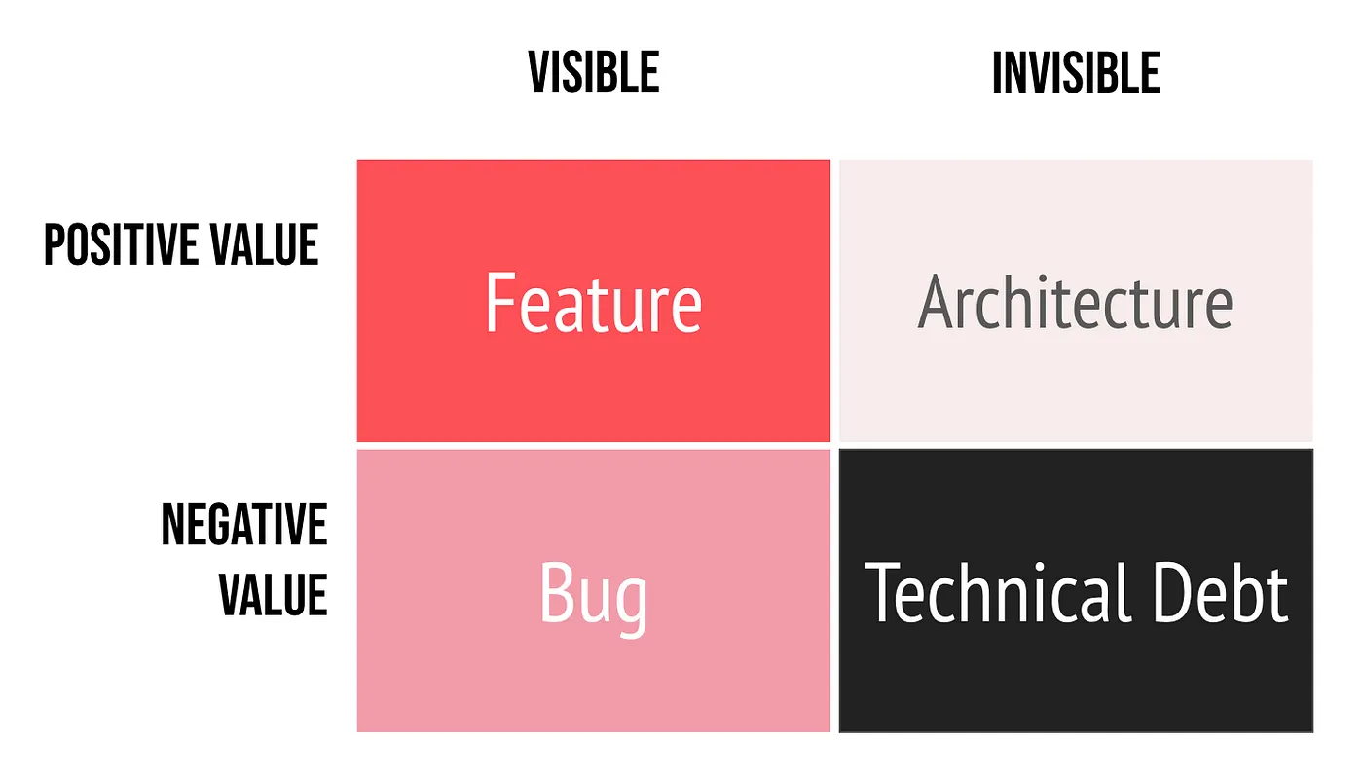
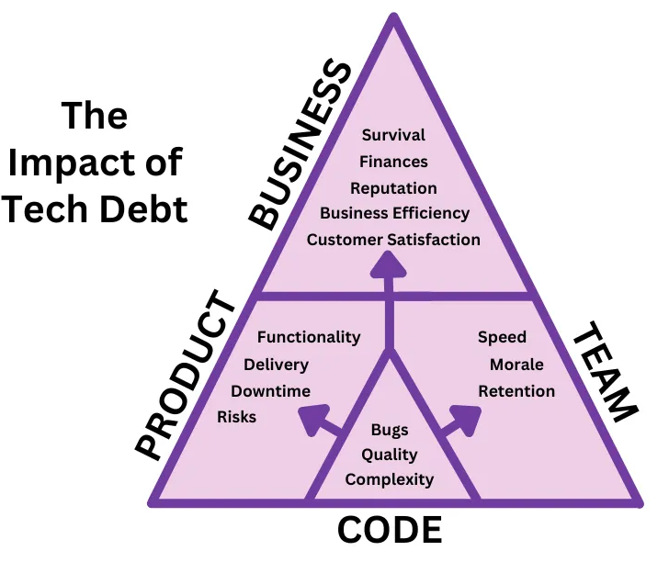
Explain Technical Debt to business
Help stakeholders visualize data (like progress, effect of debt, refactoring)

Slide 16
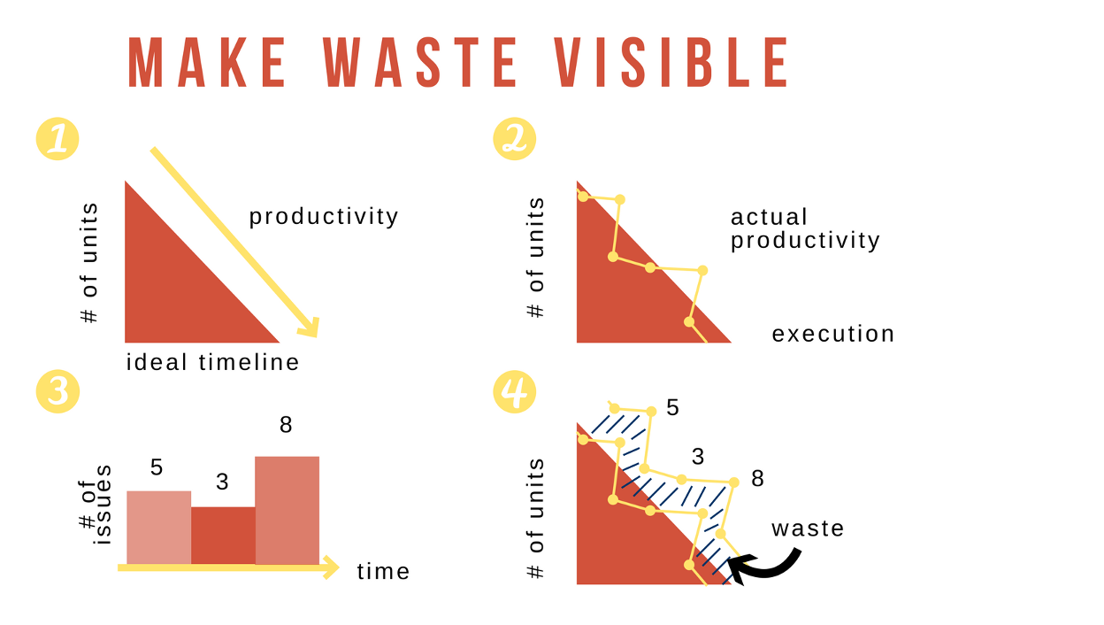
Make Technical Debt Visible
Here are the steps:
Plan the ideal
Track your Actual
Track what you spend on waste
Put it all together
Help stakeholders visualize data (like progress, effect of debt, refactoring)

Slide 17
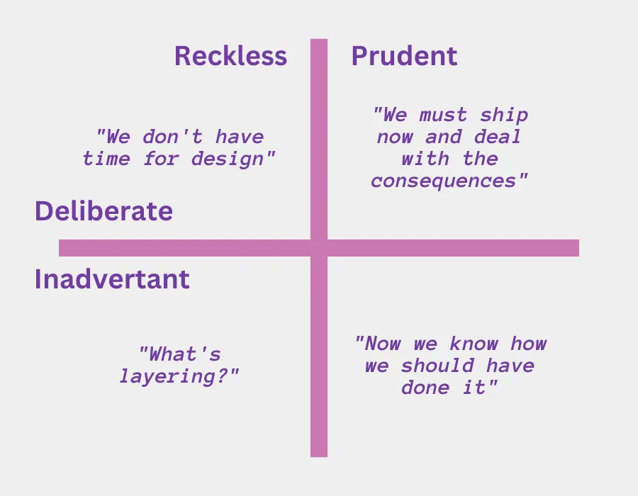
The Technical Debt Quadrant
Reckless vs Prudent: Did we know better?
Deliberate vs Inadvertent: Was it intentional?

Slide 18
The Reality is …
Technical debt is inevitable: but manageable
Recognize the signs: code smells, maintenance difficulties
Be intentional: choose when to take on debt
Track and plan repayment: don't let interest accumulate
Prevent new debt: follow good practices from the start
Remember: Technical debt isn't bad if managed properly. The problem is unacknowledged, unmanaged debt that grows over time!

Slide 19
Measuring Technical Debt
Metric | Captures | Tooling / Approach
Debt Ratio | Effort share on debt vs. new dev. | SonarQube, Code Climate
Principal (Man-Days) | Effort to eliminate debt. | Expert estimation
Interest Rate | Added effort per iteration. | Cycle-time, story-points
Defect Density | Bugs / KLOC | Static analysis, trackers
Lead Time for Changes | Change → deploy duration | DORA metrics
Code Churn | Rewritten LOC % | Git analytics

Slide 20
Managing Technical Debt
Here are the steps:
Plan the ideal
Track your Actual
Track what you spend on waste
Put it all together
Maintain a Debt Register (JIRA board).
Hold Debt Reviews during retrospectives.
Set a Debt Budget (≈ 10–20 % per sprint).
Help stakeholders visualize data (like progress, effect of debt, refactoring)

Slide 21
Tooling to detect Technical Debt
Static analysis
SonarQube
ESLint → You should use this in your IDE
CheckStyle
Complexity metrics → We will talk about this a bit

Slide 22
Question 1: When you see the word complexity, what comes to mind: mathematical difficulty or human difficulty?

Slide 23
Question 2: How might a developer’s experience level affect their perception of code complexity?

Slide 24
Complexity metrics
Quantitative measures that indicate how difficult code is to understand, test, or modify
Evaluate code maintainability
Identify high-risk or error-prone modules
Support refactoring and optimization decisions
Types of Complexity Metrics
Structural Metrics – Based on control flow and logic (e.g., Cyclomatic Complexity).
Cognitive Metrics – Reflect human understanding difficulty (e.g., Cognitive Complexity).
Volume/Size Metrics – Quantify code elements (e.g., Halstead Metrics).
Composite Metrics – Combine multiple factors (e.g., Maintainability Index).

Slide 25
Cyclomatic Complexity (McCabe, 1976)
Measures the number of linearly independent paths through a program’s control flow graph
M = E − N + 2P
Where:
E = number of edges
N = number of nodes
P = number of connected components
Range | Interpretation
1–10 | Simple, low risk
11–20 | Moderate complexity
21–50 | Complex, needs testing
>50 | Very high risk

Slide 26
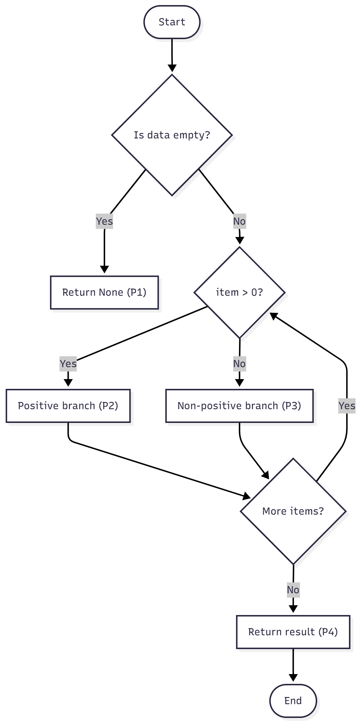
Cyclomatic Complexity: Example
def process_data(data):
if not data:
return None
result = []
for item in data:
if item > 0:
result.append(item * 2)
else:
result.append(0)
return result
Decision | Description | Paths Introduced
if not data: | Checks if input is empty or None | +1
for item in data: | Iteration over data | +1
if item > 0: | Conditional inside loop | +1
Control Flow Diagram
Notes:
graph TD
A([Start]) --> B{"Is data empty?"}
B -->|Yes| C["Return None (P1)"]
B -->|No| D{"item > 0?"}
D -->|Yes| E["Positive branch (P2)"]
D -->|No| F["Non-positive branch (P3)"]
E --> G{"More items?"}
F --> G
G -->|Yes| D
G -->|No| H["Return result (P4)"]
H --> Z([End])

Slide 27
Enumerate Independent Paths
def process_data(data):
if not data:
return None
result = []
for item in data:
if item > 0:
result.append(item * 2)
else:
result.append(0)
return result
Cyclomatic Complexity = 4
P1 | data is empty → if not data is True → returns None.
P2 | data is not empty, loop runs → every item > 0 → executes result.append(item * 2) → returns result.
P3 | data is not empty, loop runs → every item ≤ 0 → executes result.append(0) → returns result.
P4 | data is not empty, loop runs → mixed items (some >0, some ≤0) → executes both branches in loop → returns result.

Slide 28
Question 3: Does a higher Cyclomatic Complexity always mean “bad code”? Why or why not?

Slide 29
Question 4: Can you think of a scenario where two functions perform the same task but have different Cyclomatic Complexity scores?

Slide 30
Question 4: Can you think of a scenario where two functions perform the same task but have different Cyclomatic Complexity scores?
def max_of_three(a, b, c):
if a > b:
if a > c:
return a
else:
return c
else:
if b > c:
return b
else:
return c
def max_of_three(a, b, c):
return max(a, b, c)
Both functions perform exactly the same task, but: What’s the cyclomatic complexity?

Slide 31
Question 5: If two programs have the same number of decisions but different nesting, which one is mentally harder to trace?
if condition1:
do_a()
if condition2:
do_b()
if condition3:
do_c()
if condition1:
if condition2:
if condition3:
do_a()

Slide 32
Cognitive Complexity
Cyclomatic Complexity measures control flow, not human comprehension.
Readability and maintainability depend on how humans process logic.
Cognitive Complexity focuses on the mental effort required to understand code.
Developed by SonarSource (2016).
Introduced as part of SonarQube’s code analysis model.
Designed to address weaknesses of Cyclomatic Complexity.
Design Principles
Increment only for structures that increase mental load
Ignore structures that do not complicate understanding
Increment with nesting depth (each nested level increases effort)
Avoid penalizing simple, linear, or well-structured flow

Slide 33
Cognitive Complexity: Key Drivers
Factor | Effect
Conditional statements (if, else if, switch) | +1 each
Loops (for, while, do) | +1 each
Nested control flow | +1 per nesting level
Recursion | +1
Boolean logic (AND/OR chains) | +1
Breaks in structured flow (goto, continue, etc.) | +1
Early exits (return, break) | Often reduce complexity if improve readability

Slide 34
Comparison: Cognitive vs Cyclomatic
Aspect | Cyclomatic | Cognitive
Basis | Control flow graph | Human comprehension
Measures | Independent execution paths | Mental effort to follow logic
Penalizes | Every decision equally | Deep nesting, logical complexity
Goal | Testing completeness | Readability and maintainability
Scale | Integer path count | Weighted score based on structure

Slide 35
Example
if x > 0:
print("Positive")
else:
print("Negative")
if a:
if b:
if c:
do_task()
Cyclomatic Complexity: 2
Cognitive Complexity: 1
Single decision, easy to read
Cyclomatic Complexity: 3
Cognitive Complexity: 5
Deep nesting makes comprehension harder; each nested level adds mental load
if not a or not b or not c:
return
do_task()
Question:
Cyclomatic Complexity: ?
Cognitive Complexity: ?

Slide 36
Cognitive Complexity: Typical Thresholds
Cognitive Complexity | Interpretation
0–5 | Simple and clear
6–10 | Moderate cognitive effort
11–20 | Difficult to understand
>20 | Very complex and should be refactored
(Values are guidelines, not strict rules.)

Slide 37
Tools to Compute Cognitive Complexity
SonarQube / SonarLint (primary implementers)
CodeScene
PMD (Java)
Radon (Python, via extensions)

Slide 38
Question 6: Which metric (Cognitive Complexity or Cyclomatic Complexity) do you feel better reflects real-world code maintainability?

Slide 39
Question 6: Which metric (Cognitive Complexity or Cyclomatic Complexity) do you feel better reflects real-world code maintainability?
Both metrics are complementary, not substitutes.
Best practice: Use CC for testing completeness and CoC for readability and maintainability evaluation.

Slide 40
Question 7: How would you explain the difference between these two metrics to a junior developer?

Slide 41
Question 7: How would you explain the difference between these two metrics to a junior developer?
Metric | What It Measures | Analogy
Cyclomatic Complexity | The number of possible logical paths your program can take. | Think of it as the number of different routes through a maze.
Cognitive Complexity | How hard it is for a person to understand those routes. | Think of it as how mentally confusing that maze feels to navigate.

Slide 42
“The Magical Number Seven, Plus or Minus Two”
George A. Miller (1956) proposed the “Magical Number 7 ± 2” → the human working memory can hold 5–9 chunks of information at once.
This limited capacity of short-term memory forms the foundation for Cognitive Load Theory (CLT) [Sweller 1998]
Intrinsic Load:
  Complexity inherent to the task or material
  Managed through sequencing, simplification, and scaffolding
Extraneous Load:
  Caused by inefficient instructional design or irrelevant information
  Reduced through clear visuals, concise text, and well-organized materials
Germane Load:
  Cognitive effort used to build schemas and integrate knowledge into long-term memory
  Encouraged by problem-solving, practice, and self-explanation

Slide 43
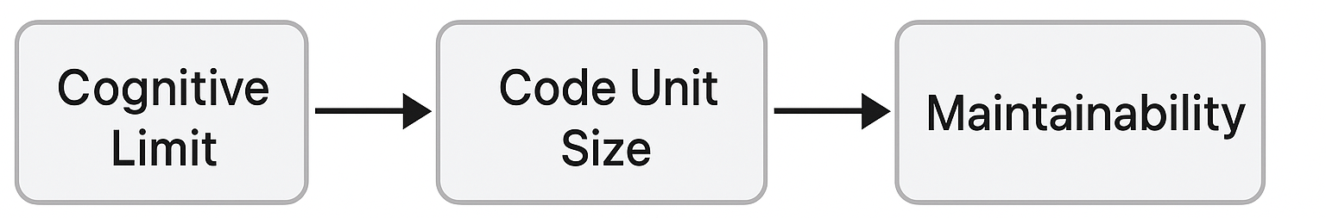
Implications for Software Design
Reduce intrinsic load: Simplify logic and modularize functions.
Minimize extraneous load: Use clear naming and consistent style.
Enhance germane load: Encourage schema formation through patterns and code reviews.
Aim for low cognitive complexity to stay within working memory limits.

Slide 44
Cognitive Driven Development (CDD)
A development paradigm that constrains design and coding decisions according to cognitive complexity limits
Core Idea: Developers can handle only a small number of simultaneous code elements (≈ 7 ± 2)
Principle: Maintain small, self-contained code units to preserve cognitive efficiency
Toward a Definition of Cognitive-Driven Development: https://ieeexplore.ieee.org/stamp/stamp.jsp?arnumber=9240662
To What Extent Cognitive-Driven Development Improves Code Readability?: https://dl.acm.org/doi/pdf/10.1145/3544902.3546241

Slide 45
Halstead Metric
Developed by Maurice Halstead in 1977, these metrics analyze software based on the number of operators and operands in the source code.
Key Components:
n₁ = Number of unique operators
n₂ = Number of unique operands
N₁ = Total occurrences of operators
N₂ = Total occurrences of operands
Program Vocabulary (n): n = n₁ + n₂
Program Length (N): N = N₁ + N₂
Volume (V): V = N × log₂(n)
Represents the size of the implementation
Difficulty (D): D = (n₁ / 2) × (N₂ / n₂)
Estimates the effort to write or understand the code
Effort (E): E = D × V
Represents mental effort required
Useful for static code analysis & software quality estimation
However, Halstead metrics are dated, but still relevant in multi-metric analysis

Slide 46
Halstead Metric: Example
a = 5
b = 10
c = a + b
Identify Operators and Operands
Operators (n₁): =, +
→ Unique Operators = 2
→ Total Operators (N₁) = 3 (=, =, +)
Operands (n₂): a, b, c, 5, 10
→ Unique Operands = 5
→ Total Operands (N₂) = 6 (a, 5, b, 10, c, a)
Calculate Metrics
Vocabulary (n) = n₁ + n₂ = 2 + 5 = 7
Length (N) = N₁ + N₂ = 3 + 6 = 9
Volume (V) = N × log₂(n) = 9 × log₂(7) ≈ 25.3
Difficulty (D) = (n₁ / 2) × (N₂ / n₂) = (2 / 2) × (6 / 5) = 1.2
Effort (E) = D × V = 1.2 × 25.3 = 30.36
Low effort and volume → very simple, easy-to-read code.
As code grows, higher values can signal complexity or maintenance cost.

Slide 47
Atom of Confusion
A bit of a joke here:
A student once told me their code was ‘100% bug-free’.
I asked to see it, and the first line was:
if not not not True:
Congratulations! you’ve just discovered a Schrödinger’s Condition → the condition is both True and False until you read it three times!

Slide 48
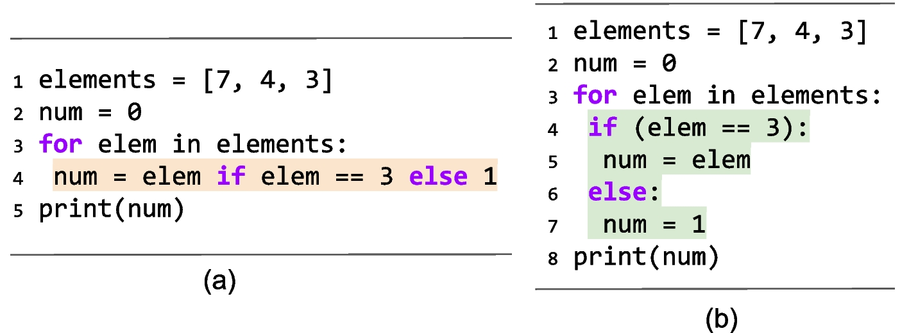
Atom of Confusion
Atoms of Confusion is a project to discover the fundamental causes of human error in programming.
https://atomsofconfusion.com/

Slide 49
In Summary …
Technical debt is inevitable—manage it deliberately
Complexity must be measured from both the system’s and the human’s point of view
Atoms of Confusion remind us that clarity beats cleverness

