Slide 1
Lecture 16 - Design principles
Mia Mohammad Imran

Slide 2
Software Design Principles
Guidelines that improve software reliability and ease maintenance
Code is read more often than it's written
Well-designed software is easier to:
  Understand, Maintain, Extend, Test
Facilitates team collaboration
To minimize code smell and technical debts

Slide 3
Software Design Survival Guide
SOLID Principles: Your Code's Foundation
DRY & KISS: Keeping Sanity in the Chaos
Separation of Concerns: Divide and Conquer
YAGNI: The Art of Not Over-engineering
Law of Demeter: Good Fences Make Good Neighbors
Design Patterns: [Will not cover today]

Slide 4
SOLID Principles
Five principles from "Uncle Bob" Martin
Single Responsibility: "Do one thing and do it well"
Open/Closed: "Open for extension, closed for modification"
Liskov Substitution: "If it looks like a duck and quacks like a duck... it should swim like a duck too"
Interface Segregation: "Clients shouldn't depend on methods they don't use"
Dependency Inversion: "Depend on abstractions, not concrete implementations"
https://blog.cleancoder.com/uncle-bob/2014/05/08/SingleReponsibilityPrinciple.html
https://blog.cleancoder.com/uncle-bob/2020/10/18/Solid-Relevance.html

Slide 5
SOLID Principles
Five principles from "Uncle Bob" Martin
Single Responsibility: "Do one thing and do it well"
Open/Closed: "Open for extension, closed for modification"
Liskov Substitution: "If it looks like a duck and quacks like a duck... it should swim like a duck too"
Interface Segregation: "Clients shouldn't depend on methods they don't use"
Dependency Inversion: "Depend on abstractions, not concrete implementations"
Question: Which SOLID principle is violated most often?

Slide 6
Single Responsibility Principle (SRP)
"A class should have only one reason to change"
Meaning: "Don't create a Swiss Army Knife class that does everything"
Each class should have only one job or responsibility
Increases cohesion, reduces coupling
Easier to understand, test, and maintain
"Roommate Test": If your class was your roommate, would they be doing too many chores?

Slide 7
Does this Class Adhere to the SRR? Why or Why Not?
class DataProcessor:
def __init__(self, data):
self.data = data
def process_data(self):
processed = []
for item in self.data:
processed.append(self._process_item(item))
self.log("Processed data: " + str(processed))
return processed
def _process_item(self, item):
# Simple data processing: for example, doubling the value
return item * 2
def log(self, message):
# Logging the processing outcome to a file
with open("processing.log", "a") as log_file:
log_file.write(message + "\n")

Slide 8
class Logger:
def log(self, message):
with open("processing.log", "a") as log_file:
log_file.write(message + "\n")
class DataProcessor:
def __init__(self, data, logger):
self.data = data
self.logger = logger
def process_data(self):
processed = []
for item in self.data:
processed.append(self._process_item(item))
self.logger.log("Processed data: " + str(processed))
return processed
def _process_item(self, item):
return item * 2
# Usage
logger = Logger()
processor = DataProcessor([1, 2, 3], logger)
processed_data = processor.process_data()

Slide 9
Open/Closed Principle (OCP)
"Software entities should be open for extension, but closed for modification"
Meaning: "Add new features without breaking existing code"
Extend behavior without modifying existing code
Use abstractions and polymorphism
Reduces risk when making changes
The "LEGO Principle": Add new blocks without dismantling the existing structure

Slide 10
Violates OCP. Why?
class Rectangle {
double width;
double height;
}
class AreaCalculator {
double calculateArea(Rectangle r) {
return r.width * r.height;
}
}
Notes:
// Adding a new shape requires modifying this class

Slide 11
Making it Better
interface Shape {
double calculateArea();
}
class Rectangle implements Shape {
double width;
double height;
double calculateArea() {
return width * height;
}
}
class Circle implements Shape {
double radius;
double calculateArea() {
return Math.PI * radius * radius;
}
}
Notes:
// Adding a new shape requires modifying this class

Slide 12
Liskov Substitution Principle (LSP)
"Derived classes must be substitutable for their base classes"
Meaning: "Don't break promises made by parent classes"
Subtypes must be behaviorally compatible with their base types
Ensures consistent behavior in inheritance hierarchies
Prevents unexpected bugs when using polymorphism
The "Square/Rectangle Problem": A mathematical truth that breaks in OOP!

Slide 13
Liskov Substitution Principle (LSP)
class Square extends Rectangle {
@Override
public void setWidth(double width) {
super.setWidth(width);
super.setHeight(width); // Must keep sides equal
}
@Override
public void setHeight(double height) {
super.setHeight(height);
super.setWidth(height); // Must keep sides equal
}
}
void resizeRectangle(Rectangle rectangle) {
rectangle.setWidth(10);
rectangle.setHeight(20);
assert rectangle.getArea() == 200; // This will fail if rectangle is actually a Square!
}
class Rectangle {
private double width;
private double height;
public void setWidth(double width) {
this.width = width;
}
public void setHeight(double height) {
this.height = height;
}
public double getArea() {
return width * height;
}
}

Slide 14
Liskov Substitution Principle (LSP)
// Violates LSP
class Bird {
void fly() { /* ... */ }
}
class Penguin extends Bird {
void fly() {
throw new UnsupportedOperationException("Penguins can't fly");
}
}
// Follows LSP
interface FlyingBird {
void fly();
}
interface SwimmingBird {
void swim();
}
class Sparrow implements FlyingBird {
void fly() { /* ... */ }
}
class Penguin implements SwimmingBird {
void swim() { /* ... */ }
}

Slide 15
Interface Segregation Principle (ISP)
"Clients should not be forced to depend on methods they do not use"
Meaning: "Don't make people pay for features they don't want"
Keep interfaces focused and minimal
Better to have many small interfaces than one large one
Reduces the impact of changes
The "TV Remote Control Problem": Why are there 60 buttons when you only use 5?

Slide 16
Interface Segregation Principle (ISP)
// Violates ISP
interface Worker {
void work();
void eat();
void sleep();
}
// Follows ISP
interface Workable {
void work();
}
interface Eatable {
void eat();
}
interface Sleepable {
void sleep();
}
class Human implements Workable, Eatable, Sleepable {
void work() { /* ... */ }
void eat() { /* ... */ }
void sleep() { /* ... */ }
}
class Robot implements Workable {
void work() { /* ... */ }
}

Slide 17
Dependency Inversion Principle (DIP)
"High-level modules should not depend on low-level modules. Both should depend on abstractions."
Meaning: "Plug into interfaces, not implementations"
Depend on abstractions, not concretions
Enables flexibility and testability
Facilitates mock objects in testing
The "Power Outlet Analogy": You plug devices into standardized outlets, not directly into the power plant

Slide 18
Dependency Inversion Principle
// Follows DIP
interface Switchable {
void turnOn();
void turnOff();
}
class LightBulb implements Switchable {
void turnOn() { /* ... */ }
void turnOff() { /* ... */ }
}
class Fan implements Switchable {
void turnOn() { /* ... */ }
void turnOff() { /* ... */ }
}
class Switch {
private Switchable device;
Switch(Switchable device) {
this.device = device;
}
void operate() {
// Works with any Switchable device
}
}
// Violates DIP
class LightBulb {
void turnOn() { /* ... */ }
void turnOff() { /* ... */ }
}
class Switch {
private LightBulb bulb;
Switch(LightBulb bulb) {
this.bulb = bulb;
}
void operate() {
// Directly depends on LightBulb implementation
}
}
Notes:
// Adding a new shape requires modifying this class

Slide 19
Dependency Inversion Principle
Why is it beneficial to depend on abstractions rather than concrete implementations? Can you discuss a scenario where this approach enhances flexibility and maintainability in your code?

Slide 20
DRY Principle
"Don't Repeat Yourself"
Meaning: "Copy-paste is not a design pattern"
Every piece of knowledge should have a single, unambiguous representation
Eliminates duplication of code and logic
Changes only need to be made in one place
The "Three Strike Rule": Copy once, shame on you. Copy twice...time to refactor!
DRY code = Less bugs, easier changes

Slide 21
Example
// Violates DRY
void processUser(User user) {
if (user.getAge() < 18) {
throw new Exception("User must be 18 or older");
}
// Process user...
}
void validateUserAge(User user) {
if (user.getAge() < 18) {
throw new Exception("User must be 18 or older");
}
// Validate age...
}
// Follows DRY
boolean isUserAdult(User user) {
return user.getAge() >= 18;
}
void processUser(User user) {
if (!isUserAdult(user)) {
throw new Exception("User must be 18 or older");
}
// Process user...
}
void validateUserAge(User user) {
if (!isUserAdult(user)) {
throw new Exception("User must be 18 or older");
}
// Validate age...
}

Slide 22
Question
What's the most copied & pasted code in your codebase?

Slide 23
KISS Principle
"Keep It Simple, Stupid"
Meaning: "Clever code impresses in code reviews but tortures in maintenance"
Simplicity should be a key goal in design
Avoid unnecessary complexity
Simple solutions are easier to understand and maintain
Often leads to fewer bugs
The "Explain It To A 5-Year-Old" test: If you can't, it's too complex

Slide 24
Example
// Violates KISS
boolean isEven(int number) {
return number % 2 == 0 ? true : number % 2 != 0 ? false : true;
}
// Follows KISS
boolean isEven(int number) {
return number % 2 == 0;
}

Slide 25
YAGNI – You Aren't Gonna Need It
"You Aren't Gonna Need It"
Meaning: "Don't build features for problems you don't have yet"
Concept: Implement only what is necessary
Prevents over-engineering
Saves time and resources by focusing on current requirements
The "Crystal Ball Fallacy": You can't predict the future of your application
Best Practice: Prioritize current needs and avoid speculative features
Every line of code is a liability, not an asset

Slide 26
Example (Bad Case)
public class UserProfile {
private String name;
private String email;
// Current requirements only need name and email
// "Future-proofing" with fields we don't need yet
private Address billingAddress;
private Address shippingAddress;
private List<PaymentMethod> paymentMethods;
private UserPreferences preferences;
private AuditLog activityHistory;
private PermissionSet permissions;
private Map<String, Object> customFields;
// Methods for fields we don't need yet
public void addPaymentMethod(PaymentMethod method) { /* ... */ }
public void exportUserDataToJson() { /* ... */ }
public void syncWithThirdPartyServices() { /* ... */ }
// Plus 20 more methods for hypothetical future features
}

Slide 27
YAGNI-Compliant Version
public class UserProfile {
private String name;
private String email;
public UserProfile(String name, String email) {
this.name = name;
this.email = email;
}
public String getName() {
return name;
}
public String getEmail() {
return email;
}
}

Slide 28
Law of Demeter: "Don't Talk to Strangers"
"An object should only talk to its immediate friends, not to strangers"
Meaning: "Stop digging through object hierarchies like they're Facebook profiles"
The "Train Wreck" code smell:
customer.getWallet().getMoney().getAmount()
"One dot rule" is a good starting point (not perfect, but helpful)
High Demeter violations = Brittle code that breaks when anything changes

Slide 29
Example
// Violates Law of Demeter
class Customer {
Wallet wallet;
// ...
}
class Wallet {
Money money;
// ...
}
class Cashier {
void checkout(Customer customer, float amount) {
// Reaching through customer to wallet to money
if (customer.wallet.money.amount >= amount) {
customer.wallet.money.amount -= amount;
}
}
}
// Follows Law of Demeter
class Customer {
private Wallet wallet;
boolean canAfford(float amount) {
return wallet.hasSufficientFunds(amount);
}
void pay(float amount) {
wallet.deductMoney(amount);
}
}
class Cashier {
void checkout(Customer customer, float amount) {
if (customer.canAfford(amount)) {
customer.pay(amount);
}
}
}

Slide 30
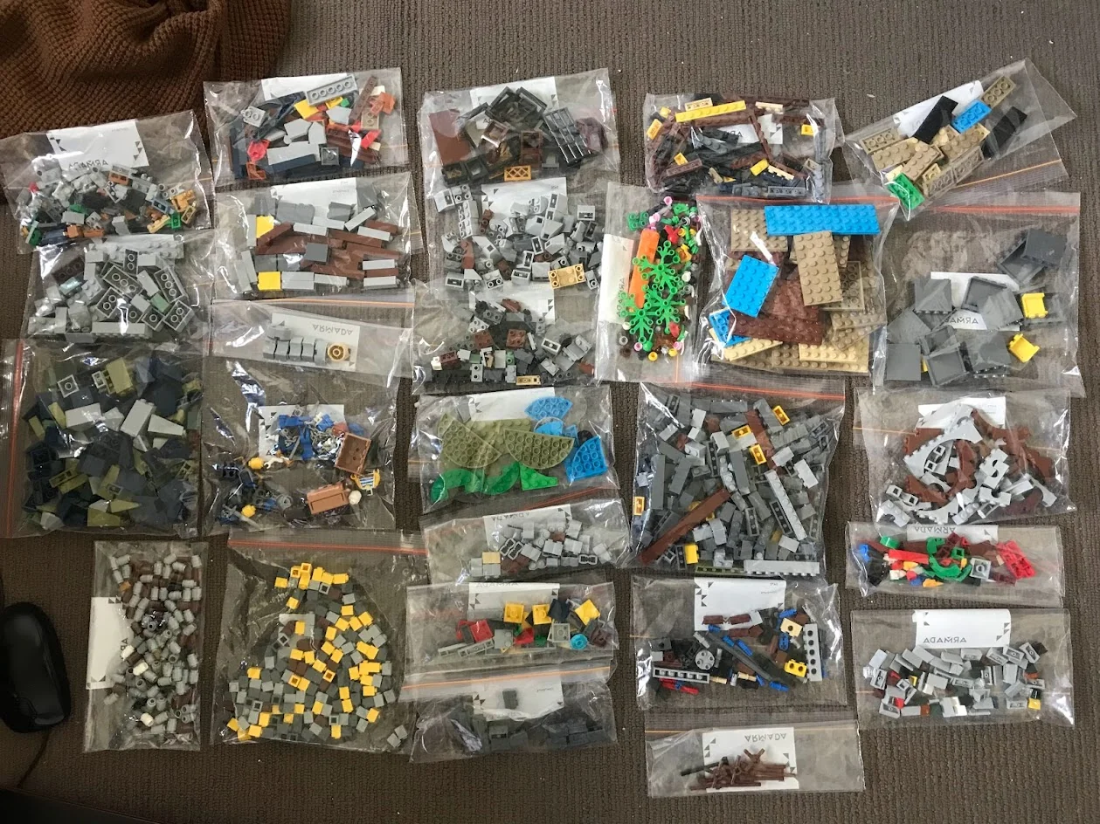
Separation of Concerns: Divide and Conquer
Concept: Divide applications into distinct, manageable sections
The "Too Many Cooks" principle: One chef per station makes a better kitchen
Have you ever built LEGO sets? Notice how they come in numbered bags?

Slide 31
Separation of Concerns: Divide and Conquer
MVC Pattern: Separating data (Model), presentation (View), and control logic (Controller)
Frontend/Backend: Different teams, different skills, common API contract
Microservices: The ultimate separation of concerns

Slide 32
Takeaways
SOLID: principles are your code's foundation - ignore them at your peril
DRY: prevents duplicated knowledge, KISS keeps you sane
Separation of Concerns: lets you divide and conquer complex problems:
  Separate your logics
Law of Demeter: keeps your code from becoming a tangled web
YAGNI: saves you from building features nobody asked for

