Slide 1
Lecture 1: Introduction
Mia Mohammad Imran

Slide 2
What is Software Engineering
Software != Programming
What do you think distinguishes a software engineer from a programmer?

Slide 3
What is Software Engineering
Software + Engineering
(Solution) + (People)

Slide 4
What is Software Engineering
Software = Programming + Design + Testing + Deployment + Maintenance + Documentation + Collaboration

Slide 5
What is a Software Program
Instructions + Data Structures + Documents

Slide 6
Why Software Engineering
Have any of you heard of Therac-25?
When Bugs literally killed (not process but subject, subject humans)
https://en.wikipedia.org/wiki/Therac-25

Slide 7
Therac-25: What Happened?
What happened?
A radiation machine malfunctioned due to a software bug
Patients received 100x the intended dose – some died
Why?
No proper testing: No safety checks in the code
Engineers relied on software instead of hardware failsafes
The Lesson:
Software isn't just code – it’s responsibility
In safety-critical systems, good engineering saves lives

Slide 8
Why Software Engineering
Imagine your favorite app crashes daily. What do you expect from the team behind it?

Slide 9
Why Software Engineering
Manage Complexity: Structured development of large systems
Quality Assurance: Meet user requirements reliably
Efficiency: Save time and reduce costs
Adaptability: Support software evolution

Slide 10
Goals of Software Engineering
Build Reliable, Maintainable, Scalable Systems
Solve Real-World Problems
Enable Collaboration Across Teams

Slide 11
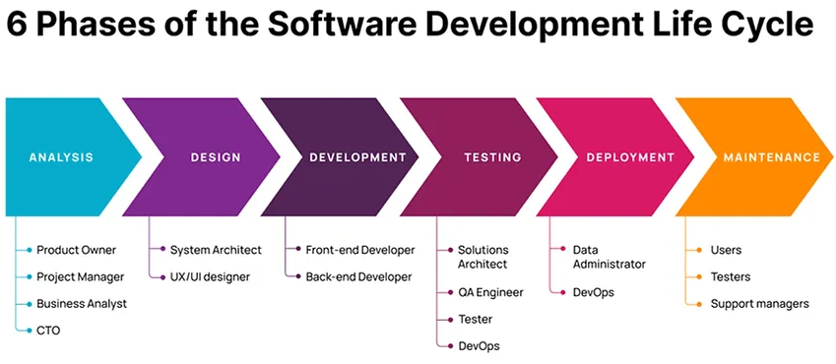
Key Concepts - Software Development Life Cycle (SDLC)
Requirements → Design → Implementation → Testing → Deployment → Maintenance

Slide 12
Key Concepts - Software Development Life Cycle (SDLC)
Imagine you’re building a new app. Which SDLC phase would you focus on first? Any guesses?

Slide 13
Key Concepts - Process Models
Iterative (as early as late 1950s)
Waterfall (1970s to early 1980s)
Spiral (mid 1980s)
Agile (late 1990s)

Slide 14
Relevance of Software Engineering
Software powers critical industries
Healthcare, Finance, Transportation, Education
Aligns with ethical and regulatory standards
Supports innovation and problem-solving in society

Slide 15
Relevance of Software Engineering (in US)
In 2020 software supported
more than 15.8M jobs in total — an increase of 5.9% since 2018
more than 12.5M non-software jobs — up 5.5% since 2018
Software industry
directly contributed $933B to the US economy in 2020 — a 15.1% increase since 2018
invested more than $103B in R&D in 2018 — more than 27% of all domestic business R&D
3.3M people worked directly in software jobs — up 7.2% over 2018

Slide 16
Relevance of Software Engineering
What would happen to the world if all software systems stopped working for a day?

Slide 17
Software Engineering Framework
People: Roles and collaboration in development
Process: Best practices and structured workflows
Technology: Tools, languages, and platforms used

Slide 18
Software Engineering Framework
People: Roles and collaboration in development
Process: Best practices and structured workflows
Technology: Tools, languages, and platforms used
Which do you think is the most important component and why?

Slide 19
About the Course
Concept Introduction
Hands-on Practice
All relevant course-related accounts and communications will be created and managed exclusively through Canvas

Slide 20
❌ Beyond the Scope of this Course
DevOps and Enterprise tools: Azure DevOps, AWS CodePipeline, Jenkins pipelines in depth
Full CI/CD automation and DevOps workflows
Distributed systems and microservices
Container orchestration: Docker, Kubernetes
Web Development
Software as a Service
Advanced software testing
Formal verification and model checking
Advanced object-oriented and enterprise design patterns
Domain-driven design (DDD) or event-driven architectures

Slide 21
Expected Learning Outcomes
Understand the core principles of software engineering, including design, development, testing, and maintenance
Apply software development lifecycle (SDLC) methodologies to plan, execute, and manage software projects

Slide 22
Topics
Software Development Lifecycle (SDLC)
Software Requirements
Software Design
Software Implementation
Software Testing
Software Maintenance
*Subject to change

Slide 23
Assessment
Weekly Quizzes (30-35%)
In-class interactive group activity (possibly)
No late submissions will be accepted
Group Assignments (35-40%)
Group Project (10-15%)
Mid-term and Final exam (15-20%)
Attendance (5-10%)
In-class interactive group activity
*Grading distribution subject to change

Slide 24
Team Formation
Team Formation
Please form the team as soon as possible as your assignments and projects will depends on it
3 person team
If you can’t find a team, contact by end of week 2
Finalize the team by week 3 please
First assignment would be posted by week 3

Slide 25
Text Books
Not Necessary! In case interested -
"Essentials of Software Engineering" by Frank Tsui, Orlando Karam, and Barbara Bernal
Secondary: The Pragmatic Programmer by Andy Hunt and Dave Thomas, 2nd edition
Available publicly (google!)

Slide 26
Communicate Only: Email Titling [CS 4090]
Clear subject lines drive attention and relevance
Include course code [CS 4090] at the start of the title
Avoid vague phrases such as 'Important' or 'Question'
Use consistent formatting across all emails
Example: [CS 4090] Assignment 2 Submission Deadline Clarification
Emails would be replied by next working day

Slide 27
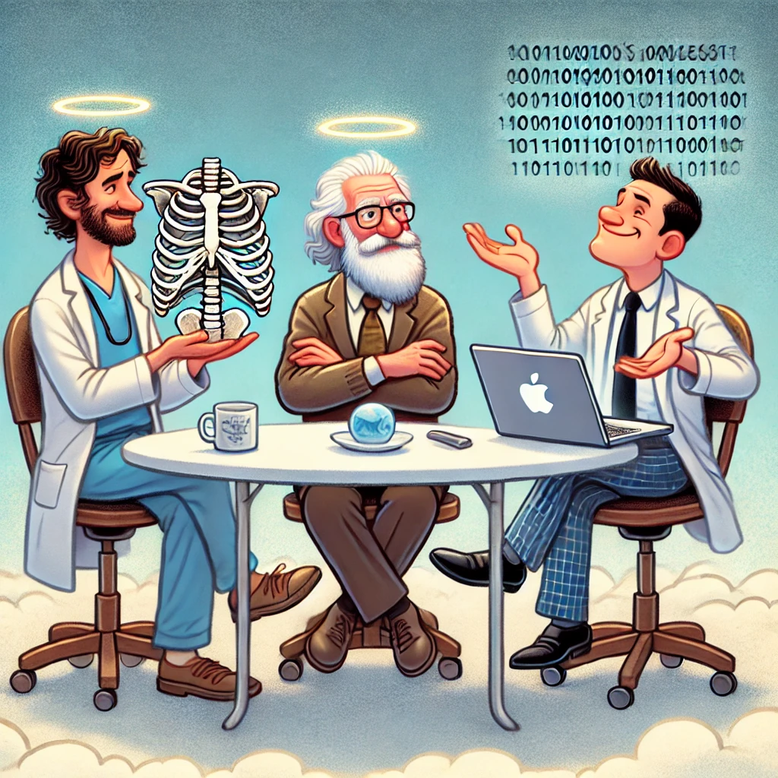
A Physician, a Civil Engineer and a Computer Scientist were arguing about what was the oldest profession in the world.
The Physician remarked, "Well, in the Bible, it says that God created Eve from a rib taken out of Adam. This clearly requires surgery, and so I can rightly claim that mine is the oldest profession in the world."
The Civil Engineer interrupted, and said, " But even earlier in the book of Genesis, it states that God created the order of the heavens and the earth from out of the chaos. This was the first and certainly the most spectacular application of civil engineering. Therefore, fair doctor, you are wrong; mine is the oldest profession in the world.“
The Computer Scientist leaned back in the chair, smiled and then said confidently, "Ah, but what do you think created the chaos? "

