Slide 1
Lecture 23 - Software Testing Demo
Mia Mohammad Imran

Slide 2
Some Announcements
No assignment 4
Weekly Quiz 4 will focus on testing (part of idea of assignment 4 will go here)
Checkpoint-4: you will need to do testing and detail that in report (part of idea of assignment 4 will go here)
Capstone II - Demo
Host: Dr. Sejun Song
Week 16 – December 10: Capstone 2 Poster Presentation & Demo Day 🎉
📍 Location: CS building, First Floor
🕒 Time: 3:00 PM – 4:30 PM

Slide 3
Course Evaluation
https://go.blueja.io/bIH4LPjPIEScbDy7_1uUdg

Slide 4
Unit Testing
Unit Testing:
Testing small, isolated parts of code (units)
Ensures correctness for individual functions or methods
Python's unittest module:
Built-in testing framework
Class-based test suites with assert methods
Mocking
Example:
class TestMath(unittest.TestCase):
def test_add(self):
self.assertEqual(add(2, 3), 5)

Slide 5
Pytest: Simpler Testing
Why Pytest?
Simple function-based tests
Rich plugin support
Works with plain Python code
Popular for unit + integration testing
Example:
pip install pytest
def test_add():
assert add(2, 3) == 5
Advanced Features:
Parameterized tests
Better output, detailed tracebacks

Slide 6
pytest-cov – Coverage Reports
Install: pip install pytest-cov
Run:
pytest --cov=your_module
pytest --cov=your_module --cov-report=term-missing

Slide 7
pytest-mock – Simplified Mocking
Install: pip install pytest-mock
Use: mocker.patch(...)
Debug plugin loading: pytest --trace-config

Slide 8
pytest-html – HTML Reports
Install: pip install pytest-html
Generate Report: pytest --html=report.html

Slide 9
pytest-xdist – Parallel Testing
Install: pip install pytest-xdist
Run in Parallel: pytest -n 4

Slide 10
CI-Friendly Plugin Combo
Install: pip install pytest pytest-cov pytest-html
Command: pytest -n auto --cov=src --html=test-report.html --self-contained-html

Slide 11
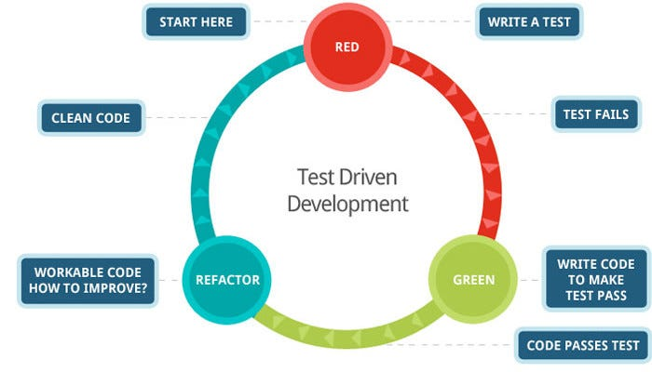
Test-Driven Development (TDD)
TDD Workflow: Red, Green, Refactor
Write a failing test (Red)
Write minimal code to pass (Green)
Refactor code while tests stay green
Benefits:
Forces you to think in terms of behavior
Prevents regressions
Encourages clean, modular code

Slide 12
Behavior-Driven Development (BDD)
BDD Overview:
Extends TDD with business-focused language
Scenarios written in Gherkin syntax (Given/When/Then)
Tools:
behave (Python)
pytest-bdd (Gherkin + pytest)
Example:
Scenario: Add two numbers
Given the calculator is running
When I add 2 and 3
Then the result should be 5

Slide 13
pytest-bdd: Behavior-Driven Testing
Install: pip install pytest-bdd
Gherkin Syntax:
Given I have numbers 2 and 3
When I add them
Then the result should be 5

Slide 14
From Example-Based to Property-Based Testing
Traditional tests check specific inputs and outputs
Property-Based Testing checks general invariants
Automated test case generation
Discovers edge cases you might miss manually
Hypothesis shrinks failing input to minimal case
Helps diagnose logic bugs
Great for catching silent errors
Improves test coverage

Slide 15
Using Hypothesis in Python
Install: pip install hypothesis
Decorate tests with @given(...)
Use strategies like st.integers(), st.lists()
Hypothesis runs tests with diverse data automatically

Slide 16
Example Property: Commutativity of Addition
Test: x + y == y + x
@given(st.integers(), st.integers())
Discovers issues in arithmetic logic if present
No need to write specific test cases

Slide 17
Example: Testing Sorting
Property: sorted(sorted(xs)) == sorted(xs)
Property: result is sorted
Combine multiple properties for robustness
Works across all valid list inputs

Slide 18
Question: If a test asserts that add(a, b) always equals add(b, a), what property is it verifying?
Why this even matters?

Slide 19
Question: In a temperature conversion function, what property can verify correctness across a range of inputs without writing many examples?

