Slide 1
Lecture 24 - CI/CD Overview
Mia Mohammad Imran

Slide 2
What Is DevOps?
DevOps = Development + Operations
DevOps is a combined culture and practice that brings developers and operations together
Goal: Help teams build, test, and deliver software quickly and reliably

Slide 3
What is CI/CD?
CI and CD are practical implementations of DevOps.
Think of DevOps as the mindset. CI and CD are the automated workflow that brings that mindset to life.
CI: Continuous Integration: Test and combine code automatically on every change
Automatic building
Running automated tests and early detection of errors
Ensuring the main branch is always stable
CD: Continuous Delivery/Deployment: Ship updates to users continuously and safely
Automatic promotion to production after all checks pass
Zero manual intervention
Very fast iteration cycles
Example Tools
CI: GitHub Actions, Jenkins
CD: Docker, Heroku, AWS

Slide 4
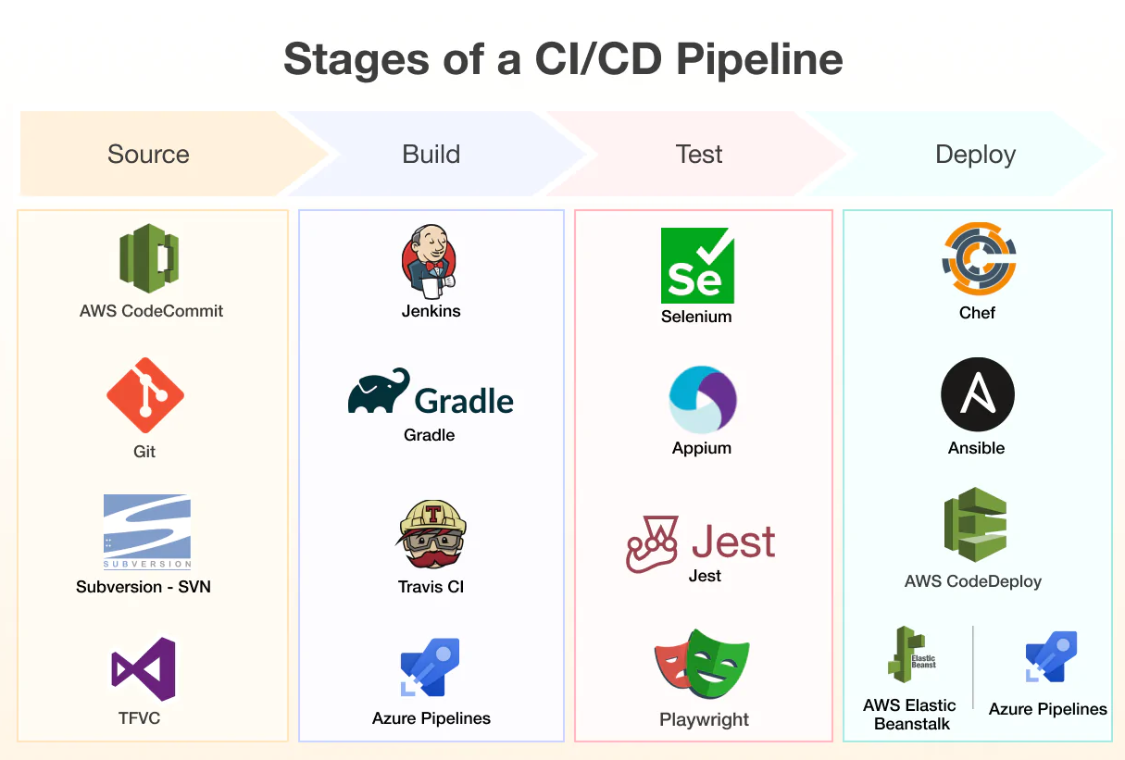
CI/CD Workflow
Write Code → Push to GitHub → CI runs tests → CD deploys app → User sees it
https://bytebytego.com/guides/cicd-pipeline-explained-in-simple-terms/
https://bytebytego.com/guides/cicd-simplified-visual-guide/

Slide 5
Getting Started with CI/CD
Create GitHub repo
Add `.github/workflows/ci.yml`
Define CI steps:
Checkout code
Install dependencies
Run tests
Add CD (deploy to Heroku, Netlify, etc.)

Slide 6
Demo
Demo complete: https://github.com/imranraad07/cicd_demo
Demo in-class: https://github.com/imranraad07/cicd_dec04

