Slide 1
Lecture 3
Mia Mohammad Imran

Slide 2
Today’s Objective
Building a “System”

Slide 3
From Individual Programs to Complex Systems
Moving from writing a program to building a system.
What’s the difference?!
Key Question: What transforms a simple program into a complex system requiring teams, processes, and specialized management?

Slide 4
System vs. Program: The Fundamental Difference
Simple Program
Few developers (1)
Limited functionality
Few users
Direct implementation
Minimal coordination
Complex System
Multiple developers (5-100+)
Extensive functionality
Diverse user base
Structured development process
Heavy coordination requirements

Slide 5
Building a “System”
Moving from writing a program to building a system. What’s the difference?!
More: parts, tasks, people, tools, etc.
  Complexity, size, Complexity, size — Complexity
    Breadth of Complexity
    Depth of Complexity

Slide 6
Increase of Complexity Everywhere
Solution
Problem
transformation
Increase in
effort due to
size and complexity
Increase in
size and complexity
Increase in
size and complexity

Slide 7
Two Dimensions of Complexity
Breadth Complexity
Multiple functionalities
Rich feature sets
Various interfaces (APIs, UIs)
Diverse user types
Multiple data types and structures
Scale Challenge: What happens when your system needs to handle 1 trillion data points?
Depth Complexity
Intricate data sharing
Complex control flow
Nested processing logic
Multi-level hierarchies
Interdependent components
Integration Challenge: Managing countless interconnections between system parts

Slide 8
Complexity (Breadth)
More functionalities
More features within each functionality
More varieties of interfaces (internal and external)
More users and varieties of users
More data, varieties of data, data structures
For the average problem, what happens if the number of input data increases to 1 trillion and the input numbers themselves are pretty large ?

Slide 9
Complexity (Depth)
More linkages and connections
  Data sharing among the functionalities and logic
  Control passing among functionalities
  Nested loops among logic
  Multiple hierarchical levels among functions

Slide 10
Examples for in-class discussion
Let’s modify the sorting problem
“Modified” Sorting problem — show the largest and the smallest of the read-in numbers
  Where is the complexity increase?
“Further Modified” Sorting problem — show the read-in numbers in a sorted ascending order.
  Where is the complexity increase?

Slide 11
Handling Complexities (A)
Via “simplification”
  Decomposition of the problem and of the solution
  Modularization of solution
  Separation of concerns of problem and of solution
  Incrementally resolve problems
*** Not “advertised,” but sometimes used technique is: REDUCE the problem

Slide 12
Handling Complexities (B)
Via “improving technology and tools”
  Database to handle information and structures of information
  Programming and dev. platforms
  Computing network
  Multi-developer configuration management
  Modeling techniques of problem and solution
  Automated testing
Note: The first time you use these, it will actually be more complex.
Aka Learning Curve: New tools initially increase complexity

Slide 13
Handling Complexities (C)
Via “improving process and methodologies”
  Coordinate multiple and different people performing different tasks
  Guidance for overlapping incremental tasks
  Guidance for measuring separate artifacts and outcomes
Note: First time you put in a process, it is like the new tool—it is more complex.
Aka Overhead: Process implementation adds initial complexity

Slide 14
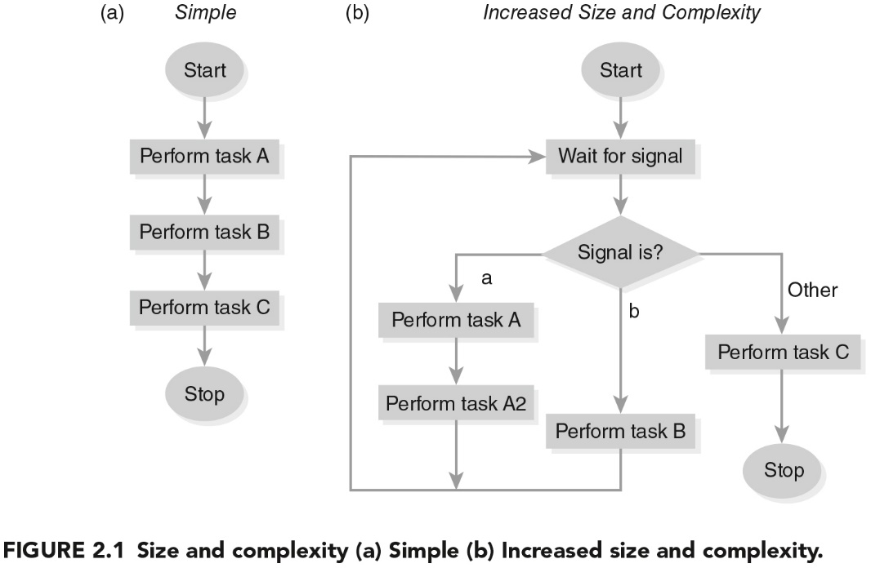
Example of Size and Complexity Increases

Slide 15
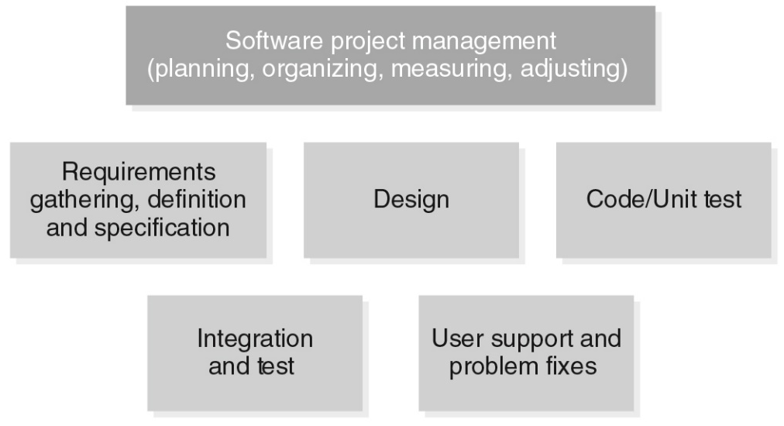
Task Breakdown (Macro) Example (Handling Complexity)
Who performs what task?
How is the task completed with what technique or tool?
When should which task start and end?
Who should coordinate the people and the tasks?

Slide 16
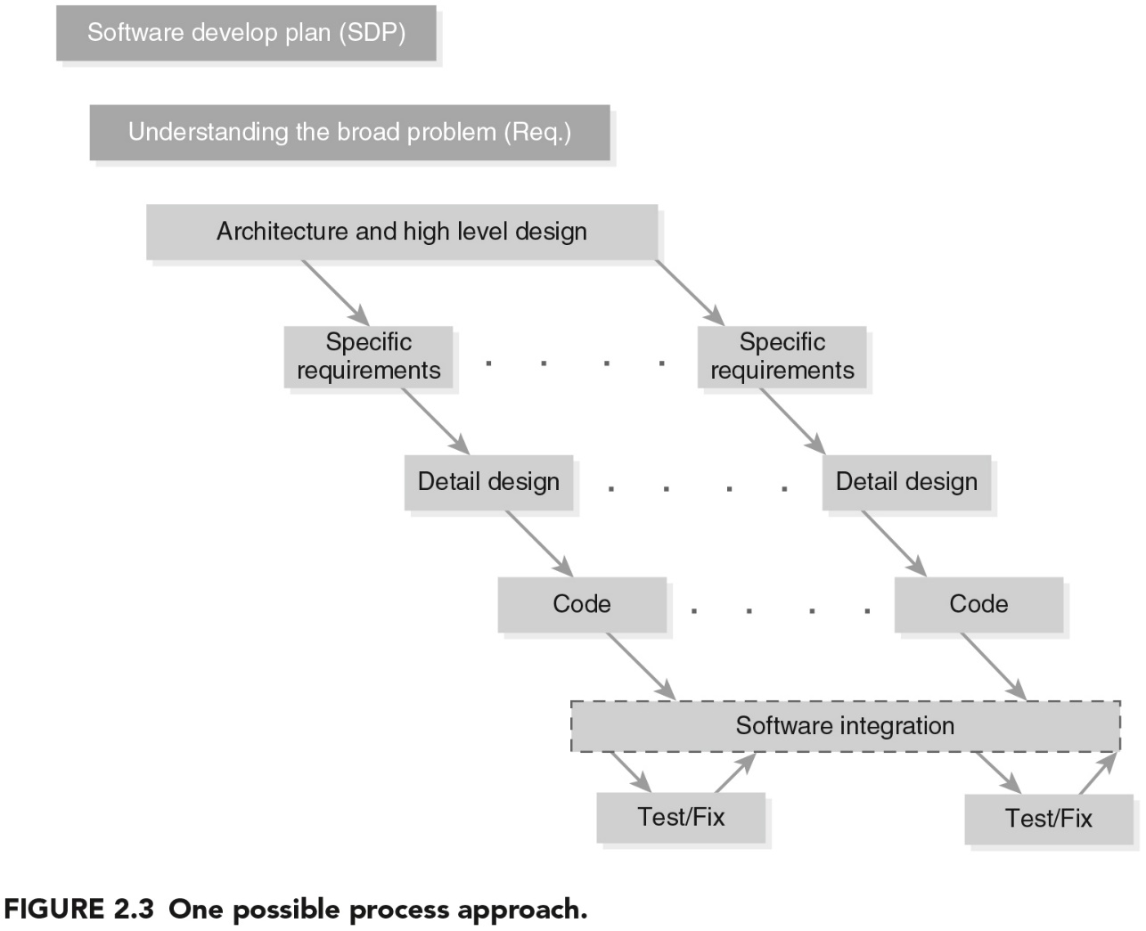
Iterative Process Example (Handling Complexity)

Slide 17
Handling the “Details” Separately
Seemingly “simple” test/fix and Integrate steps:
Should there be separate and independent test group?
How should problem be reported and to whom?
How much information must accompany a problem report?
Who decides on the priority of the problem?
How is the problem fix returned?
Should all problems be fixed?
What should we do with non-fixed problem?
How are fixes integrated back to the system?

Slide 18
Some “Non-technical” Considerations for Developing and Supporting a System (requiring more effort, more resources, etc.)
Effort and schedule expansion
  How does one estimate and handle this?
Assignment and communications expansion?
  Do we need some process?
  Do we need some tools?

Slide 19
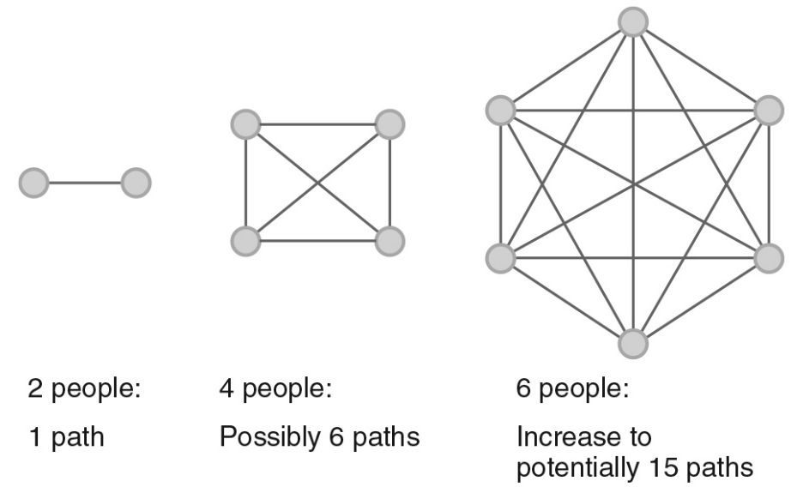
With the increase in system complexity, there is a corresponding increase in the “manpower” or human resources
For n people, number of potential communications paths
= ∑ (n-1) = [n x (n-1)] / 2
Critical Impact: More communication paths lead to more opportunities for miscommunication, errors, and coordination failures.

Slide 20
Key Process Questions
People & Roles
Who performs each task?
What are the skill requirements?
How do roles interact?
Coordination & Timing
When should tasks start/end?
What are the dependencies?
How do we manage overlaps?

Slide 21
Complexity vs. Software product quality?
complexity vs. Software dev. effort ?
What type of “relationship” can we expect?
Complexity
?
Complexity
?
Software Product Quality
Software Development Effort
Think about apps that you use and observed changes over the years
Give an example of an increase in software size
Give an example of an increase in complexity
Discuss which type of increase, in your view, is more difficult to handle

Slide 22
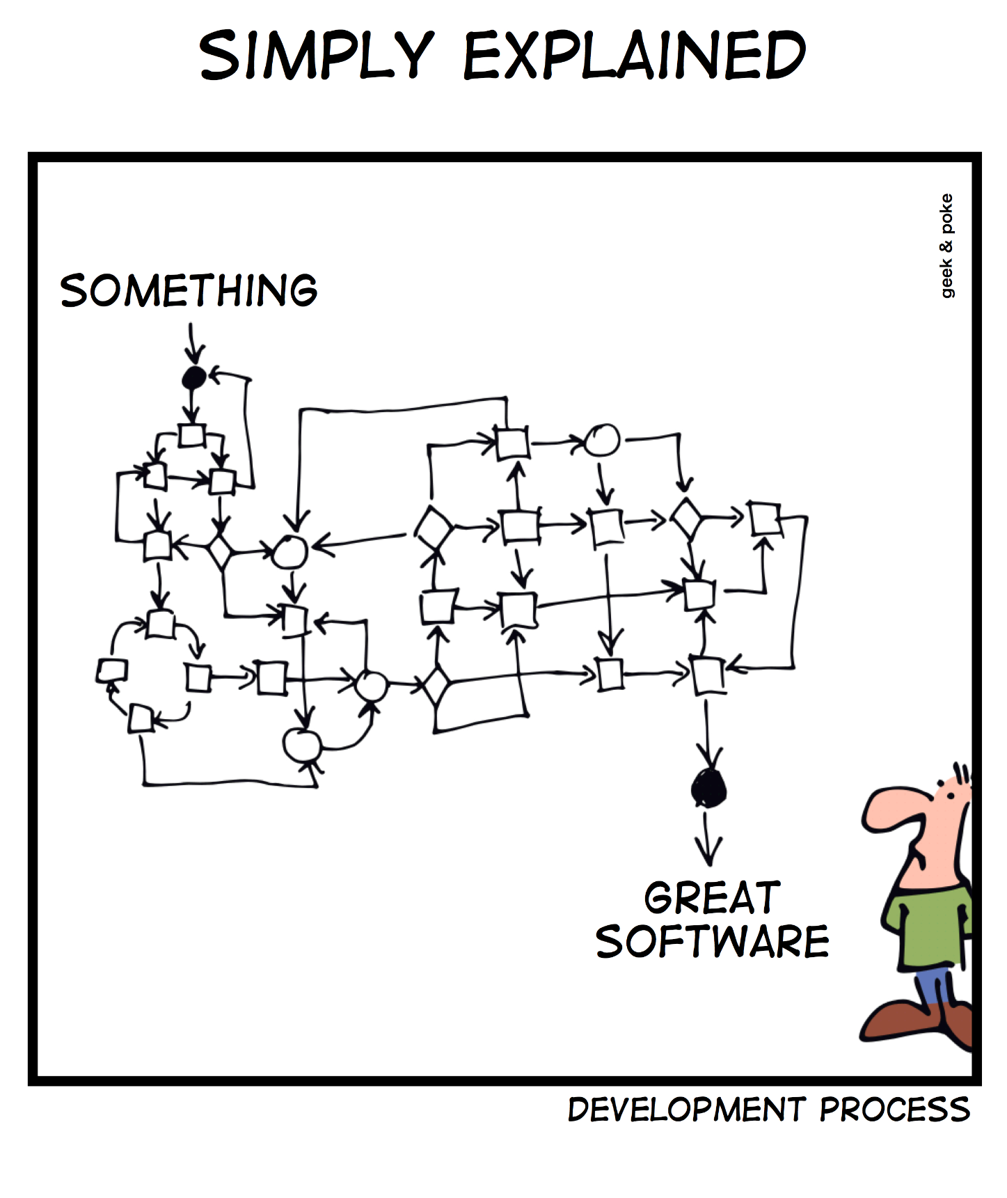

Slide 23
A Large, Complex System (e.g. payroll system)
Building “mission critical” or “business critical” system requires (1) several separate activities performed by (2) more than one person (e.g. 50 ~ 100):
  Requirements: gathering, analysis, specification, and agreement
  Design: abstraction, decomposition, cohesion, interaction, and coupling analysis
  Implementation: coding and unit testing
  Integration and tracking of pieces and parts
  Separate testing: functional testing, component testing, system testing, and performance testing
  Packaging and releasing the system

Slide 24
Requirements of the Payroll System
Everyone has some idea of what a payroll system is
Q: “What core functions must a payroll system have?”
Discuss.

Slide 25
Requirements of the Payroll System
Add, modify, and delete the names and associated personal information of all employees.
Add, modify, and delete all the benefits associated with all employees.
Add, modify, and delete all the tax and other deductions associated with all employees.
Add, modify, and delete all the gross income associated with all employees.
Add, modify, and delete all the algorithms related to computing the net pay for each employee.
Generate a paper check or an electronic direct bank deposit for each employee.
Requirements phase is time-consuming, team-based, and ~15% of all defects come from errors here.

Slide 26
Designing the Payroll System
Once the requirements of the payroll system are understood and agreed to, the system must still be designed
Q: “How should the functions be grouped for easier development?”
Think how to design that:
Provides some design cohesiveness within the component
Matches the business flow and the payroll processing environment
Provides a potential assignment of work by components
Allows easier packaging of the software by components

Slide 27
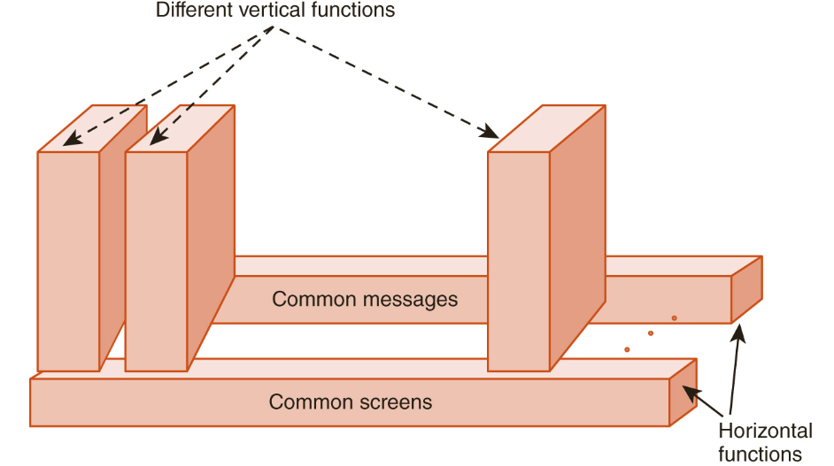
Designing the Payroll System
Payroll Administration
Payroll Processing
Exceptions Handling
Interfaces (banks, remote sites)

Slide 28
Code and Unit Testing the Payroll System
Q: “Why test modules individually before combining them?”

Slide 29
Code and Unit Testing the Payroll System
Precise layout of the screen interface in some language
Precise functional processing logic in some programming language
Precise data access and storage logic in some language
Precise interface logic in some language
Q: “Why test modules individually before combining them?”
Prevents small errors from spreading; enforces coding standards; ensures consistent error messages.

Slide 30
Integration and Functionally Testing the Payroll System
Q: “When should integration happen—at the end or continuously?”

Slide 31
Integration and Functionally Testing the Payroll System
Q: “When should integration happen—at the end or continuously?”
It depends, but Continuous Integration preferred → faster error detection, smoother builds.

Slide 32
Release, Support and Maintenance of the Payroll System
Q: “Does the system’s life cycle end at release?”
Think about 3-4 factors that should be considered

Slide 33
Release, Support and Maintenance of the Payroll System
Q: “Does the system’s life cycle end at release?”
Points to think about:
Number of expected users and customers
Number and type of known problems that existed at release time
Projected number of problems that will be discovered by users
Amount of user training
Amount of support personnel training
Number of development personnel committed to support the system
Expected number of problem-fix releases and future functional releases
A group to answer and handle system usage and simple problem work-arounds
A group to fix difficult problems and implement future enhancements

Slide 34
Release, Support and Maintenance of the Payroll System
Q: “Does the system’s life cycle end at release?”
No. Maintenance (bug fixes, enhancements, user support) continues indefinitely.

Slide 35
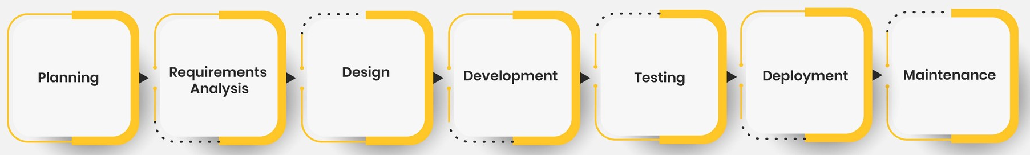
Question
Looking at this flow, where do you think most project risks occur?

Slide 36
Coordination Efforts Required in Systems Development and Support
Because there are i) more parts, ii) more developers, and iii) more users to consider in “large systems” than a single program developed by a single person for a limited number of users, there is the need for coordination of the 3P’s:
“Processes” and methodologies to be used
Final “product” and intermediate artifacts
“People” (developers, support personnel, and users)

