Slide 1
Lecture 4: Theories of Software Engineering
Mia Mohammad Imran

Slide 2
Today’s agenda
Theories of software engineering discipline
  Success/Failure Criteria
  Code of Ethics
  Principles and foundation concepts

Slide 3
So far, we have talked about…
A bit history of Software Engineering as a discipline
How to “build a program” and how it is different from building a software
How to “build a system”

Slide 4
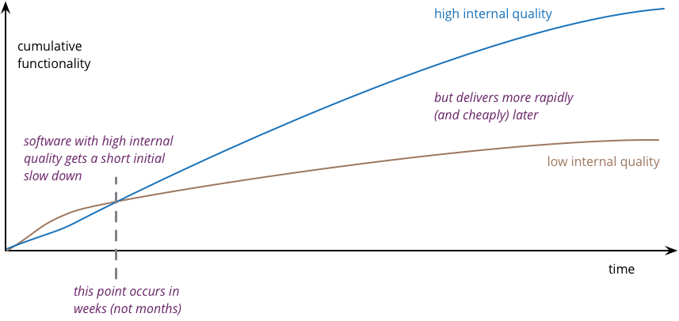
Answer to Quiz of 09/02

Slide 5
Software Project Failures: The Reality
CHAOS Report (1995) - Standish Group
365 Companies surveyed
Industries Studied:
Banking and Finance
Manufacturing
Retail
State and Local Government
Healthcare
Only 16% Projects Succeed
  Deliver on time
  Deliver to budget
  Outcome satisfactory to the customer
84% projects failed!
  Challenged (late, over budget, reduced scope): 52.7 %
  Outright Canceled: 31.1 %

Slide 6
Software Project Failures: The Reality
CHAOS Report (2009)
32 % of projects succeeded (on time, on budget, with satisfactory results)
44 % were challenged (over budget/time or incomplete)
24 % failed outright
CHAOS Report (2021)
29 % of projects succeeded (on time, on budget, with satisfactory results)
52 % were challenged (over budget/time or incomplete)
19 % failed outright

Slide 7
Software Project Failures: The Reality
Key Finding: The same mistakes continue to be repeated - many software project failures are not well investigated, leading to recurring problems.

Slide 8
Software Project Failures - Bug Origins
Distribution of Software Errors by Origin (Jones, 2008)
38.33%
Code Errors
24.17%
Design Errors
13.33%
Documentation Errors
12.50%
Requirements Errors
11.67%
Bad-fix Errors

Slide 9
Top Failure Factors
37% of failures attributed to top 3 reasons
36% of cancellations due to top 3 reasons
Lack of user input
Incomplete requirements and specifications
Changing requirements and specifications
Incomplete requirements
Lack of user involvement
Lack of resources

Slide 10
Top Success Factors (Chaos Report - 1994)
User Involvement: Active participation of end users throughout the development process
Executive Management Support: Strong leadership commitment and resource allocation
Clear Requirement Statements: Well-defined, unambiguous project requirements
Proper Planning: Comprehensive project planning and realistic scheduling
Key Insight: Notice the pattern: Requirements and User Involvement appear in both success and failure factors - they are critical!

Slide 11
Chaos Report - 2021 - Takeaway
Takeaway 1 - people make projects successful
  The Good Team
  The Good Sponsor
  The Good Place
Takeaway 2 - small Agile projects are more successful than large Waterfall
Takeaway 3 - skills, tooling, and clarity and completeness of requirements are not indicators of success
Takeaway 4 - if you fix one thing, fix your decision latency
  If we were to identify one root cause of software project failures it would be slow decision latency

Slide 12
Software Engineering Profession & Ethics
Traditional Engineering:
  Has Professional Engineer (PE) certification with work experience, training, and examinations
Software Engineering:
  1998: Texas Board of Professional Engineers adopted software engineering as distinct discipline
  Still developing - anticipated to take time before actual licenses granted

Slide 13
Software Engineering Profession & Ethics
Traditional Engineering:
  Has Professional Engineer (PE) certification with work experience, training, and examinations
Software Engineering:
  1998: Texas Board of Professional Engineers adopted software engineering as distinct discipline
  Still developing - anticipated to take time before actual licenses granted
Why Ethics Matter: Software is Critical:
Valuable intellectual property - millions stolen yearly
Key role in all life dimensions - finance, health, safety
Professional responsibility - ensure no harm to society
Justice Department priority - specialized prosecution team for IP crimes

Slide 14
Why Ethics Matter
Hypothetical Case: An autonomous vehicle (self-driving cars) made by Company X (let’s assume it’s not Elon Musk's X) crashes, injuring a pedestrian. Investigation shows the machine learning model made a decision based on biased data — it prioritized avoiding larger vehicles over pedestrians.
Discussion Questions:
Who is ethically responsible: the software developers, the company, or the users?
Should the software be required to explain its decisions ("explainable AI") in critical situations?
How should ethical decision-making be programmed in life-or-death scenarios (e.g., the "trolley problem")?

Slide 15
Why Ethics Matter
Hypothetical Case: A student developer uploads a tool on GitHub that allows users to bypass the licensing system of a popular paid software. The Justice Department charges them with software piracy and IP theft.
Discussion Questions:
Should intent (e.g., educational vs. malicious) affect the legal or ethical judgment?
How can educational environments teach students about the real-world consequences of IP violations?
Is the justice system fair in how it treats IP crimes compared to physical theft?

Slide 16
Why Ethics Matter
Hypothetical Case: A startup reverse-engineers a competitor’s proprietary algorithm for real-time translation and integrates it into their product without permission.
Discussion Questions:
Is it ever ethical to use reverse engineering to compete in the market?
What if the competitor was using a monopoly to restrict access to vital technology?

Slide 17
Why Ethics Matter
Hypothetical Case: A startup reverse-engineers a competitor’s proprietary algorithm for real-time translation and integrates it into their product without permission.
Discussion Questions:
Is it ever ethical to use reverse engineering to compete in the market?
What if the competitor was using a monopoly to restrict access to vital technology?

Slide 18
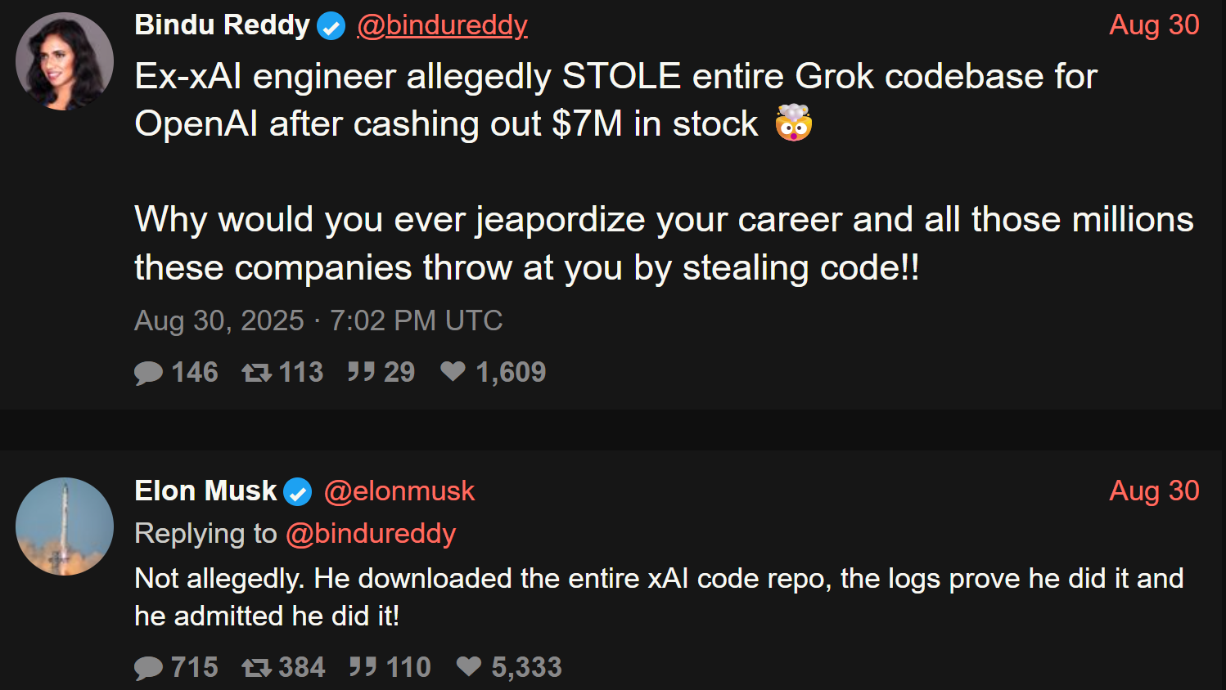
Why Ethics Matter
Why would you even risk yourself for billionaires that don’t even blink an eye to fire you?

Slide 19
IEEE-CS/ACM Code of Ethics
Integrity and ethical conduct
Respect and fair treatment
Avoid harm to others
Advance technology understanding
Accept and give criticism
Maintain professional competence
Disclose conflicts of interest
Reject all forms bribery
Support ethical colleagues
Promote sustainability practices
https://www.ieee.org/about/corporate/governance/p7-8
https://www.acm.org/code-of-ethics

Slide 20
Practical Professional Behavior
Core Ethical Guidelines (influenced by IBM values):
Respect others and strive for fairness
Perform to one’s best capability
Follow the law
Key Idea: Apply respect, fairness, capability, and law-abiding conduct before making judgments or taking actions.

Slide 21
Davis's 15 Principles of Software Engineering (1994)
Make quality number 1
High-quality software is possible
Give products to customers early
Determine the problem before writing the requirements
Evaluate design alternatives
Use an appropriate process model
Use different languages for different phases
Minimize intellectual distances
Put techniques before tools
Get it right before you make it faster
Inspect code
Good management is more important than good technology
People are the key to success
Follow with care
Take responsibility
Are these consistent within themselves?
How “key” is “people are key to success”?
What do you think?
13/15 deal with
“process”/“technique”

Slide 22
Royce's 10 Modern Principles (1998)
Architecture first approach Example:
Before coding begins, the team defines a high-level architecture:
A microservices backend
RESTful API layer
Web and mobile frontends
OAuth2 for authentication
Helps identify critical components and integration points early
Architecture first approach
Iterative life cycle process—address risk early
Component Based Approach
Change Management system
Use round-trip engineering
Model Based Evolution
Objective Quality Control
Evolving levels of details
Establish a configurable process
Demonstration Based approach
Component Based Approach Example:
The app is built from reusable components:
Authentication service
Transaction processing module
Notification system
These can be independently developed, tested, and reused in future projects
How many deal with
“process”/“technique”?

Slide 23
Wasserman's 8 Fundamental Concepts (1996)
Abstraction (a form of simplification)
Analysis and design methods and notation
User interface prototyping
Modularity and architecture
Reuse
Life cycle and process
Metrics
Tools and integrated environment
How many deal with
“process”/“technique”?
How do they relate to the earlier listed principles from Davis or Royce?

Slide 24
Question for some Upcoming Topic
How many of you are familiar with “Git”?
Used GitHub, GitLab, etc?
How many of you are familiar with “Code Review”?
How many of you are familiar with “JIRA” or “Trello”, or “GitHub Projects”?
How many of you are familiar with “Unit Testing”?

