Slide 1
Lecture 5: SDLC Basics
Mia Mohammad Imran

Slide 2
Today’s agenda
Moving from Theory to Practice: SDLC Basics

Slide 3
Some possible answer to last class’s question
Who Is Liable in a Self-Driving Car Accident? https://www.brumleylawfirm.com/who-is-liable-in-a-self-driving-car-accident/
Self-Driving Car Accidents: Who’s at Fault in Missouri? https://www.hoffmannpersonalinjury.com/self-driving-car-accidents-whos-at-fault-in-missouri/

Slide 4
Wasserman's 8 Fundamental Concepts (1996)
Abstraction (a form of simplification): Abstraction in Object-oriented programming
Analysis and design methods and notation: UML, ER Diagram, etc
User interface prototyping: making a rough draft of the screens (pages, buttons, menus, etc.) of an app or software before building the actual product
Modularity and architecture: Web app with front-end, back-end, database, all separated but interacting via APIs.
Reuse: Using open-source libraries; Creating reusable functions or services
Life cycle and process: Common Life Cycle Models: Waterfall, Agile, etc
Metrics: Line of Code (LoC), Bug density, Code complexity, Test coverage
Tools and integrated environment: Git, IDEs, Maven/Gradle, JUnit, etc

Slide 5
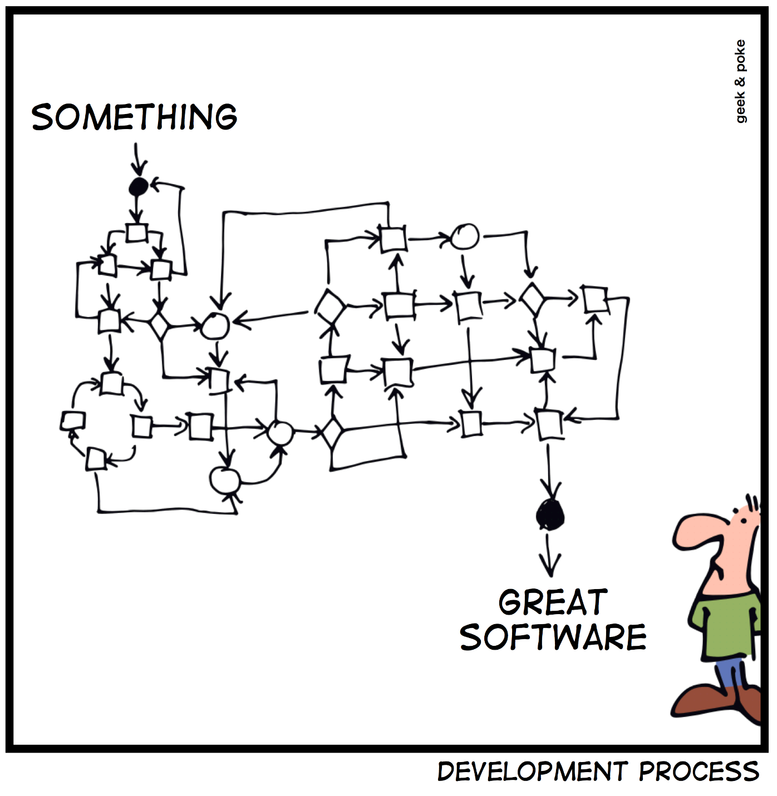
From Theory to Practice: Software Engineering Reality
The Development Challenge
How do we turn something complex into great software?
🤔 → ⚡ → ⭐

Slide 6
From Theory to Practice: Software Engineering Reality
The Development Challenge
How do we turn something complex into great software?
🤔 → ⚡ → ⭐
Client Side Controls
Cost - Budget constraints
Functionality - What it should do
Time - When it's needed
Tech Side Controls
Process - How we build it
Product - What we deliver
People - Who builds it
Key Insight: Software has two sides that must communicate effectively – this is where structured processes become essential!

Slide 7
The Reality of Software Teams
Team Effectiveness = Project Success
Key
Communication is essential for team coordination
Complex
Teams can be clients to other teams
Example: Backend API team can be client to authentication server team – internal client-vendor relationships require clear processes!

Slide 8
The Reality of Software Teams
Question:
Communication Processes: How do software developers communicate?

Slide 9
The Reality of Software Teams
Communication Processes
Documentation
Written specs, requirements, and guidelines
Code Review
Peer review of implementation quality
Code Comments
In-line documentation and explanations
Tooling
Shared development and communication tools
Handoffs
Formal transition between phases/teams

Slide 10
Software as a “cycle” of life: Everything Evolves
Teams
Formation → Operation → Evolution → Distribution
People
Junior → Senior → Lead → New Ventures
Projects
MVP → Production → Evolution/Maintenance
Reality Check:
Rarely is everything built from scratch
Extending others' work is essential
Complexity becomes critical at scale
Critical Factors for Success
Scale: Complexity → Knowledge Gaps → System Boundaries
Legacy: Code Inheritance → System Evolution → Integration

Slide 11
Software Development Life Cycle (SDLC)
It’s a Process
Purpose
Lead to good software
Reduce risk
Enable visibility and measurement
Enable teaming
Key attributes
Outcomes/results of processes are key deliverables or products
Roles are clear
Pre and post conditions are understood and held true

Slide 12
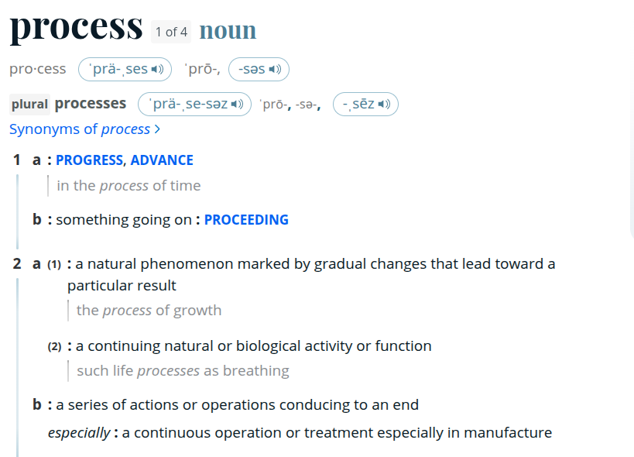
Process

Slide 13
Think of it as Building a House
You wouldn't start building a house by ordering windows first:
You need blueprints (Planning)
You check the soil and regulations (Analysis)
You create detailed plans (Design)
You build it (Implementation)
You inspect it (Testing)
You hand over the keys (Deployment)
You maintain it (Maintenance)

Slide 14
Planning aka The "Coffee Meeting" Phase
Determine project goals, scope, and feasibility.
Identify stakeholders and gather initial requirements.
Deliverables: Project plan, budget estimation, and timeline.

Slide 15
Planning aka The "Coffee Meeting" Phase
Interactive Exercise: Form groups of 2-3 and plan for an app in 4-5 minutes! Consider:
Target audience
Basic features
Resources needed
Potential risks

Slide 16
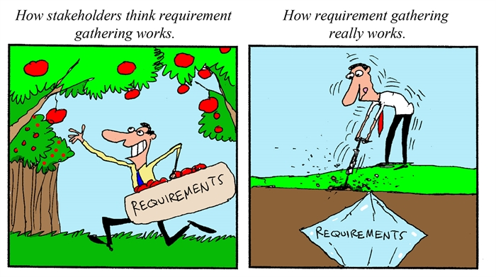
Requirements Analysis aka "Detective Work"
Gather and document detailed functional and non-functional requirements.

Slide 17
Requirements Analysis aka "Detective Work"
Gather and document detailed functional and non-functional requirements.
Collaborate with stakeholders to ensure clarity.
Deliverables: SRS (Software Requirements Specification)
How companies like Uber, Doordash, Spotify, etc, do it:
User interviews
Usage pattern analysis
Competitor research
Market trends study

Slide 18
Requirements Analysis aka "Detective Work"
Identify 3 features of your favorite app
Why are they your favorite features?

Slide 19
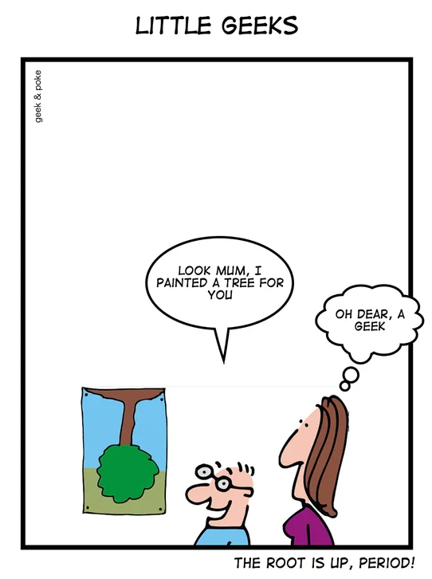
Design aka "Architect's Dream"
Deliverables: UML diagrams, database schema, and interface designs
Technical design
UX/UI design

Slide 20
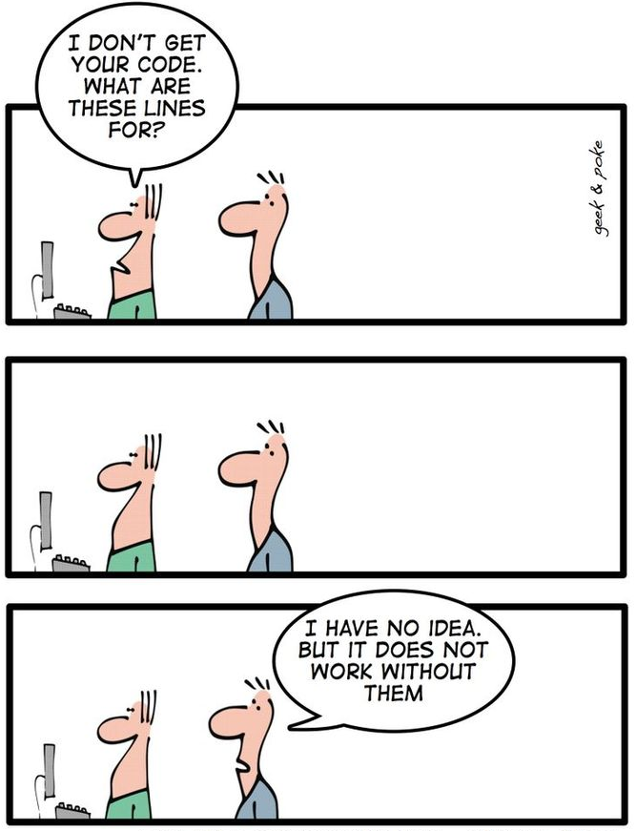
Implementation aka The "Builder's Paradise" Phase
Implementation = Coding.
Focus on modularity, readability, and testing during development.
Deliverables: Source code and build versions.

Slide 21
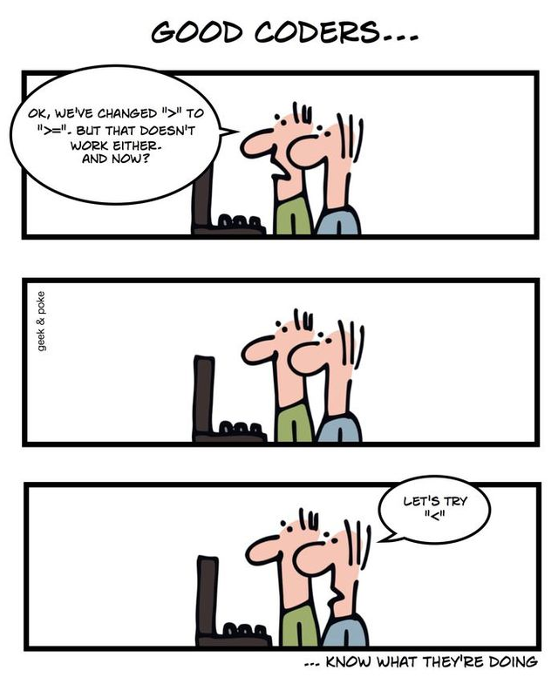
QA aka "Quality Control"
Identify and fix bugs to ensure functionality and performance.
Types of testing: Unit, integration, system, and user acceptance.
Deliverables: Test cases and reports.

Slide 22
Deployment aka The "Launch Day"
Release the software to production or target environments.
Implement monitoring and feedback mechanisms.
Deliverables: Deployed application and deployment scripts.

Slide 23
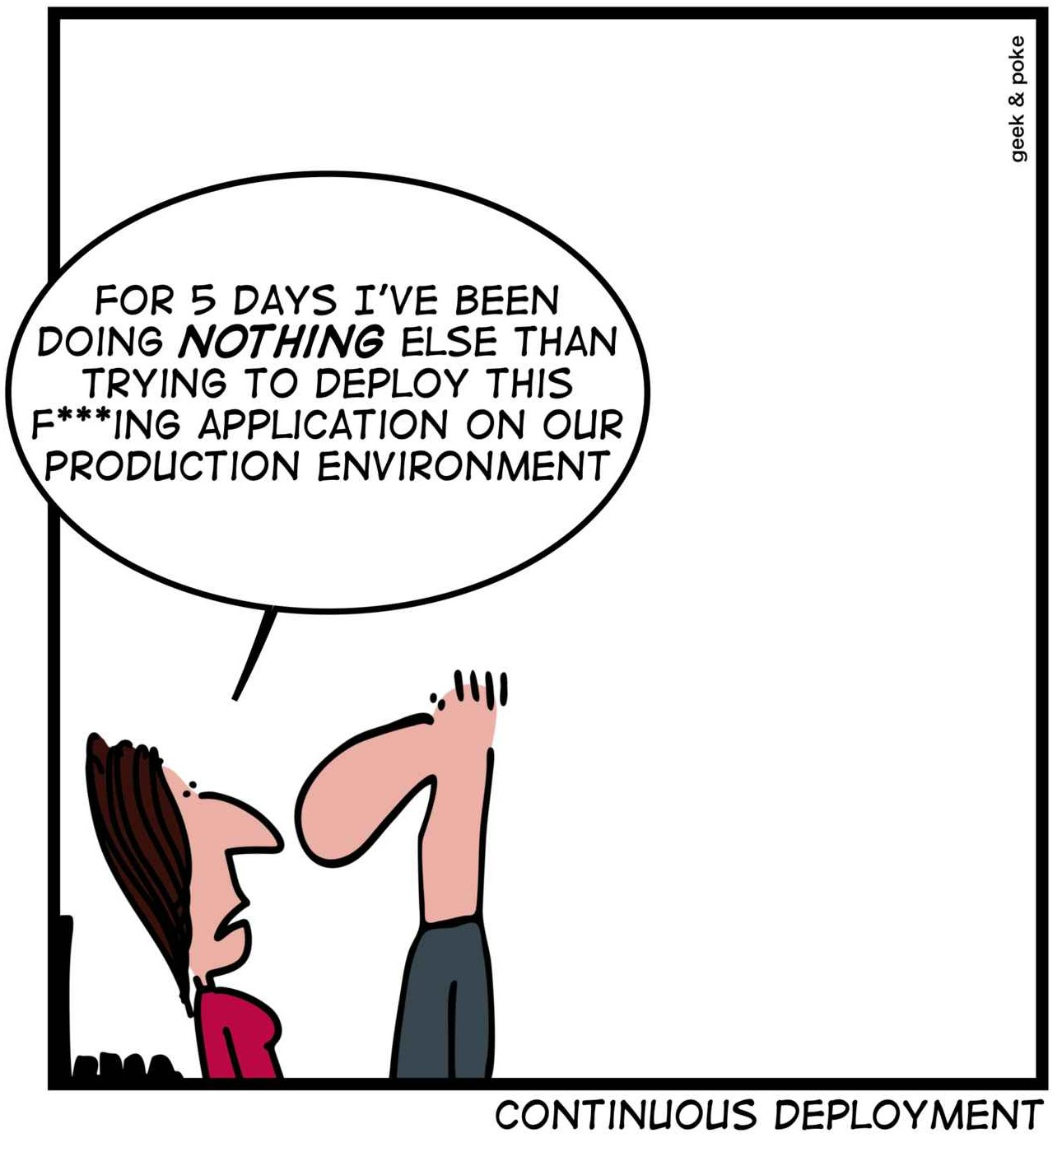
Deployment aka The "Launch Day"
Tips for Smooth Deployment
Have a rollback plan
Deploy in phases
Monitor everything
Keep your fingers crossed (kidding!)

Slide 24
Deployment aka The "Launch Day"
Case Study: Pokemon Go Launch
15 million downloads in the first week
Servers crashed worldwide
Lesson: Always prepare for success (and disappointment when it crashes during demo!)

Slide 25
Maintenance aka The "Garden Care" Phase
What's the oldest app on your phone?
Why have you kept it so long?
Fun Fact: About 50% of development time is spent on maintenance (not so fun)!

Slide 26
SDLC Models
Waterfall: The disciplined martial artist
Agile: The street-smart boxer
Spiral: The cautious strategist
V-Model: The perfectionist
We will talk some of those in the next classes

Slide 27
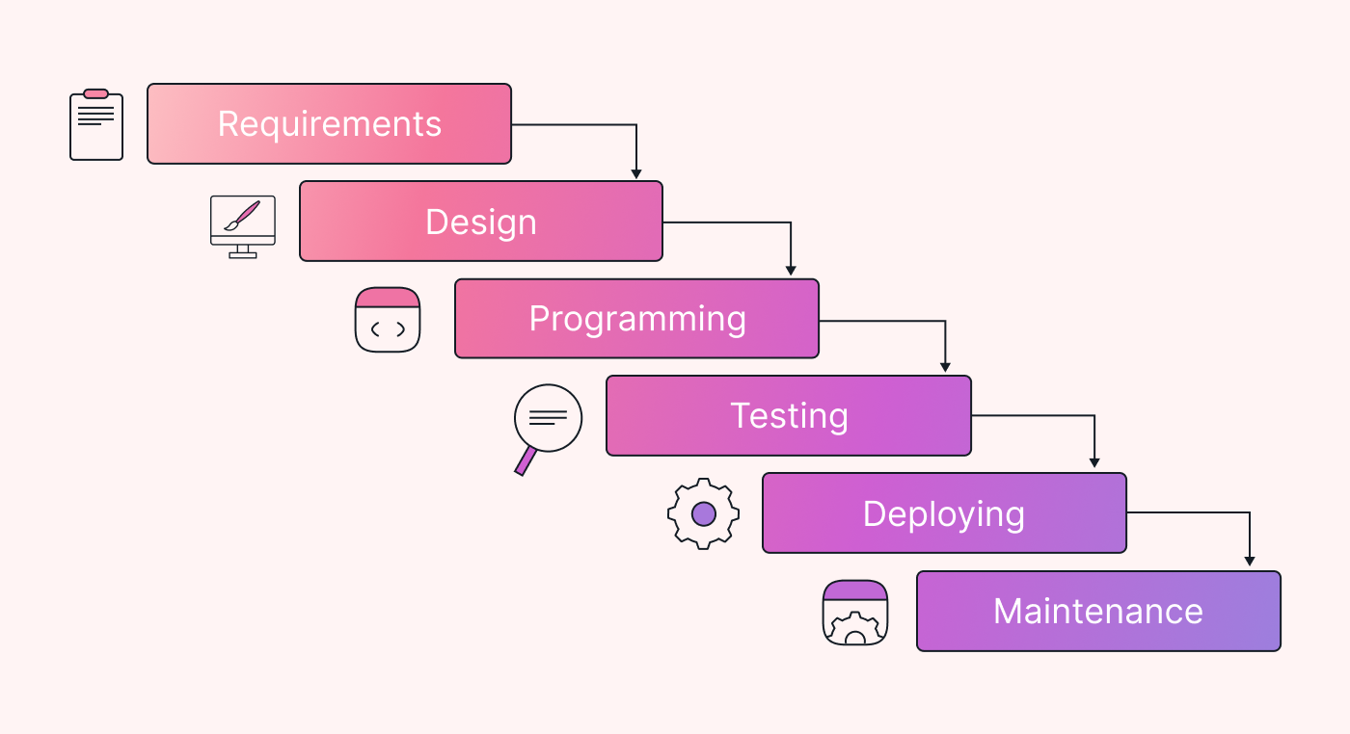
Waterfall Model

Slide 28
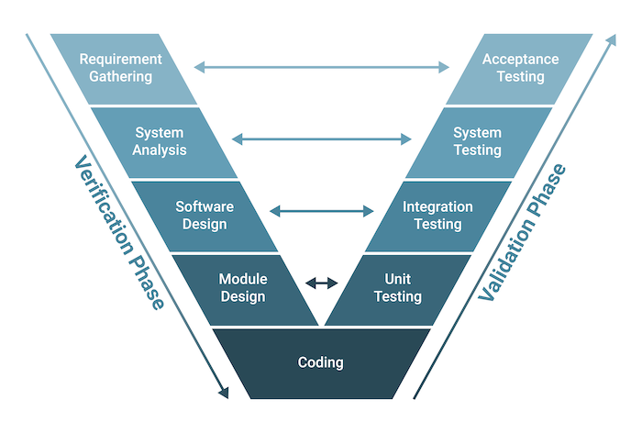
V-Model

Slide 29
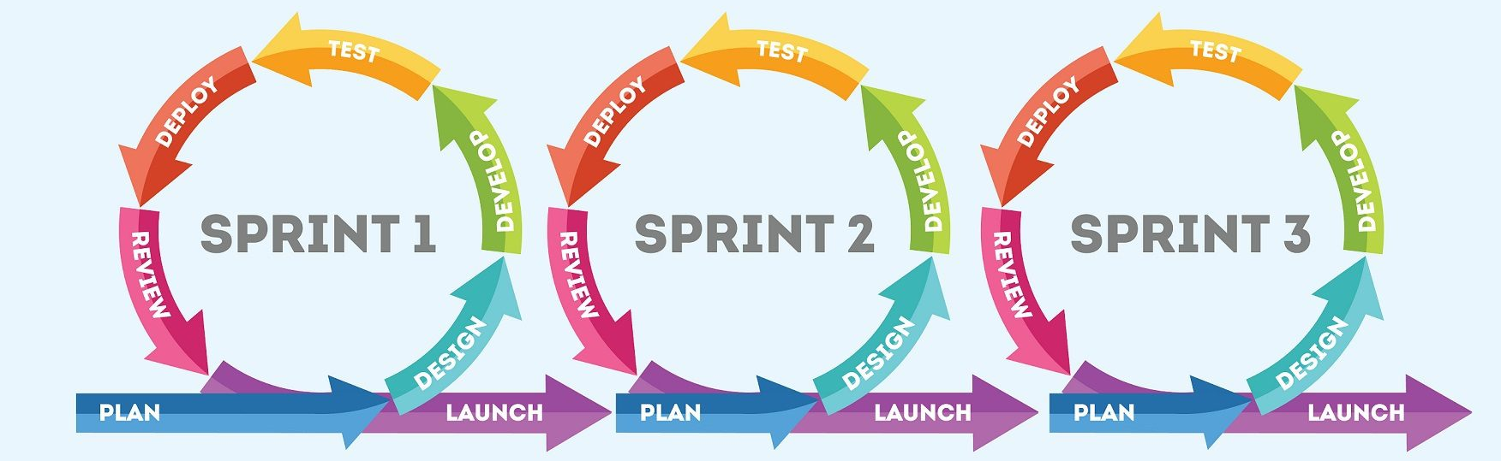
Agile

Slide 30
Success Stories
Discord (2015): From gaming chat to community platform
Canva (2012): Simple yearbook design tool
Slack (2013): Internal tool becomes communication giant
Shopify (2006): From selling snowboards to empowering businesses

Slide 31
Discord's SDLC Approach
Initial Development Model: Agile with rapid iterations
Key SDLC Characteristics:
Continuous deployment with multiple releases per day
Heavy focus on user feedback and metrics
Feature flags for controlled rollouts
Real-time monitoring and quick fixes
Notable Practices:
Started with gaming-specific features
Gradually expanded based on user behavior
Uses canary deployments to test changes
Strong emphasis on performance metrics

Slide 32
Slack's SDLC Approach
Development Model: Agile with strong QA focus
Key SDLC Characteristics:
Internal-first development
Heavy emphasis on reliability
Extensive testing infrastructure
Regular feedback loops
Notable Practices:
Started as internal tool
Strong focus on search functionality
Extensive integration testing
Regular security audits

Slide 33
Common Success Factors
User-Centric Development: Prioritized user feedback and data-driven decisions
Iterative Approach: Started with core features, regular small updates
Technical Excellence: Strong focus on reliability and performance
Scalable Architecture: Built for growth from the beginning

Slide 34
Real-World SDLC Failure Story - HealthCare.gov
Initial Release: October 1, 2013
Issues:
Crashed within 2 hours
Only 6 people could enroll on day 1
Cost: $1.7 billion
What Went Wrong:
Inadequate Testing: Insufficient load and integration testing
Poor Requirements: Unclear specifications and changing requirements
Integration Issues: Multiple systems didn't work together
Timeline Pressure: Political deadlines overrode technical readiness
Lack of User Testing: No real-world usage scenarios tested
Key Insight: Skipping proper SDLC phases can be catastrophic!

Slide 35
