Slide 1
Lecture 6: Overview of Git
Mia Mohammad Imran

Slide 2
Today’s agenda
Overview of Git

Slide 3
Concepts
┌──────────────┐ ┌──────────────┐
│ local │ push ─> │ remote │
│ repo │ <- pull │ repo │
└──────────────┘ └──────────────┘
check │ ↑↓ commit / reset
out │ ┌──────────────┐
│ │ staging area │
│ └──────────────┘
▽ ↑↓ add / restore
┌──────────────┐
│ working tree │
│ . │
│ ├── go.mod │
│ └── main.go │
└──────────────┘
Guideline: https://antonz.org/git-by-example/

Slide 4
Basic Commands: Setup & Basics
git init → Initialize a repository
git clone <url> → Copy a remote repo
git config user.name "Name"
git config user.email "email@example.com"

Slide 5
Basic Commands: Working with Files
git status → Show repo status
git add <file> → Stage file
git commit -m "Message" → Save snapshot
git diff → Show unstaged changes

Slide 6
Basic Commands: Branching
git branch → List branches
git branch <name> → Create branch
git checkout <name> → Switch branch
git merge <branch> → Merge branch

Slide 7
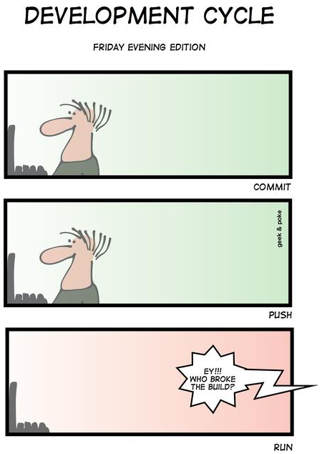
Basic Commands: Remote Repositories
git remote -v → List remotes
git fetch → Download updates
git pull → Fetch + merge updates
git push → Upload changes

Slide 8
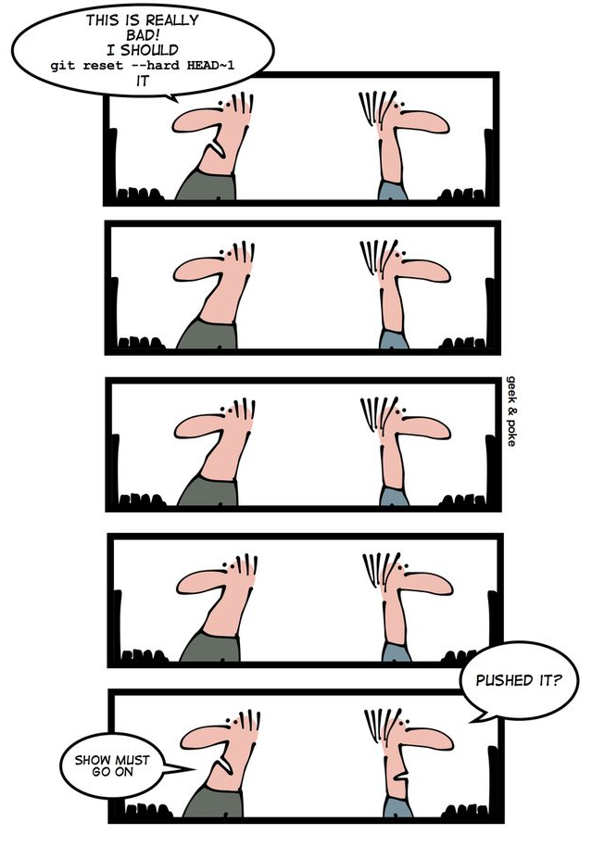
Basic Commands: Undo & Clean Up
git reset <file> → Unstage file
git checkout -- <file> → Discard changes
git revert <commit> → Undo commit safely
git log --oneline → View history

Slide 9
Git Initialization
# Create an empty repo:
git init
# Set user name and email for the repo
# (they are required):
git config user.email imranm@mst.edu
git config user.name "Mia Mohammad Imran"
# Use the --global flag to set the name and email
# at the OS user level instead of the repo level.
# Show user and repo configs:
git config --list --show-origin

Slide 10
Git Clone
Project: https://github.com/imranraad07/cs4090-git-demo
git clone git@github.com:imranraad07/cs4090-git-demo.git

Slide 11
Adding a file
echo "git is awesome" > message.txt
git add message.txt

Slide 12
View changes in the staging area
Commit to the local repo
Showing current status
Showing logs
git diff --cached
git commit -m "add message"
git status
git log

Slide 13
Show specific commit
Show the last commit contents:
git show HEAD
Show the second-to-last commit:
git show HEAD~1
Use HEAD~n to show the nth-before-last commit or use the specific commit hash instead of HEAD~n.

Slide 14
Git Workflow Essentials: Branch and merge
Branch
Create a parallel line of development.
Used to isolate features, bug fixes, or experiments.
git branch <name> or
git checkout -b <name>
Merge
Integrates changes from one branch into another.
Preserves full history and creates a merge commit.
git merge <branch>
Rebase
Rewrites commit history by placing your changes on top of another base.
Makes history linear and cleaner.
git rebase <branch>
Squash
Combines multiple commits into a single commit.
Useful before merging to keep history tidy.
git rebase -i <base> → choose squash (for Interactive Rebase)
git merge --squash <branch> (for Merge Squash)
Cherry-pick
Apply a specific commit from one branch onto another.
Useful for selective fixes or features.
git cherry-pick <commit-hash>

Slide 15
Branch and merge
Show branches:
git branch
Create and switch to a new branch:
git branch hellopython
git switch hellopython
Show branches (the current one is hellopython):
git branch

Slide 16
Add and commit a file to the new branch
echo "print('git is awesome')" > awesome.py
git add awesome.py
git commit -m "awesome.py added"

Slide 17
Merge
Switch to master branch and then merge:
git switch master
git merge hellopython
You can also do checkout:
git checkout master
git merge hellopython

Slide 18
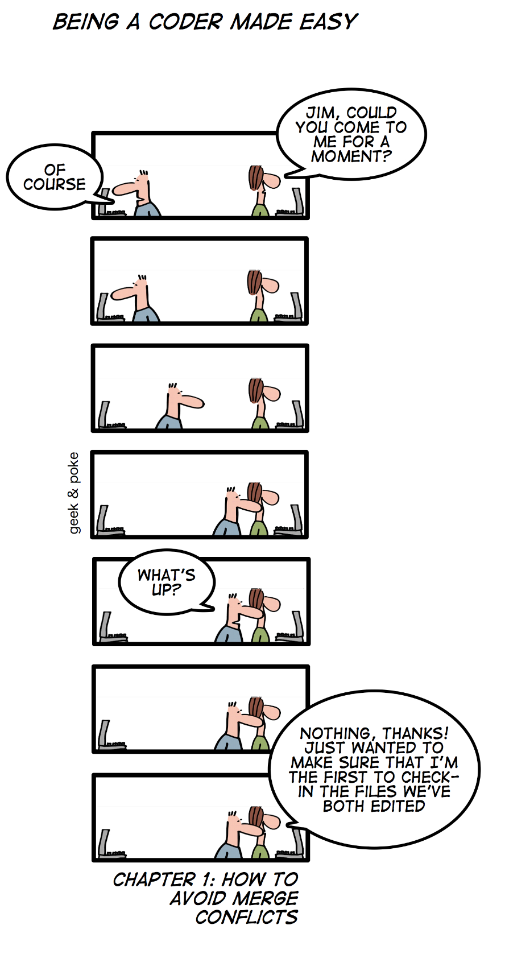
Merge Conflict
Two branches modify the same line of code in a file.
One branch deletes a file while the other modifies it.
Changes overlap in a way that Git cannot decide which version is correct.
<<<<<<< HEAD
print("Hello World")
=======
print("Hi World")
>>>>>>> feature
HEAD = your current branch’s version
feature = the other branch’s version

Slide 19
How to Resolve
Open the file, review both versions
Decide which change to keep (or merge both)
Edit the file to the final version you want
Mark as resolved
git add <file name>
git commit -m “merge conflict fixed”
git push origin <branch name>
Merge conflicts are not errors in Git. They are simply places where Git needs human judgment to decide the correct result.

Slide 20
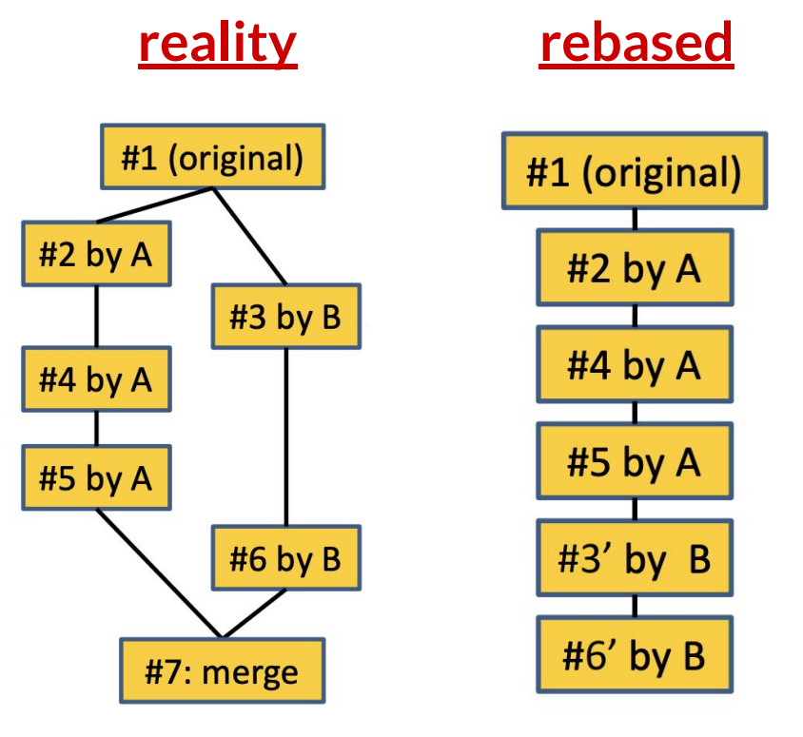
Rebase
git rebase hellopython
rebase rewrites history

Slide 21
Squash
git log --all --oneline --graph
git switch hellopython
Combine all hellopython changes into a single commit in the working directory:
git merge --squash master
Switch back to the master branch:
git switch master

Slide 22
Cherry-pick
I have a typo in message.txt:
cat message.txt
And I accidentally fixed it in the hellopython instead of master:
git log --all --oneline --graph --decorate
I'm not ready to merge the entire hellopython branch, so I will cherry-pick the commit:
git cherry-pick <hash>
cherry-pick applied the comment to the main branch:
git log --all --oneline --graph --decorate
The typo is fixed:
cat message.txt

Slide 23
Pull Requests
What is a Pull Request?
A request to merge code from one branch to another
Used for collaboration & code review

Slide 24
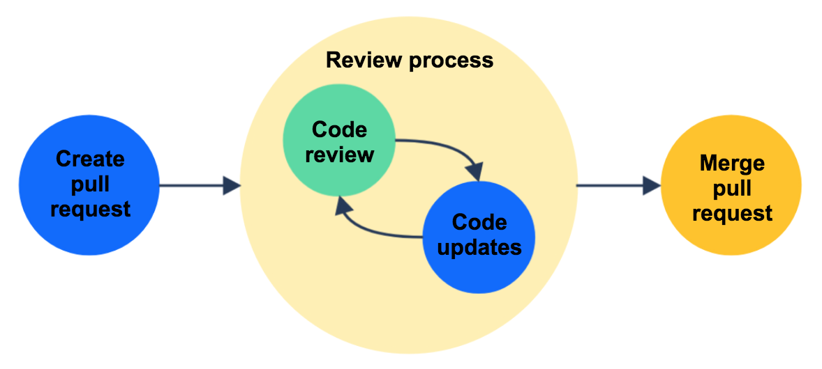
Pull Request Workflow
Create a feature branch
Commit & push changes
Open a pull request
Review & discuss changes
Approve & merge

Slide 25
Pull Request Workflow
Clone the Repository
git clone git@github.com:imranraad07/cs4090-git-demo.git
cd cs4090-git-demo/
Create a New Branch
git checkout -b feature-branch
Make Changes and Stage Them
nano feature-hello-world.py
git add feature-hello-world.py
Commit Changes and Push Branch to Remote
git commit -m "Add new feature to cs4090-git-demo"
git push origin feature-branch
Open a Pull Request
Done on GitHub (or GitLab/Bitbucket) UI.
Compare feature-branch → master branch.
Review, Approve, and Merge
Reviewers check the PR and approve.
Update Local Main Branch After Merge
git checkout main
git pull origin main

Slide 26
Adding a PR in public GitHub repo
First you need to fork and then do the changes and then make pull request
Documentation: https://docs.github.com/en/pull-requests/collaborating-with-pull-requests/proposing-changes-to-your-work-with-pull-requests/creating-a-pull-request
After creating fork:
Create a New Branch
Make Changes and Stage Them
Commit Changes and Push Branch to Remote
Open a Pull Request

Slide 27
Some advices:
Best practice: don’t commit binary files
Commit messages: Always write a commit message yourself
Commit messages should be descriptive
Don’t write a novel: summarize. The code documentation in the commit should cover the rest.
Commit early and often
Make many small commits, not one big one
Do only one task at a time and commit after each one
Easier to understand, review, merge, revert
Squash when needed
Your commit history is like your coding diary. Someday, someone will read it. Make it readable, not embarrassing

Slide 28
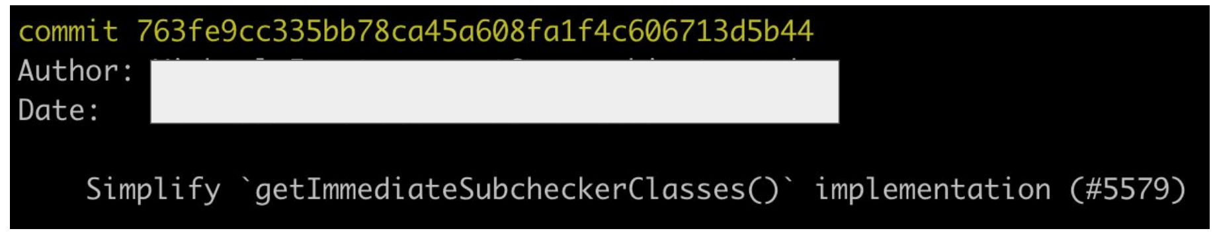
Commit messages: good or bad?

Slide 29
Commit messages: good or bad?
GOOD: short and to the point. Contains link to the PR it was merged in

Slide 30
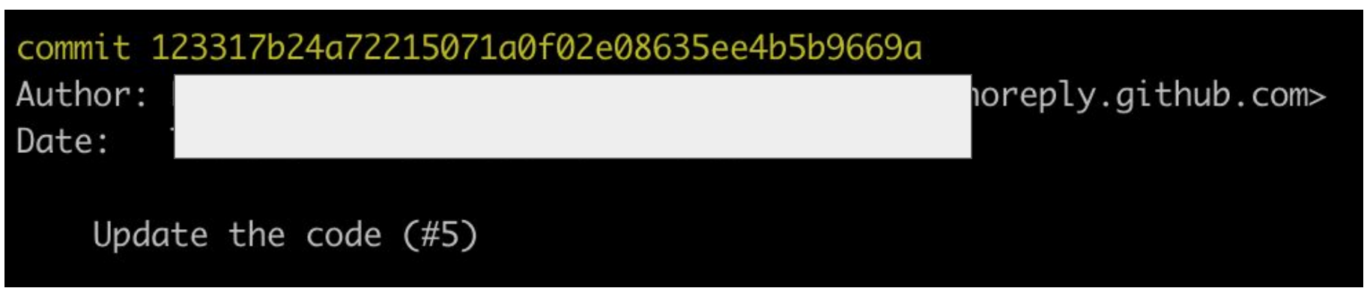
Commit messages: good or bad?

Slide 31
Commit messages: good or bad?
NOT SO GOOD:
description is vague

Slide 32
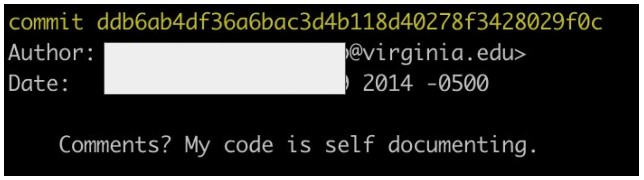
Commit messages: good or bad?

Slide 33
Commit messages: good or bad?
NOT SO GOOD:
while the humor is nice, this message is content-free

Slide 34
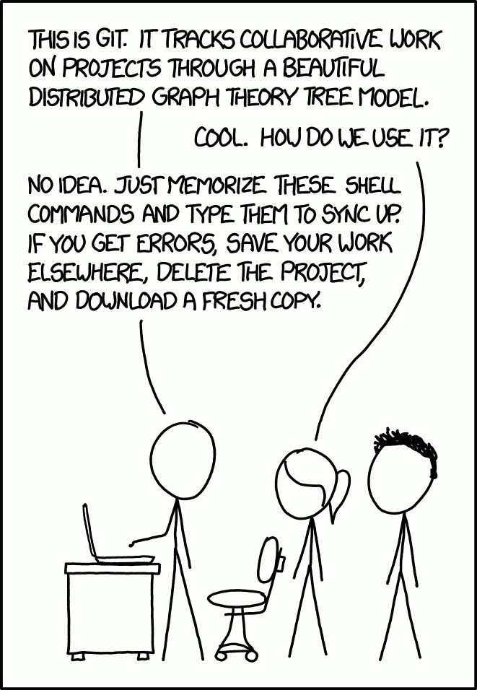

Slide 35
Two Quick Announcements before the Quiz
No weekly Quiz this week
Please think about the Project you want to do. I will post a guideline for a one page document today. Please submit before Tuesday class. If it needs to change, I will provide the feedback by end of next week.

Slide 36
Quiz for today
Create a PR in the repo:
https://github.com/imranraad07/cs4090-git-demo
Create a python script and make a PR.
The python script should print: “Hello from {Your Name}”.
You can also print anything else you want
Branch name should be: feature-request-{your mst id}
In the canvas share the PR you have created

