Slide 1
Lecture 8: User Stories
Mia Mohammad Imran

Slide 2
Today’s Objectives
Recap: Code Review & Git Practices
We will move back from “Practical” side to slight “Theoretical” side one more time
Shift focus from how we build to what we build
Today’s topic: User Stories & EPICs
Moved forward this topic so that you don’t need to be congested with assignments later

Slide 3
Let’s Consider You are Building a Software…
"Connect hungry customers with local restaurants through the fastest, most reliable food delivery platform in the city."
For this for product from Vision to become Reality what is need?

Slide 4
Let’s Consider You are Building a Software…
"Connect hungry customers with local restaurants through the fastest, most reliable food delivery platform in the city."
For this for product from Vision to become Reality what is need?
"Create an awesome food delivery app"
"Implement REST API endpoints for beverage ordering"
"Build menu, payment, loyalty, social sharing..."

Slide 5
The Communication Challenge
❌ Too Vague: "Create an awesome food delivery app"
No clear success criteria
Different interpretations by team members
No user perspective
❌ Too Technical: "Implement REST API endpoints for beverage ordering"
Focuses on implementation, not user value
Doesn't explain the "why"
Hard for non-technical stakeholders to understand
❌ Too Much: "Build menu, payment, loyalty, social sharing..."
Overwhelming scope
No prioritization guidance
Impossible to estimate or deliver incrementally

Slide 6
What's Missing?
Customer perspective
Clear value proposition
Manageable chunks
Shared understanding
This is where User Stories come in

Slide 7
User Stories
A user story is a short, simple description of a feature told from the perspective of the person who desires the new capability.
Question: What is a User Story?

Slide 8
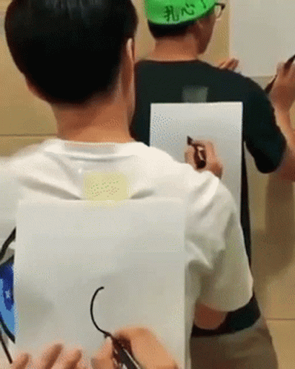
Why do We need User Stories?

Slide 9
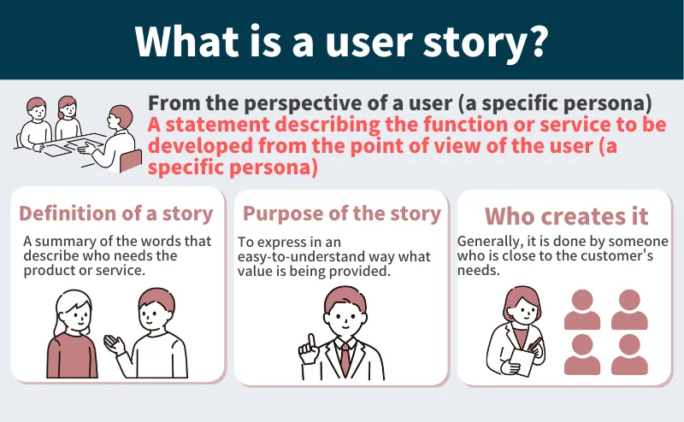
What is a User Story?
Requirements from user's perspective

Slide 10
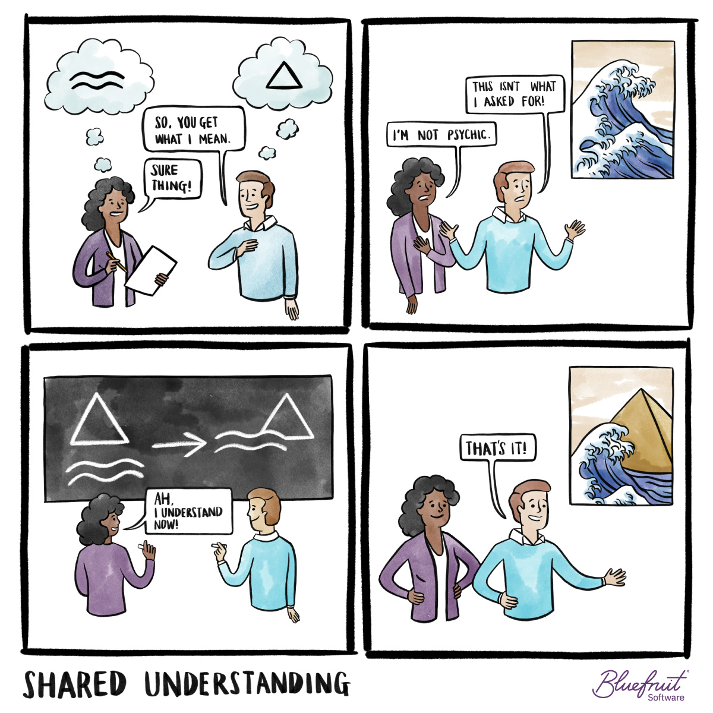
Main Benefit of User Stories

Slide 11
User Stories Answer 3 Questions
Who needs the product?
What users (or specific personas) want?
What purpose can the developed product achieve?
User Story Structure
"As a [type of user],
I want [goal/desire],
so that [benefit]"

Slide 12
User Story Example
✅ Good Story: "As a busy parent, I want to order groceries online, so that I can save time on shopping"
❌ Bad Example: "The system shall implement an e-commerce module for grocery ordering"

Slide 13
Another Example
❌ Technical Requirement: "Implement OAuth2.0 authentication with Google"
✅ User Story: "As a new user, I want to sign up using my Google account, so that I can start using the app quickly"

Slide 14
Case Study - FoodieExpress App
Our Product Vision
"Connect hungry customers with local restaurants through the fastest, most reliable food delivery platform in the city."
User Stories can be from:
Customer Stories
Restaurant Owner Stories
Delivery Driver Stories

Slide 15
Sample User Stories
Customer Stories:
"As a hungry customer, I want to browse restaurants by cuisine type, so that I can quickly find the food I'm craving."
"As a busy professional, I want to reorder my favorite meals with one click, so that I can get lunch quickly during my short break."
"As a health-conscious user, I want to see nutritional information for each dish, so that I can make informed dietary choices."
Restaurant Owner Stories:
"As a restaurant owner, I want to update my menu in real-time, so that customers only see items that are currently available."
"As a small restaurant owner, I want to set my own delivery radius, so that I can manage delivery times effectively."
Delivery Driver Stories:
"As a delivery driver, I want to see optimized routes, so that I can deliver more orders and earn more money."
"As a delivery driver, I want to update order status in real-time, so that customers know when to expect their food."

Slide 16
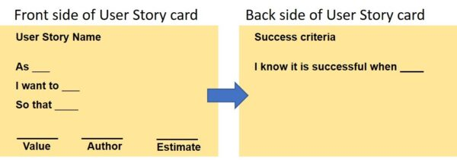
User Story Components
Title
Description (Who/What/Why)
Acceptance Criteria
Story Points
Dependencies
Notes/Attachments

Slide 17
Acceptance Criteria
Format: Given/When/Then
Given I'm on the login page
When I click "Sign in with Google"
Then I should be logged in
And directed to my dashboard
Make Them Specific:
❌ "User can search for restaurants"
✅ "User can search by cuisine type, restaurant name, or dish name and see results within 2 seconds"

Slide 18
Writing Good User Stories (INVEST Model)
Independent: Minimal dependencies
Negotiable: Room for discussion
Valuable: Clear benefit
Estimable: Team can size it
Small: Completable in sprint
Testable: Clear acceptance criteria

Slide 19
Complete Story Structure
TITLE: Quick Reorder Functionality
USER STORY:
As a busy professional,
I want to reorder my favorite meals with one click,
so that I can get lunch quickly during my short break.
ACCEPTANCE CRITERIA:
- Given I have previous orders
- When I view my order history
- Then I see a "Reorder" button for each past order
- When I click "Reorder"
- Then all items are added to my cart
- And I'm taken to the checkout page
- And the estimated delivery time is displayed
DEPENDENCIES: User account system, Order history feature
NOTES: Consider dietary restrictions changes since last order
STORY POINTS: 5 (WE WILL TALK ABOUT STORY POINTS IN A DIFFERENT LECTURE)

Slide 20
In-class Group Activity [5-6 Minutes]
Form group of 2-3
Write at least 5-10 user stories
Different perspectives needed
Feel Free to design any App you want!
Maybe the project you have proposed
Write them down in this format:
"As a [type of user],
I want [goal/desire],
so that [benefit]"
Use google doc. OR paper/pen
Example:
FoodieExpress App:
User Stories can be from
Customer perspective
Restaurant Owner view
Delivery Driver needs
Admin requirements

Slide 21
From Stories to Bigger Work
A single story is small and focused.
But real products require many related stories.
These related stories need grouping → that’s where EPICs come in.

Slide 22
What is an EPIC?
An EPIC is a large body of work that can be split into smaller user stories
Too big for a single sprint
Provides context and grouping for related stories

Slide 23
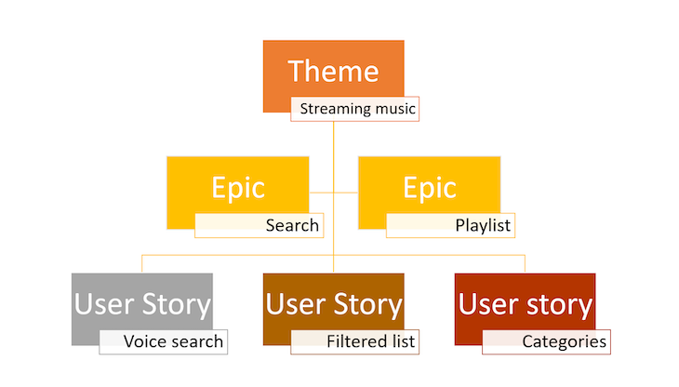
What is an EPIC?
An EPIC is a large body of work that can be split into smaller user stories
Too big for a single sprint
Provides context and grouping for related stories

Slide 24
Example
EPIC: “As a checking account holder, I want to deposit a check from my mobile device, so that I don’t have to waste time going to the bank.”
What are the assumptions here?
User already have a checking account account
User has username and password
User has a signed check
User has photographed the check
User confirms the deposit

Slide 25
Example: FoodieExpress App
EPIC: “As a customer, I want to manage my food orders end-to-end, so that I have complete control over my dining experience.”
Stories under this EPIC:
Browse restaurants and menus
Add items to cart
Apply discounts and promotions
Choose delivery time
Make payment
Track order status
Rate and review order
Handle order issues/refunds

Slide 26
How Stories and EPICs Relate
User Story = one small piece of functionality
EPIC = a collection of related stories that deliver a bigger feature
Relationship: Stories are written first, then grouped into EPICs when needed for structure and backlog management
🏢 EPIC: Customer Order Management
├── 📄 Story: Browse restaurants by cuisine
├── 📄 Story: Add items to cart
├── 📄 Story: Apply discount codes
├── 📄 Story: Schedule delivery time
├── 📄 Story: Process payment
├── 📄 Story: Track order status
└── 📄 Story: Rate completed order

Slide 27
User Story Mapping
What is Story Mapping?
A visual exercise that helps product teams understand the user journey and organize user stories into a useful model for prioritizing features and planning releases.
Visual organization of user stories
Shows user journey
Gives you the bigger picture of the product
Identifies MVP (minimum viable product)
Helps release planning

Slide 28
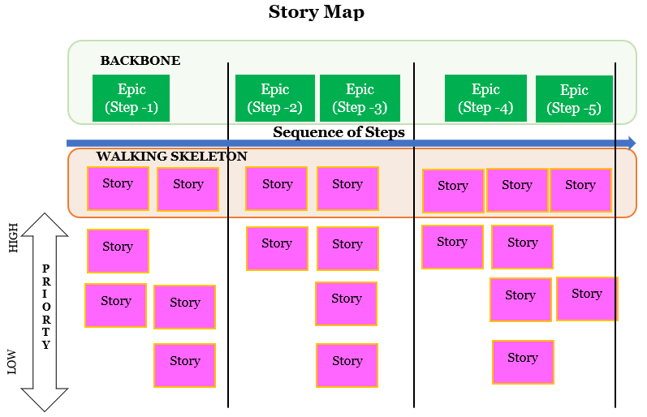
Story Map is 2D Visual Structure
Horizontal Axis (User Journey): The main activities users do to accomplish their goal
Vertical Axis (Priority/Detail):
Top: High-level user activities (backbone)
Middle: User tasks (walking skeleton)
Bottom: Sub-tasks and details (nice-to-haves)

Slide 29
How They Connect
Epics contain multiple user stories - You break down large epics into smaller, actionable user stories
User story mapping organizes these stories - The map shows how individual stories fit into the broader user journey
User story mapping helps prioritize epic breakdown - By visualizing the user flow, you can better decide which parts of an epic to tackle first

Slide 30
Example
Top-level flow: Browse → Order → Pay → Track
Stories under each:
Browse: “As a customer, I want to search for restaurants by cuisine.”
Order: “As a customer, I want to add meals to a cart.”
Pay: “As a customer, I want to pay with credit card.”
…

Slide 31
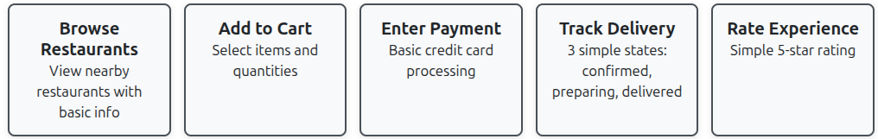
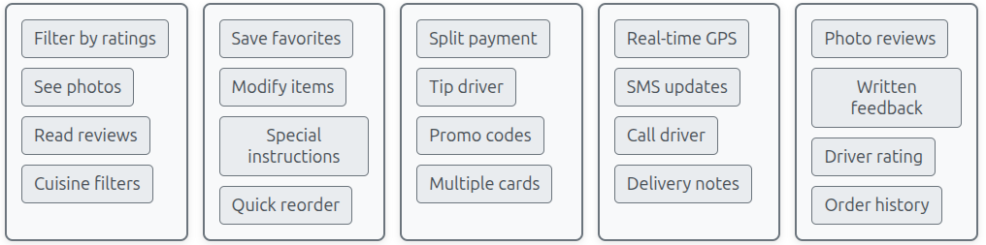

Slide 32
When to Create a Story Map?
Project inception
New product feature
Major redesign
Roadmap planning
Release strategy development
❌ Not Needed For:
Small bug fixes
Minor enhancements
Technical debt work
Single user stories

Slide 33
How to Create a Story Map
Frame the Problem
Who are your users?
What's their goal?
Map the Journey
List major user activities
Arrange in sequence
Add detailed stories below
A good way to do is using sticky notes and arranging them

Slide 34
Group Activity 2: Create Story Map [5-6 Minutes]
Take your user stories from Activity 1
Identify the main user journey (3-5 major activities)
Organize your stories under these activities
Prioritize: Which stories are essential vs. nice-to-have?
Use this template:
Activity 1 → Activity 2 → Activity 3 → Activity 4
Essential:
□ Story A □ Story C □ Story E □ Story G
Nice-to-have:
□ Story B □ Story D □ Story F □ Story H

Slide 35
Minimum Viable Product
Minimum Viable Product: The smallest version of your product that delivers core value to early customers and enables maximum learning.
MVP Selection Using Story Maps
Step 1: Identify your core user journey
Step 2: Select only the essential stories for each activity
Step 3: Remove any story that doesn't directly support the main value proposition
MVP Example: Car Evolution
🛴 Skateboard (MVP)
Gets you from A to B
Tests basic mobility
🛵 Scooter
Adds motor
More convenience
🚗 Car
Full feature set
Complete solution

Slide 36
Defining Your MVP
Example: FoodieExpress App
Core Value: "Get food delivered from local restaurants"
MVP:
Browse nearby restaurants
View basic menu with prices
Add items to cart
Enter delivery address
Pay with credit card
Track order status (3 states: confirmed, preparing, delivered)
Later: Advanced filters, favorites, reviews, loyalty program, multiple payment methods, real-time GPS tracking
🛴 MVP v1: Basic Ordering
- Browse restaurants
- Order food
- Basic payment
- Simple status updates
🛵 MVP v2: Enhanced Experience
- Restaurant ratings
- Order history
- Multiple payment options
- Estimated delivery times
🚗 Full Product: Complete Platform
- Advanced search & filters
- Loyalty program
- Social features
- Restaurant analytics
- Driver optimization

Slide 37
Let’s Go Through
Check the page uploaded in the lecture modules on Canvas
Note the apps designed by Claude
It’s missing the exact format on how to write user stories
Use it just to get the idea and not as a template as it is not completely correct

Slide 38
Common Pitfalls & Best Practices
❌ Common Mistakes
1. Writing Technical Stories
Bad: "Implement user authentication microservice"
Good: "As a new user, I want to create an account quickly, so that I can start using the app"
2. Stories Too Large
Bad: "As a user, I want a complete dashboard with analytics, reports, and user management"
Good: Break into separate stories for each major function
3. Missing the "So That" (No Clear Value)
Bad: "As a user, I want to see a list of products"
Good: "As a customer, I want to see a list of products, so that I can compare options and make a purchase decision"
4. Vague Acceptance Criteria
Bad: "System should be fast and user-friendly"
Good: "Search results appear within 2 seconds, display is mobile-responsive"

Slide 39
Best Practices
1. Start with User Research
Interview real users
Create personas
Understand actual problems
2. Collaborate on Story Writing
Include developers, designers, product owners
Stories are conversation starters, not complete specifications
Refine through discussion
3. Keep Stories Visible
Use physical or digital boards
Update story status regularly
Celebrate completed stories
4. Regular Story Grooming
Review and refine stories before sprint planning
Break down large stories
Add details as understanding grows

Slide 40
Tools & Templates: Digital Tools for Story Management
JIRA: Enterprise story tracking -> I will strongly encourage you to use JIRA for capstone projects and assignments
Trello: Simple kanban boards
GitHub projects

Slide 41
Story Template
## Story Title: [Brief, descriptive name]
**User Story:**
As a [specific user type],
I want [specific capability],
so that [specific benefit].
**Acceptance Criteria:**
- [ ] Given [context], when [action], then [outcome]
- [ ] Given [context], when [action], then [outcome]
- [ ] Given [context], when [action], then [outcome]
**Story Points:** [Team's estimate]
**Priority:** [High/Medium/Low]
**Dependencies:** [Related stories or external dependencies]
**Notes:** [Additional context, assumptions, or constraints]

